Slide 1
IRB 57X0 Product and Options
November 2025, version C, Document id:
Global Product Management - Large robots

Slide 2
Content
01.
02.
03.
04.
IRB 57X0 Intro
IRB 5710 Variants
IRB 5720 Variants
IRB 57X0 Options

Slide 3
IRB 57X0 Product and Options
Instructions
Content: All IRB 5700 manipulator variants and options
Target groups: Main: Salespersons and technical product support, Other: Customers
Customer sharing: The content is approved to be shown and shared to a customer.
Instructions: Use the chapters to make your selection of slides to present to your customers. Customize the presentation in RApp 2.0/Showpad, present it and share the link to collect data statistics if needed. Always look for the latest version of the presentation in
Rapp 2.0/Showpad.
If you have comments, contact Niko Quiskamp.
Customize your sales presentation in RApp 2.0/Showpad today!

Slide 4
1. IRB 57X0 Intro

Slide 5
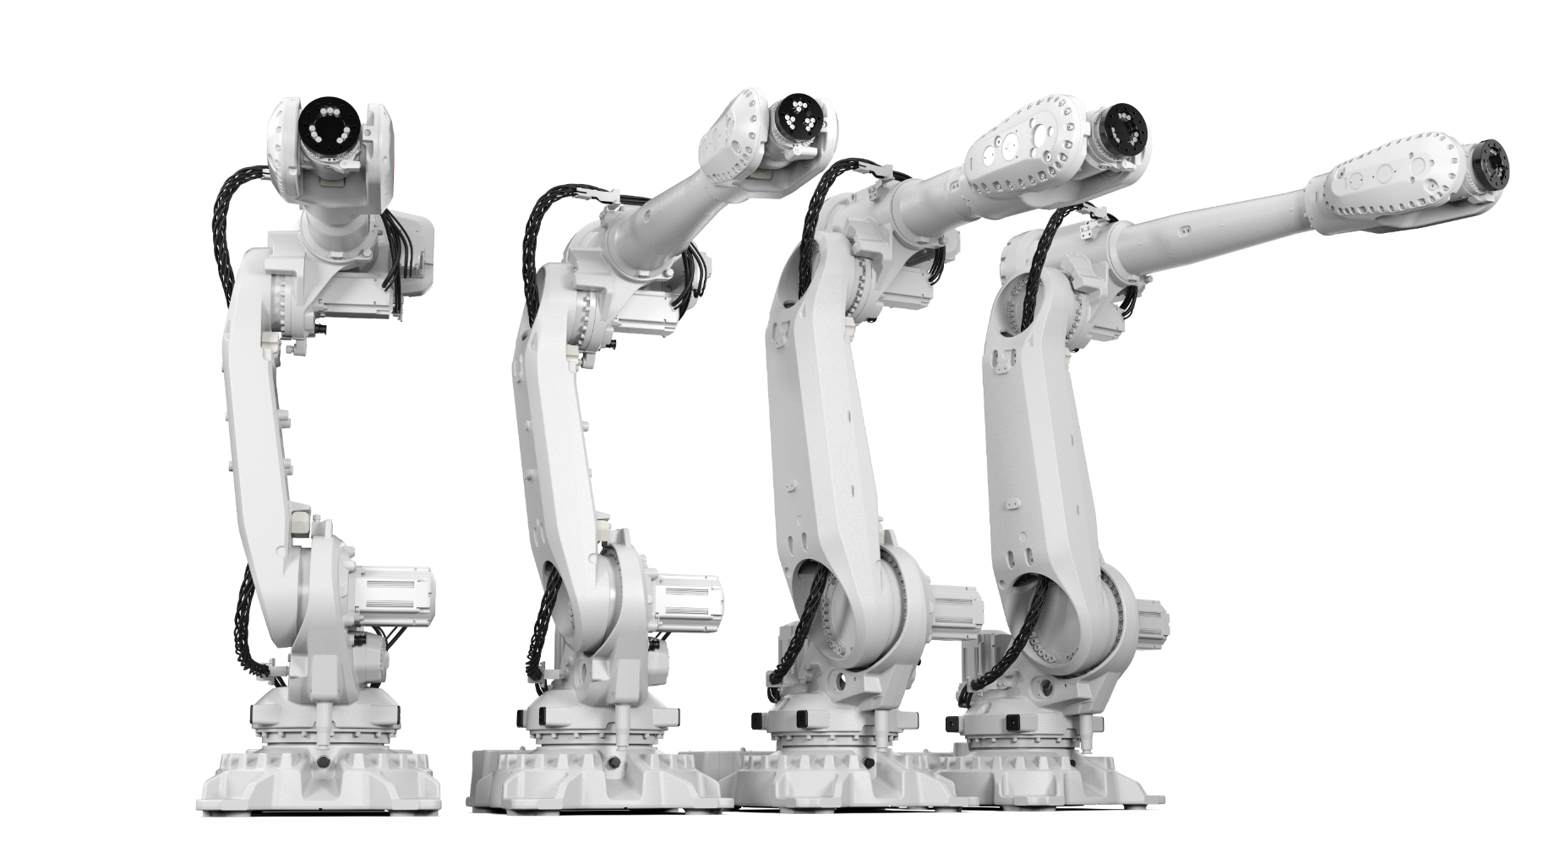
The IRB 57X0 Range
ABB is expanding its large-size robot portfolio with the IRB 57X0 range, offering faster, more robust, and accurate performance.
Based on a new modular platform, the IRB 57X0’s are offered with the OmniCore controller V250XT and features RobotWare 7.
IRB 57X0’s are ideal for use in material handling, machine tending, and high precision assembly applications in electric vehicle battery production, automotive, and the general industries, but is supporting all industries and business lines.
The robot family is also supporting various process applications. Spotwelding is one key where the robot enables fast and accurate spotwelding with light weight guns. The robots also support high precision applications like Dispense and Laser process

Slide 6
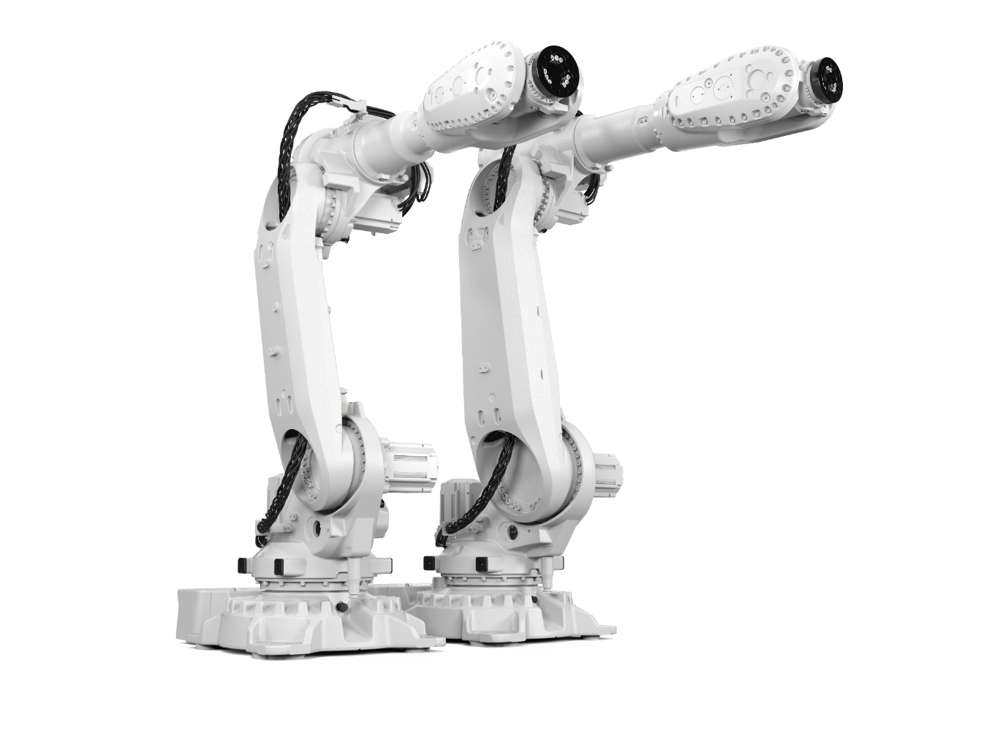
Shared Features
Protection
  IP 67 protection as standard
Footprint
  Standardized footprint
  Built in features – guide pins for easy replacement
Controller
  Available with OmniCore V250XT
Arm Load
  Additional arm load – Std load 20 kg but built in flexibility to balance between wrist/arm load.
Mounting alternatives
  Floor (std)
  Inverted (Option)
  Angled: (IRB 5710: ≤ 20°, IRB 5720: ≤ 15°) (std)
  Semi-shelf (std)

Slide 7
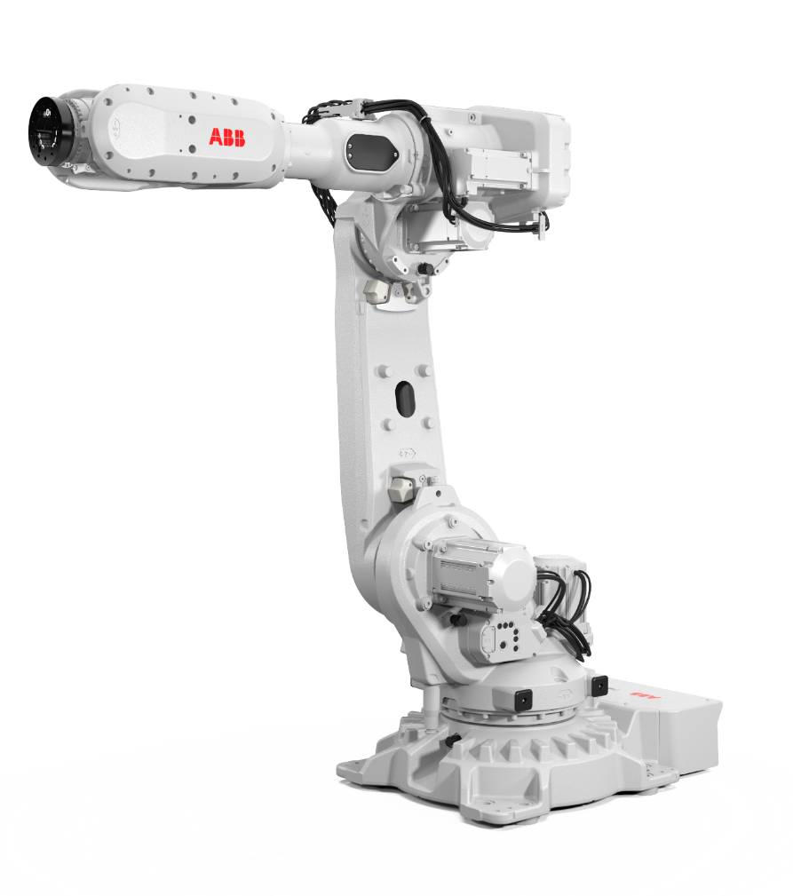
Main Benefits
The IRB 57X0 robots are our fastest, most compact and most flexible large robot designed especially for multi-purpose customer applications.
Performance
  Cycle time performance significantly better than IRB 6700
  More compact wrist with same re-orientation capabilities
  Reduced swing radius
  Inverted mounting as option
Modular design
  Shared technical solutions and parts between 90-500 kg payload large robots
  Based on learnings from large installed volume of IRB 6700
  Shared service procedures, spare parts and maintenance intervals
  Shared footprint with same base hole pattern for 90-300kg robots
Options
  Lean ID integrated Dress Pack for best lifetime and off-line programming performance
  Foundry Plus with same high protection as in the IRB 6700 robots

Slide 8
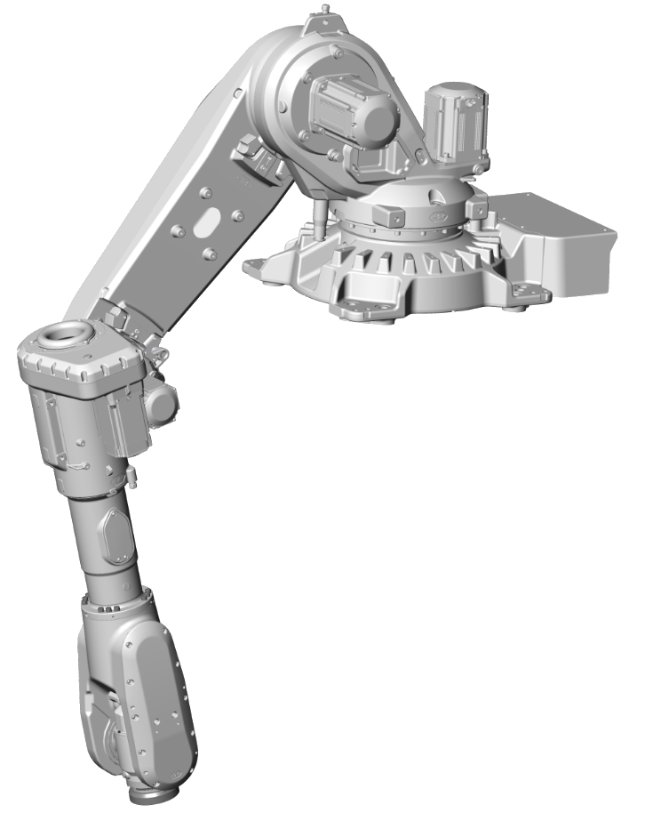
Shared Features
Semi shelf
The IRB 57X0 is designed to have a better working range for the axis 2 movement, than normal large robots.
This is possible since there is no balancing device.
The axis 2 center is pushed forward, which enables a semi shelf working range (reach below robot foot).
Axis 2 working range: -75° / +145°

Slide 9
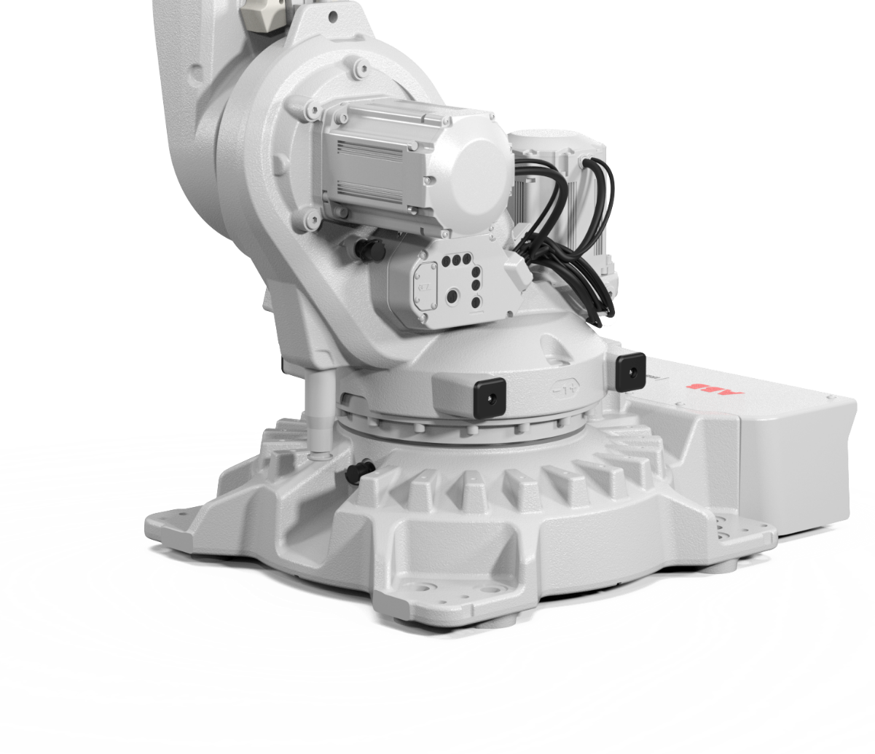
Shared Features
Footprint
  Standardized interface towards the floor, same for the IRB 57X0 as for the IRB 67X0 and 6700.
  Pitch diameter of screw circle 800 mm
  8 holes for M24 screws
  Guiding pins fittings for easier installation
  Footprint 1023 x 724

Slide 10
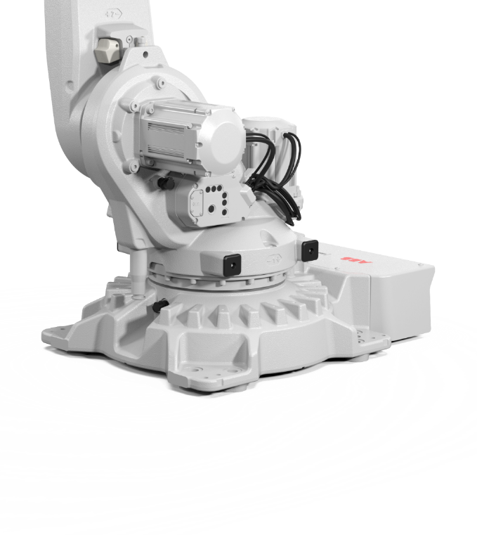
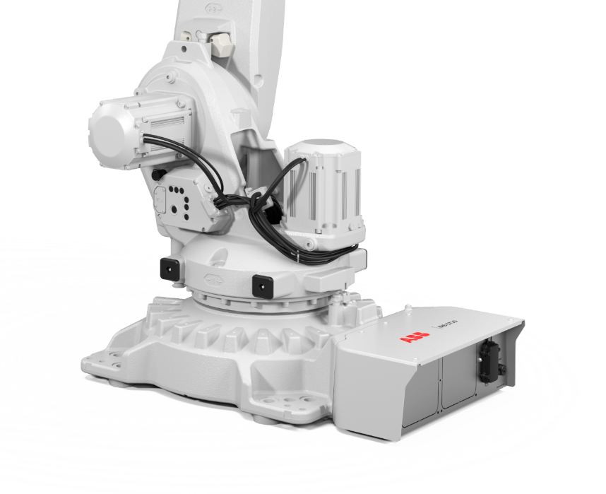
Shared Features
Swing radius front
Swing radius
  IRB 5710: Front 482 mm / Back 284 mm
  IRB 5720: Front 536 mm / Back 285 mm
Swing radius back

Slide 11
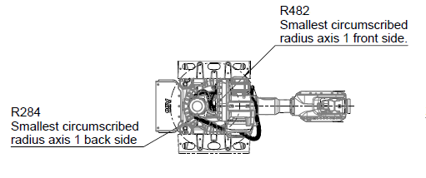
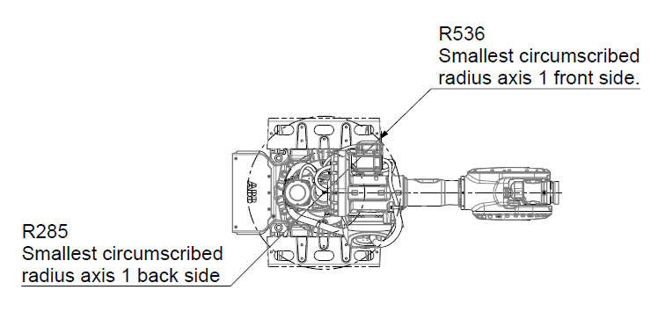
Shared Features
Swing radius
  IRB 5710: Front 482 mm / Back 284 mm
  IRB 5720: Front 536 mm / Back 285 mm

Slide 12
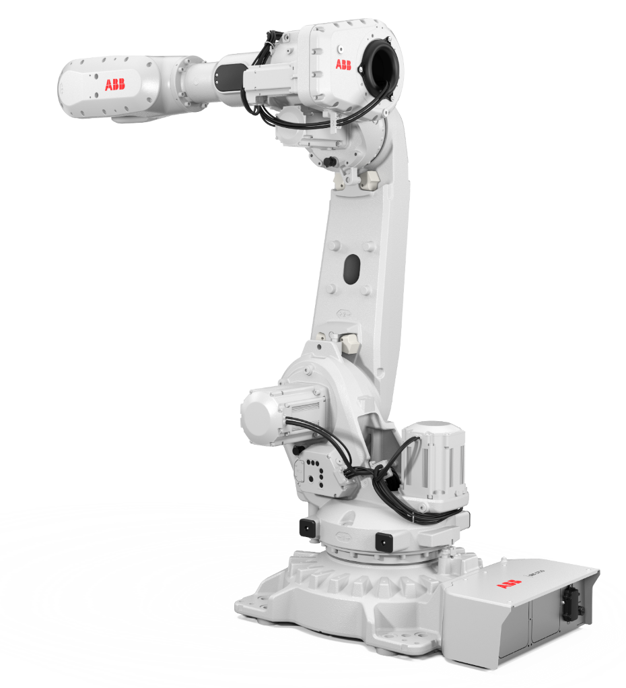
Main Tech Solutions
Feature | Value
Motors
16-pole motor program | + Compactness, Performance
Brake release board for variable brake voltage | + Compactness, Energy Savings
Electronic box module and interface for brake release | + Modularity, Safety, Usability
Gearboxes
Z-series compact gearboxes ax 1-3 & 6 | + Compactness, Performance
Serviceability
Unique base variant for inverted mounting | + Serviceability
Standardized lifting and turning tools 90-300 kg | + Modularity, Serviceability
Mechanical Concept
No balancing device on axis 2 | + Work range
Inverted mounting available as option for all variants | + Flexibility
Quality
Carry-over of IRB 6700 improvements (double seal in motors etc.) | + Quality
Increased static brake torque margin | + Quality
Poka Yoke motor connectors | + Quality
Encapsulated motor ax 6 | + Protection, Serviceability
Drivers
+ Performance
+ Compactness
+ Flexibility
+ Quality / Up-time
+ Energy efficiency

Slide 13
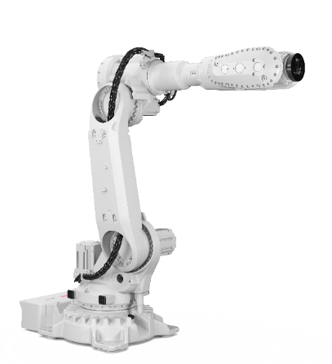
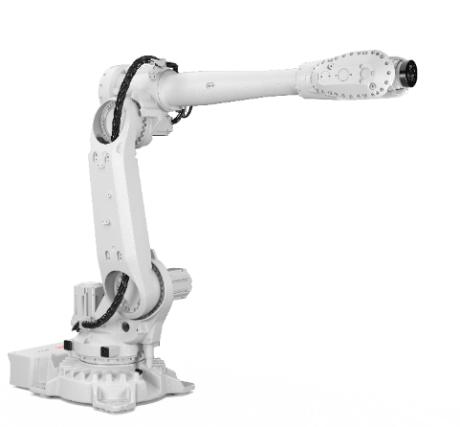
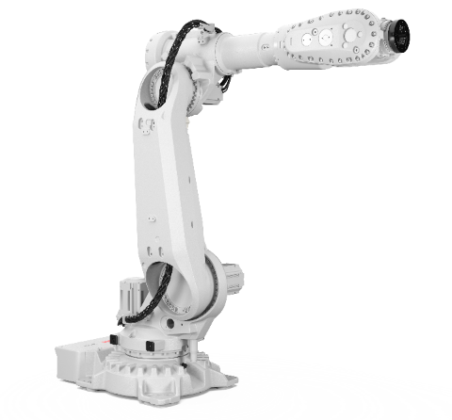
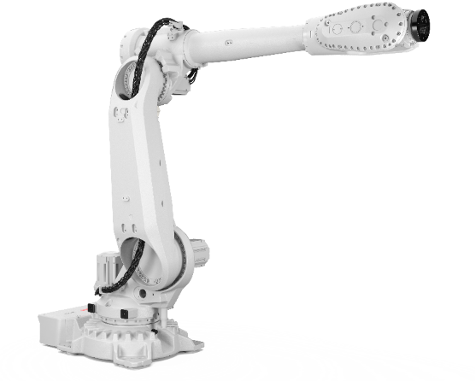
Core IRB 57X0 Variants
Model | IRB 5710 | IRB 5710 | IRB 5720 | IRB 5720
Main applications | Spot Welding Material Handling, Dispense, Laser Welding, Assembly (high precision applications) | Material Handling, Dispense, Laser Welding, Assembly (high precision applications) | Spot Welding Material Handling, Dispense, Laser Welding, Assembly (high precision applications) | Spot Welding Material Handling, Dispense, Laser Welding, Assembly (high precision applications)
Configurations | 110 kg / 2.3 m | 90 kg / 2.7 m | 180 kg / 2.6 m | 125 kg / 3.0 m
Options | Lean ID Inverted Foundry Plus | Lean ID Inverted Foundry Plus | Lean ID Inverted Foundry Plus | Lean ID Inverted Foundry Plus

Slide 14
2. IRB 5710 Variants

Slide 15
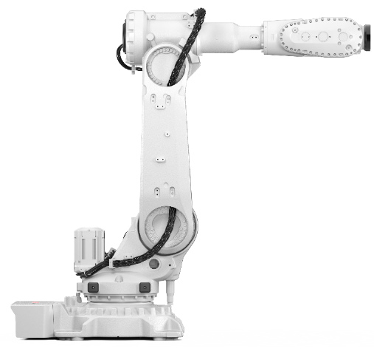
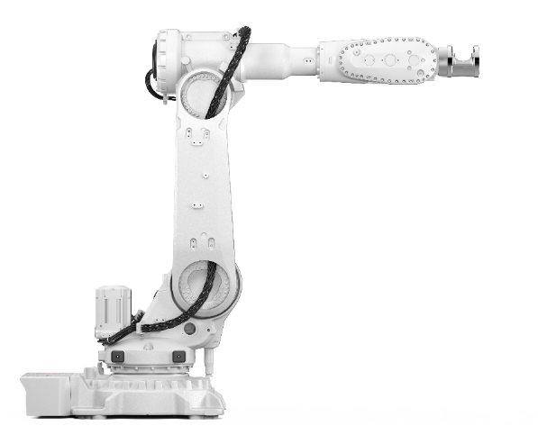
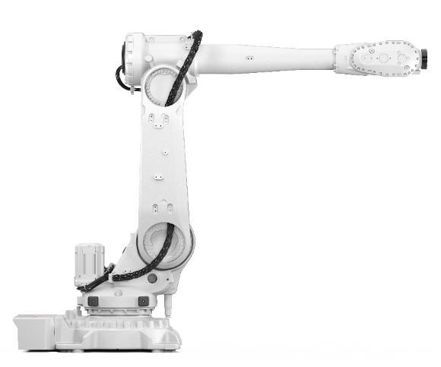
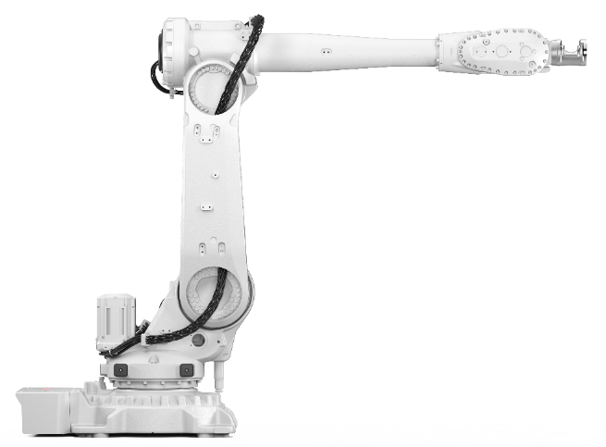
IRB 5710
IRB 5710 2,3 m
IRB 5710 2,3 m LeanID
IRB 5710 2,7 m
IRB 5710 2,7 m LeanID

Slide 16
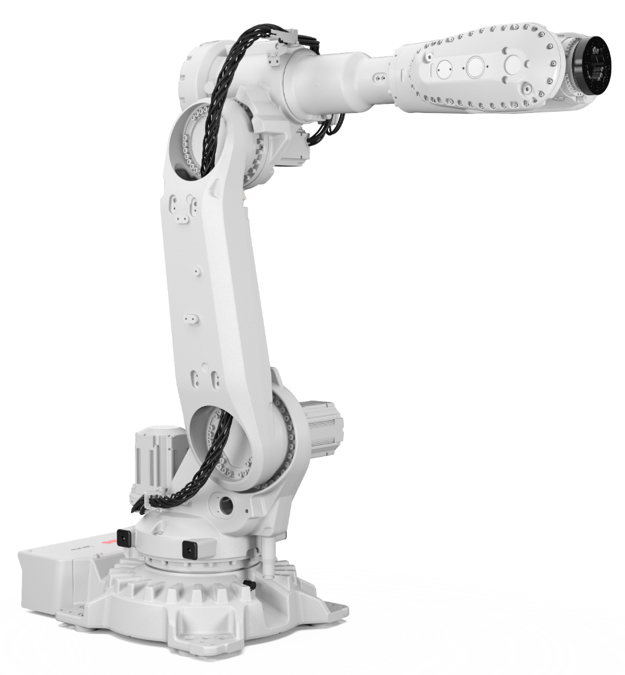
IRB 5710
Options number: 3300-322 – 110kg / 2.3m
Load Diagram
Armload: Upper Arm 20kg

Slide 17
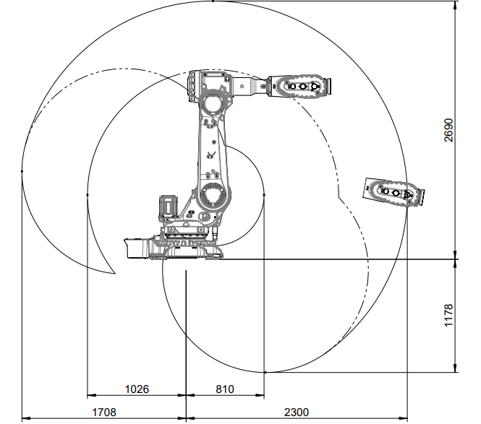
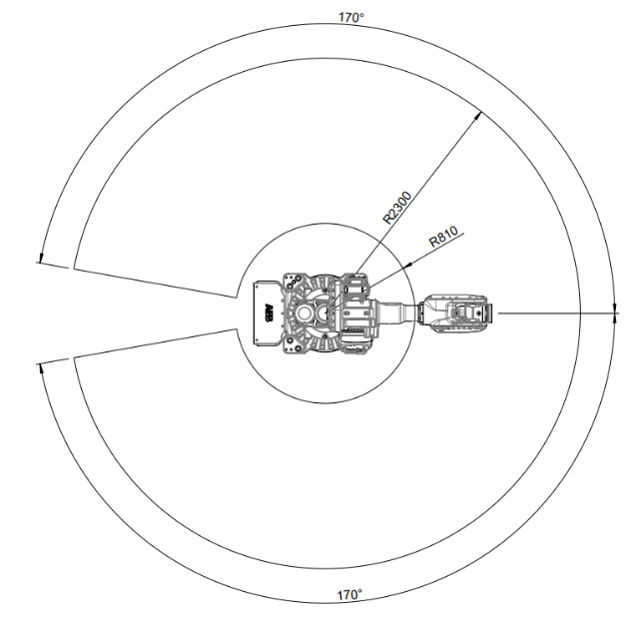
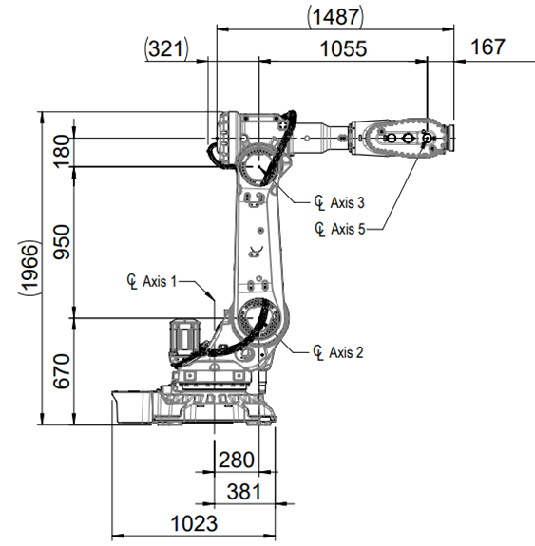
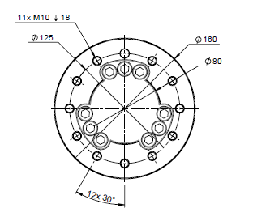
IRB 5710
Options number:
3300-322 – 110kg / 2.3m
Working Range
  Axis 1 ±170°
  Axis 2 +145°/-75°
  Axis 3 +70°/-180°
  Axis 4 ±300°
  Axis 5 ±130°
  Axis 6 ±360°
Weight
  817kg

Slide 18
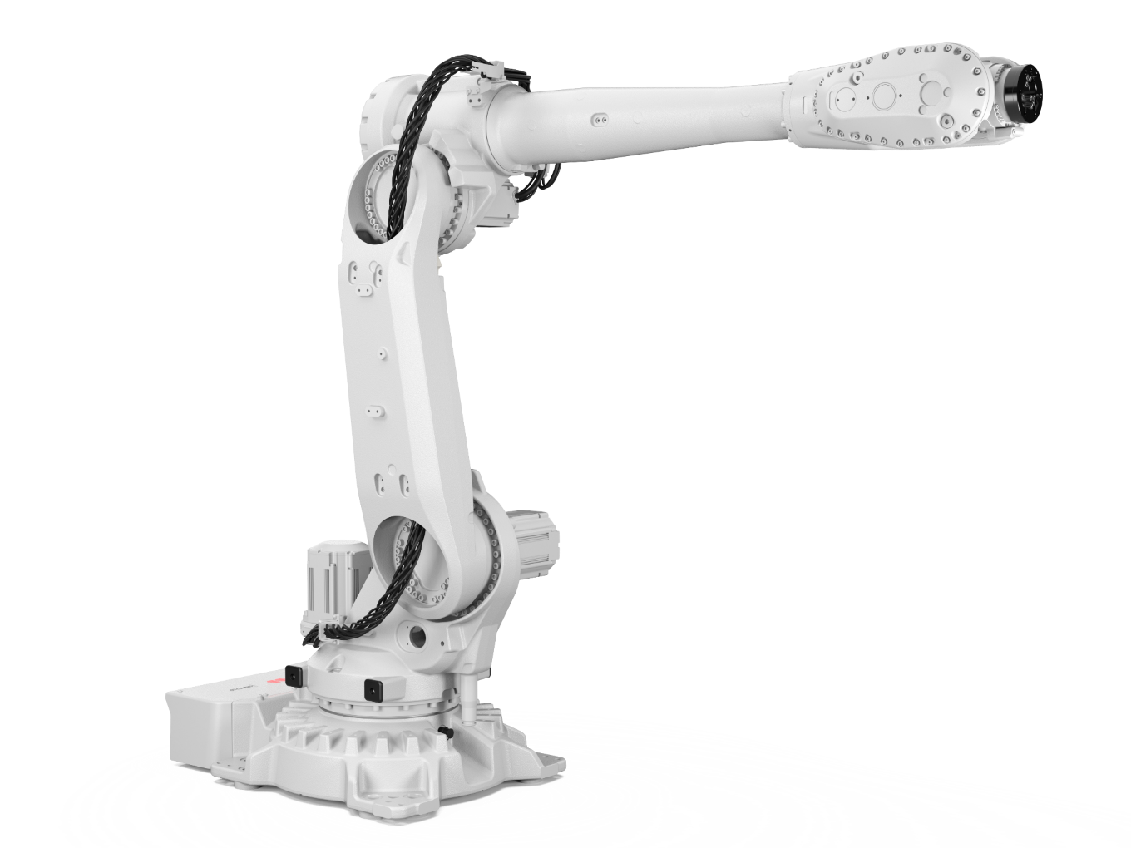
IRB 5710
Options number: 3300-323 – 90kg / 2.7m
Load Diagram
Armload: Upper Arm 20kg

Slide 19
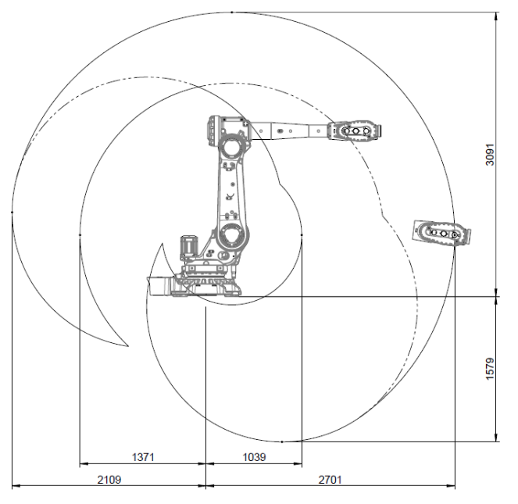
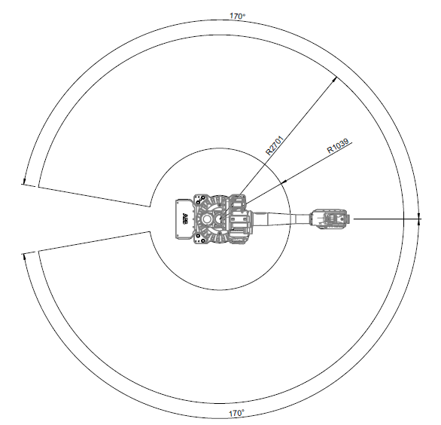
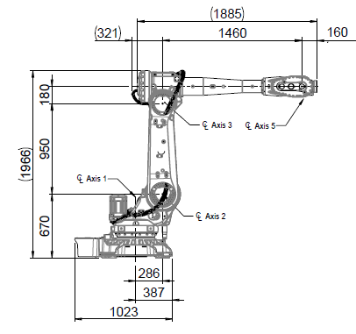
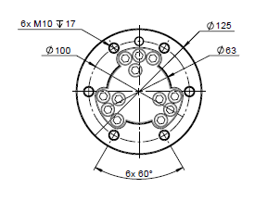
IRB 5710
Options number:
3300-323 – 90kg / 2.7m
Working Range
  Axis 1 ±170°
  Axis 2 +145°/-75°
  Axis 3 +70°/-180°
  Axis 4 ±300°
  Axis 5 ±130°
  Axis 6 ±360°
Weight
  813kg

Slide 20
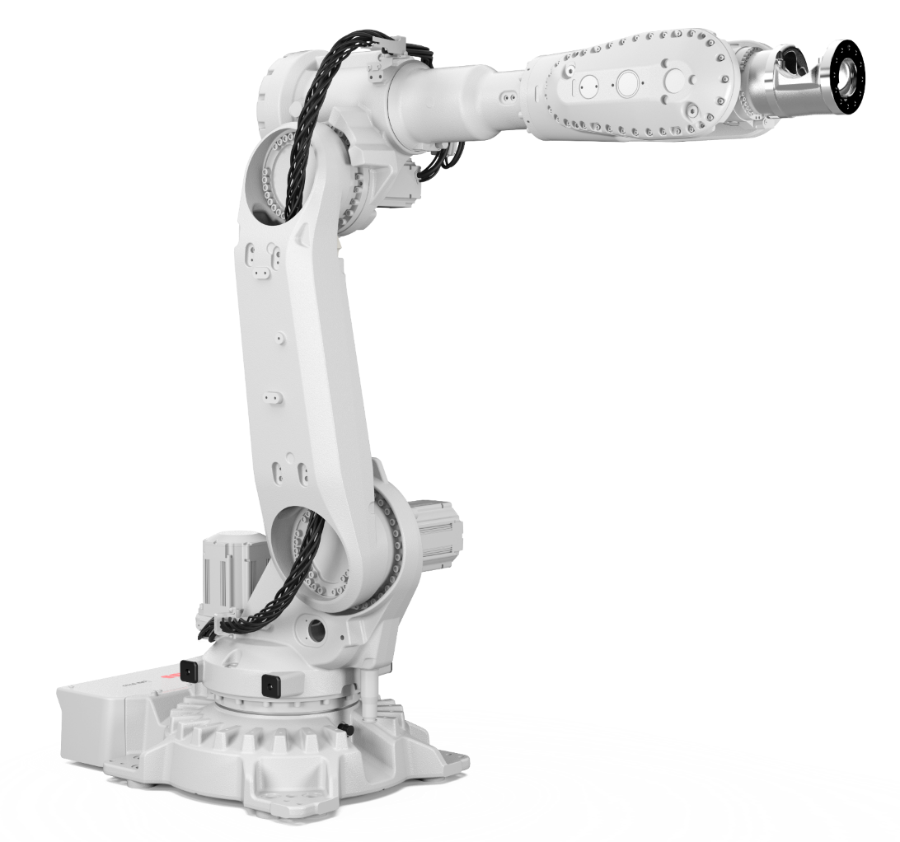
IRB 5710
Options number: 3300-324 – 90kg / 2.3m LeanID
Load Diagram
Armload: LeanID SW

Slide 21
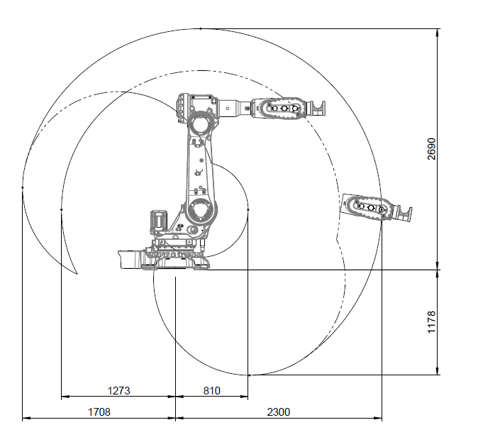
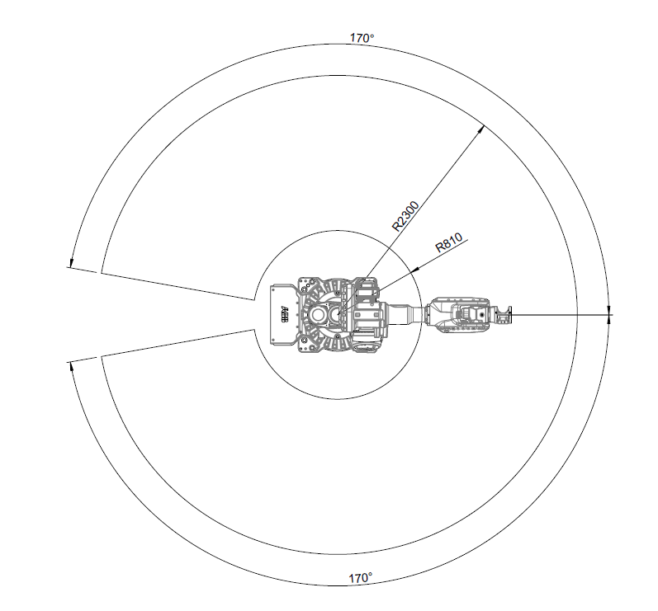
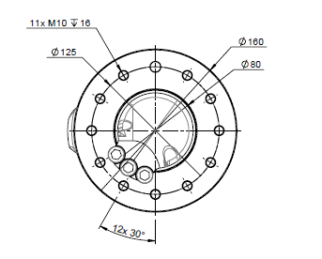
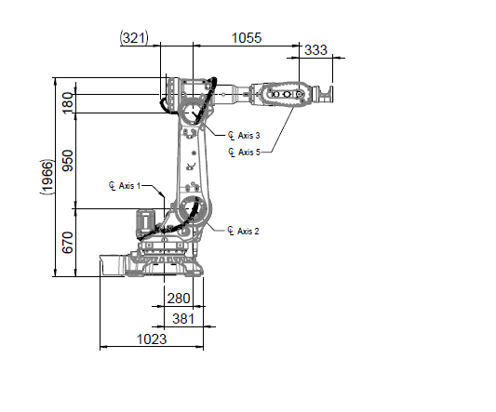
IRB 5710
Options number: 3300-324 – 90kg / 2.3m LeanID
Working Range
  Axis 1 ±170°
  Axis 2 +145°/-75°
  Axis 3 +70°/-160°
  Axis 4 ±300°
  Axis 5 ±120°
  Axis 6 ±220°
Weight
  824kg
Limitations & Dependencies
  Requires LeanID Dress Pack

Slide 22
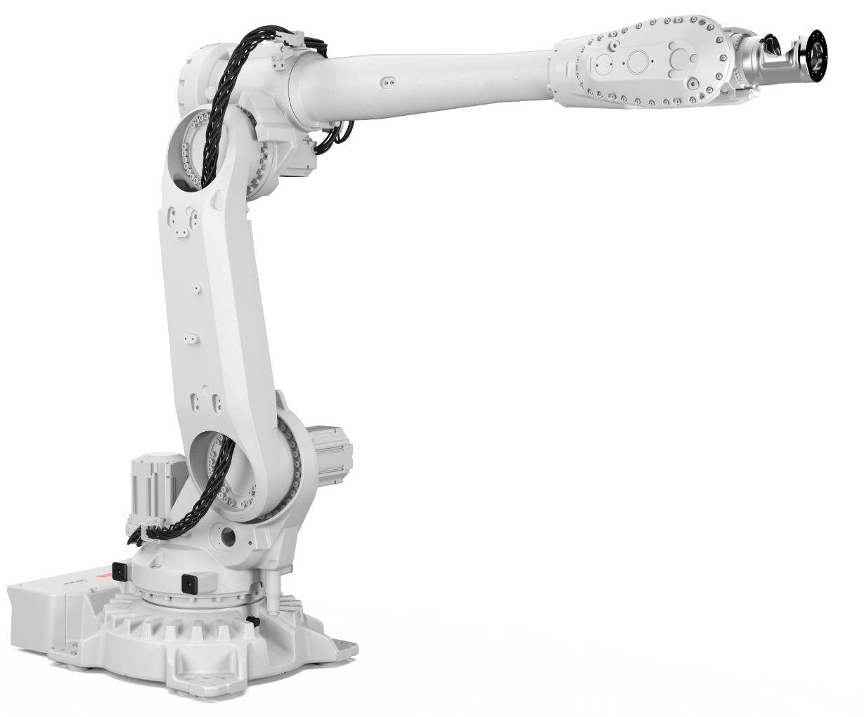
IRB 5710
Options number: 3300-325 – 70kg / 2.7m LeanID
Load Diagram
Armload: LeanID MH

Slide 23
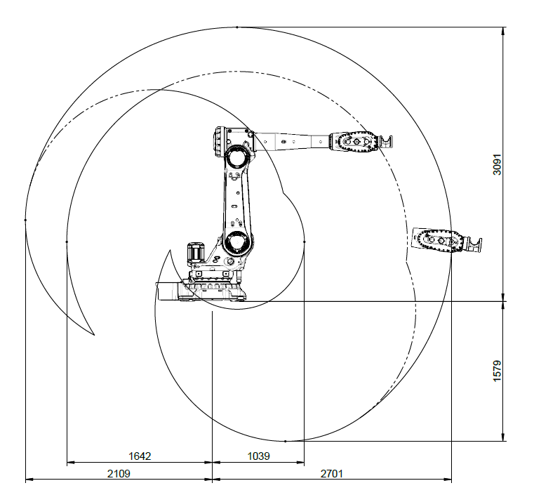
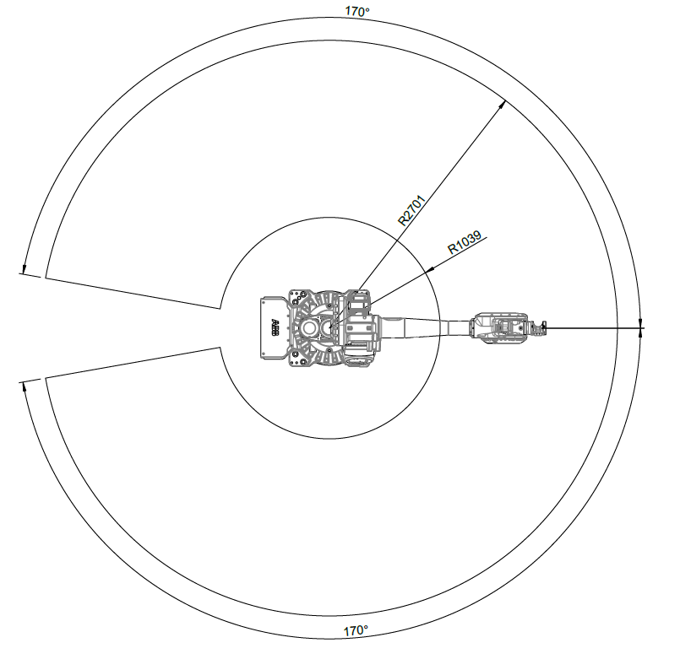
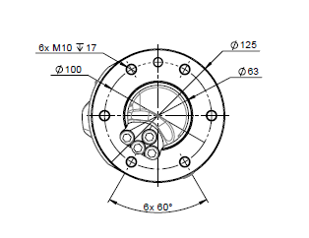
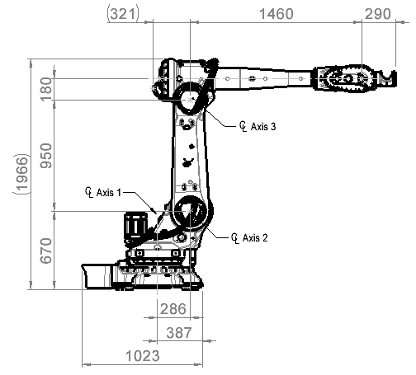
IRB 5710
Options number:
3300-325 – 70kg / 2.7m LeanID
Working Range
  Axis 1 ±170°
  Axis 2 +145°/-75°
  Axis 3 +70°/-160°
  Axis 4 ±300°
  Axis 5 ±120°
  Axis 6 ±220°
Weight
  818kg
Limitations & Dependencies
  Requires LeanID Dress Pack

Slide 24
3. IRB 5720 Variants

Slide 25
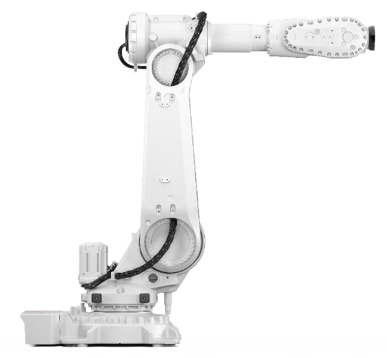
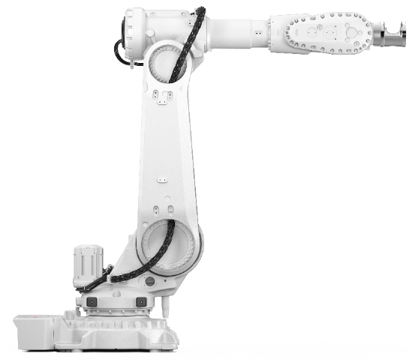
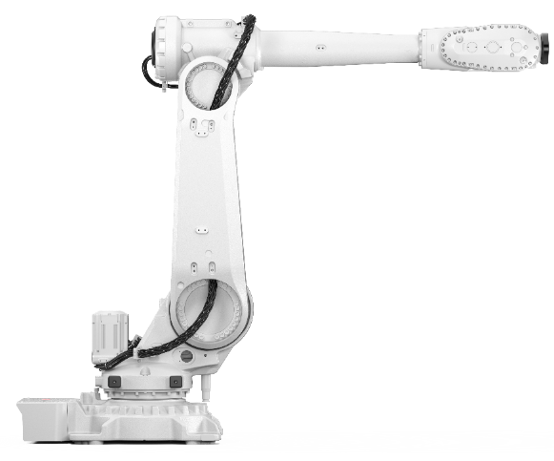
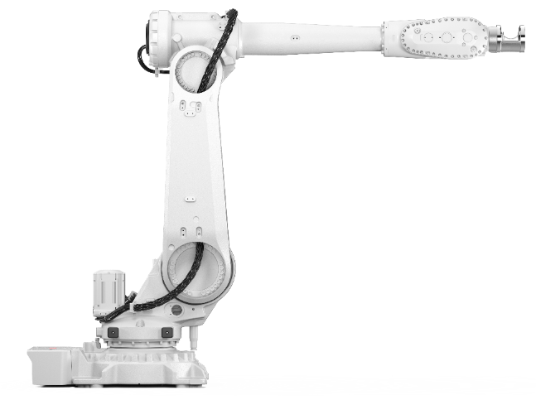
IRB 5720
IRB 5720 2,6 m
IRB 5720 2,6 m LeanID
IRB 5710 3,0 m
IRB 5710 3,0 m LeanID

Slide 26
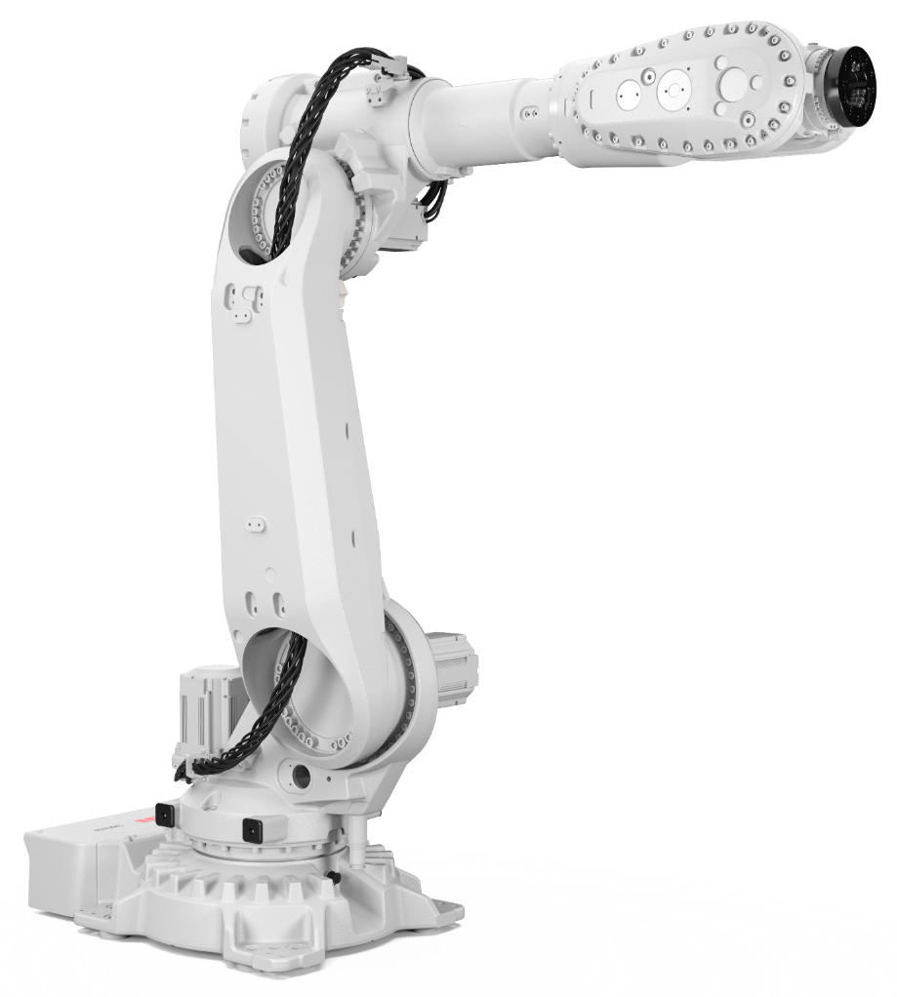
IRB 5720
Options number: 3300-326 – 180kg / 2.6m
Load Diagram
Armload: Upper Arm 20kg

Slide 27
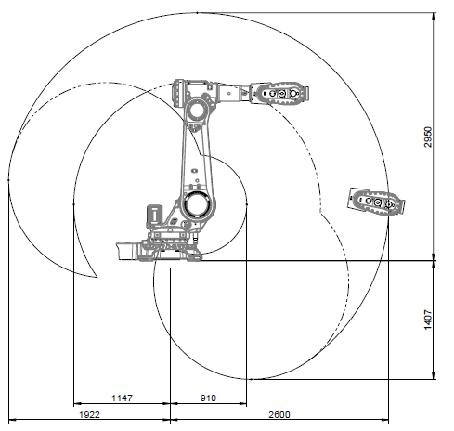
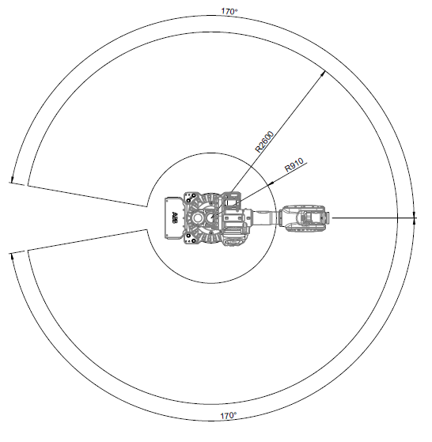
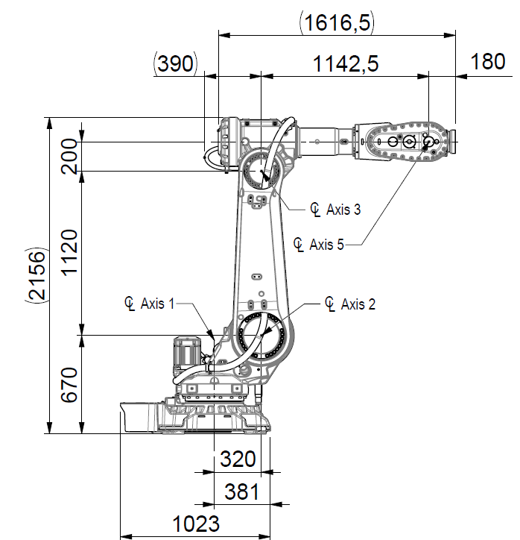
IRB 5720
Options number:
3300-326 – 180kg / 2.6m
Working Range
  Axis 1 ±170°
  Axis 2 +145°/-75°
  Axis 3 +70°/-180°
  Axis 4 ±300°
  Axis 5 ±130°
  Axis 6 ±360°
Weight
  974kg

Slide 28
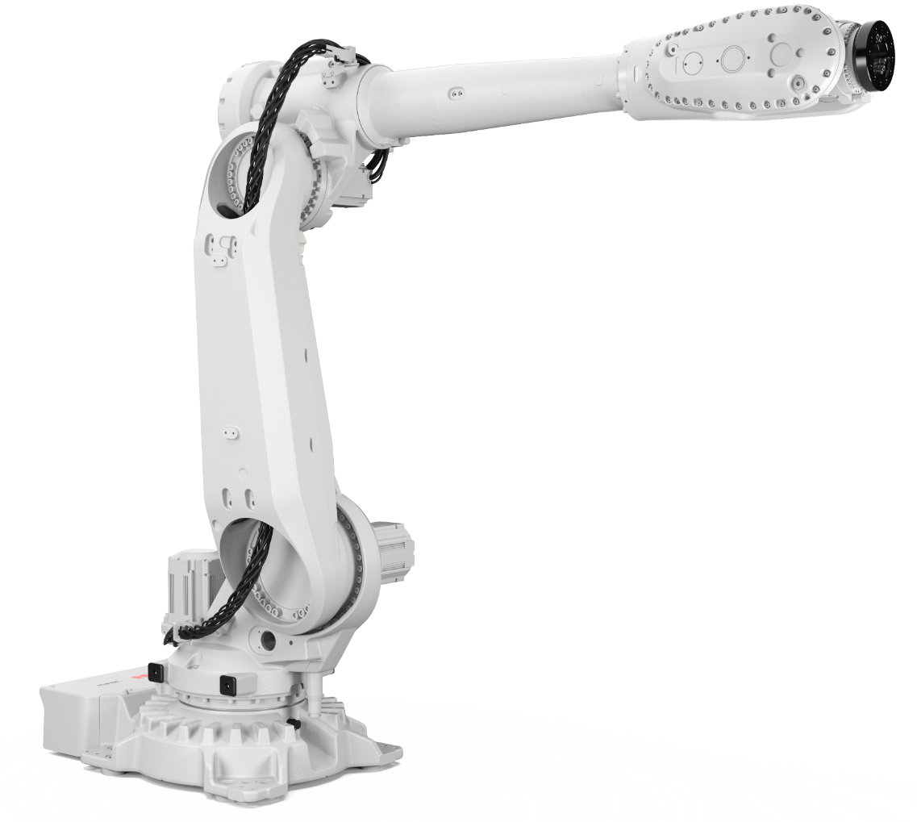
IRB 5720
Options number: 3300-327 – 125kg / 3.0m
Load Diagram
Armload: Upper Arm 20kg

Slide 29
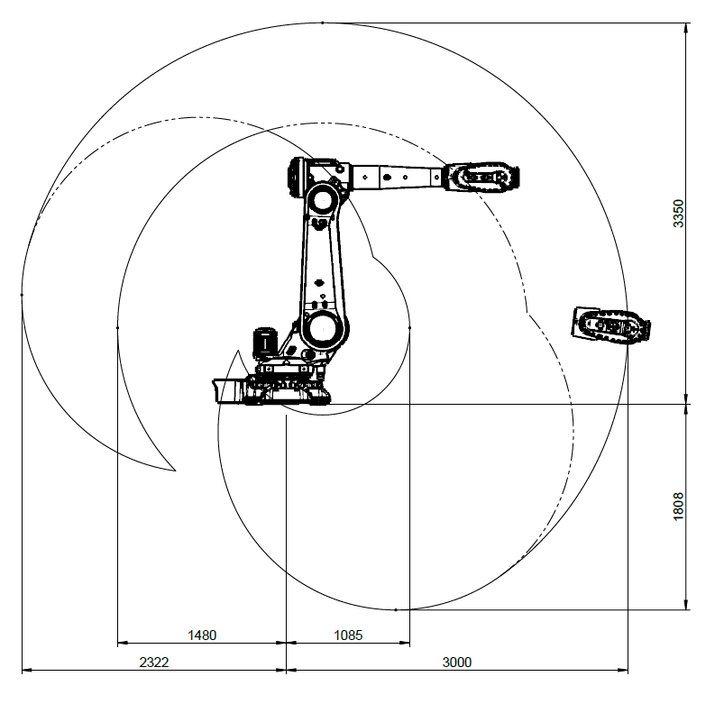
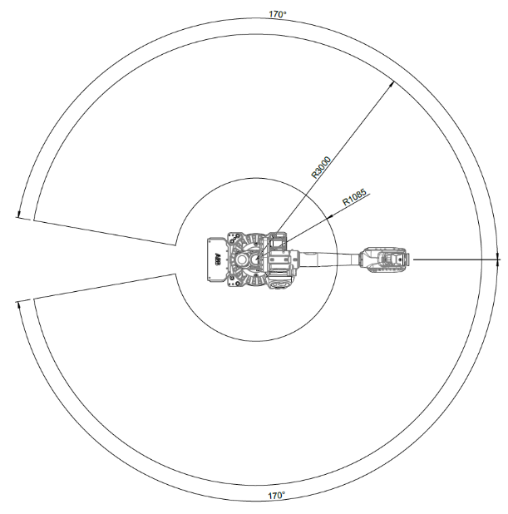
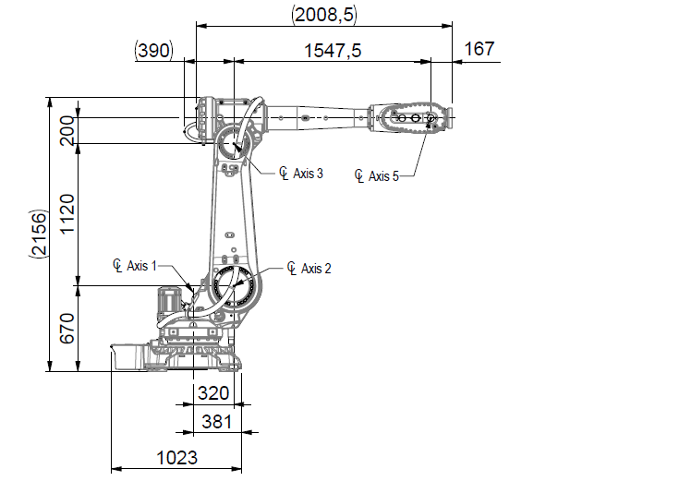
IRB 5720
Options number:
3300-327 – 125kg / 3.0m
Working Range
  Axis 1 ±170°
  Axis 2 +145°/-75°
  Axis 3 +70°/-180°
  Axis 4 ±300°
  Axis 5 ±130°
  Axis 6 ±360°
Weight
  970kg

Slide 30

IRB 5720
Options number: 3300-328 – 155kg / 2.6m LeanID
Load Diagram
Armload: LeanID SW

Slide 31



IRB 5720
Options number:
3300-328 – 155kg / 2.6m LeanID
Working Range
  Axis 1 ±170°
  Axis 2 +145°/-75°
  Axis 3 +70°/-160°
  Axis 4 ±300°
  Axis 5 ±120°
  Axis 6 ±220°
Weight
  1025kg
Limitations & Dependencies
  Requires LeanID Dress Pack

Slide 32

IRB 5720
Options number: 3300-329 – 90kg / 3.0m LeanID
Load Diagram
Armload: LeanID SW

Slide 33



IRB 5720
Options number:
3300-329 – 90kg / 3.0m LeanID
Working Range
  Axis 1 ±170°
  Axis 2 +145°/-75°
  Axis 3 +70°/-160°
  Axis 4 ±300°
  Axis 5 ±120°
  Axis 6 ±220°
Weight
  1023kg
Limitations & Dependencies
  Requires LeanID Dress Pack

Slide 34
4. IRB 57X0 Options

Slide 35

Base Protection
Options number: 3350-670
Purpose and Value
The manipulators are offered with different protection level. The basic design, option Base 67, is well prepared for normal or tough environment. This includes electrical design following the IP 67 standard and stainless-steel screw used for all add-on parts after painting.
Limitations & Dependencies
—
Ingress Protection
  IP 67

Slide 36


Foundry Plus 2 Protection
Options number: 3352-10
Purpose and Value
For harsh environments, such as a foundry, the Foundry Plus2 67 option is recommended. This includes extra cable protection, more seals, and coverage for unused connections. The manipulator is finished with a more durable paint and rust preventive.
The main features include:
  Upgraded paint specialized for harsh environments
    Graphite White and Orange standard colors
    Orange color is recommended as it is a risk of color changes over time. The functionality is not affected, only the visual aspect.
  Nickel-phosphorus coating on the tool flange that further reduces corrosion risk in tough environments.
  UV-resistant polymer covers, either PCABS thermo-plastic or PA66 nylon.
  Nitrile rubber gaskets
  Sikaflex sealant
  Stainless steel screws
  Protection plugs for certain unused holes
Limitations & Dependencies
  Option Foundry Plus2 67 requires option Upper Arm Cover 3316-1
  Ingress Protection
  IP 67
Nitrile rubber
gaskets
UV-resistant polymer covers
Nickel-phosphorus
coating
Upgraded paint

Slide 37

Foundry Plus 2 – Color Coating
Further clarifications option: 3352-10
Purpose and Value
The robots are available in 2 standard colors (Graphite White and Orange).
For the Foundry applications or in general for extra tough environment the Orange color is recommended as it mitigates the risk of color changes over time better than any other color.

Slide 38

Foundry Plus 2 – Turning Disc
Further clarifications option: 3352-10
Purpose and Value
In the Foundry Plus 2 Protection option, the turning disc is treated with a nickel-phosphorus coating that further reduces corrosion risk in tough environments.

Slide 39


Foundry Plus 2 – Covers
Further clarifications option: 3352-10
Purpose and Value
In the Foundry Plus 2 Protection option, additional covers are added to protect hoses/cables and other parts of the manipulator from liquids, hot metal spits and similar

Slide 40


Foundry Plus 2 – Gaskets
Further clarifications option: 3352-10
Purpose and Value
Gaskets are upgraded to nitrile rubber gaskets to better withstand harsh environment.

Slide 41

Color Options
Options number: 209-X
Purpose and Value
For our robots, Graphite White is the standard default color, option 209-202. However, the robots are offered in ABB Orange as one additional standard color, option 209-1.
Custom-made coloring according to the RAL color systems can be provided.
Limitations & Dependencies
  This is only valid for base manipulators; accessories has a standard color. Normal spare parts are only offered in standard colors

Slide 42

Foundry Cable Guard
Options number: 3315-1
Purpose and Value
The manipulator could be equipped with additional cable guards for extra tough environmental conditions with as example metals spits, frequent weld spatter. These additional cover will prolong cable lifetime and simplify service/maintenance as the robot are kept cleaner under the covers.
Limitations & Dependencies
  Recommended for 3352-10 Foundry Plus 2 to achieve best protection of the manipulator harness and Dress Pack harness.
  Requires Upper Arm Cover 3316-1

Slide 43

Upper Arm Cover
Options number: 3316-1
Purpose and Value
The manipulator could be equipped with additional upper arm covers, option 3316-1, for environmental conditions where you want to further seal of the upper arm in wet or dirty conditions. These additional cover will prolong cable lifetime and simplify service/maintenance as the robot are kept cleaner under the covers. The center piece of the cover can be removed if using it together with Dress Pack axis 3-6 harness (routing through the cover).
Made out of UV-resistant PA66 nylon.
Limitations & Dependencies
  Included in option 3352-10 Foundry Plus 2
  Mandatory for option 3315-1 Foundry Cable Guard
  Mandatory for option 3326-xx upper arm Dress Pack options

Slide 44

Inverted Mounting Position
Options number: 3317-1
Purpose and Value
The manipulator could be placed inverted to add more flexibility in layout design. The robot is prepared in production for inverted mounting.
Limitations & Dependencies
  Not possible together with AbsAcc Floor mounted

Slide 45

Forklift Device
Options number: 3318-1 on base, 3318-2 on frame
Purpose and Value
The manipulator can be delivered with forklift devices.
These devices allow a truck with forks to be used when the manipulator must be moved. Instructions on how to mount the devices is included in the kit.
There are two different alternatives.
  Forklift loops placed on the base, option 3318-1, which allows for a low lifting point.
  Forklift rails placed on the frame, option 3318-2, which allows a more balanced lifting point. This could be used together with special tool to invert a robot.
Limitations & Dependencies
  3318-1 on base not compatible with 3317-1 Inverted
  To be removed after installation / use
  Preparations and consideration at use specified in
  product manuals
  Delivered on pallets including bolts
  Tools to invert a robot to be coordinated with
  ABB after market team
Option 3318-1 on base
Option 3318-2 on frame

Slide 46


7th Axis Resolver Connection
Options number: 3322-1 On base, 3322-2 In servo Dress Pack
Purpose and Value
The manipulator could be prepared to support an additional servo motor drive, e.g., to enable track motion or servo tools. The option includes connection of one extra resolver channel beside the 6 axis that are used in the basic robot.
Used to connect an external axis resolver feedback from the motor to the control system.
There are two different alternatives.
  Resolver signal for one additional motor are routed to the foot of the robot, option 3322-1
  Resolver signals for one additional motor are routed via the Dress Pack to the tool, option 3322-2
Limitations & Dependencies
  Only one extra motor possible
  Option 3322-2 In servo Dress Pack is required for servo options of Dress Pack base-axis 3
Option 3322-1 On base
Option 3322-2 In servo Dress Pack

Slide 47




Additional drive units • Robot held servo tool • Stationary servo tool
Options number 3062-1, 3068-1, 3068-2, 3206-x
OmniCore V250XT
Purpose & value
Included in servo-dress pack selection
Matching legacy dress pack with single wire-solution (low power)
Floor cable – single motor, low power
  OmniCore V250XT controller is available with up to 3 ADU (additional Drive Unit) and up to 6 ADU with V400XT for use with robot held OR stationary servo motor. Typically for Spotwelding, servo gripper, stationary transport or other.
ADU 1
M03:07
Servo tool
MDU
M03:06/11
M04:03/02
ADU 1
SMB
M08:06
M06:09
Limitations & Dependencies
OmniCore V250XT
Only valid for V250XT and V400XT
Option uses only one ADU
This option is available for the following robots: IRB 2600, 4600, 57X0, 6650S, 6700, 67X0, 67X0S, 6760, 460, 660, 7600, 77X0
Floor cable – single motor, low power
Requires “connection on base” on the manipulator
ADU 1
M03:07
MDU
M03:06/11
M04:03/02
SMB
Servo tool
M08:06
M06:09
ADU 1

Slide 48

Limited Working Range Axis 1
Options number: 3323-1
Purpose and Value
Used to mechanically restrict the motion range of axis 1.
The manipulator can be equipped with adjustable stops which mechanically limit the working range on axis 1. The mechanical stops are delivered alongside the robot. The stops can be mounted in 15-degree increments. Assembly instructions are covered in the product manual.
Limitations & Dependencies
  Not compatible with 3324-1 Extended working range

Slide 49

Extended Working Range Axis 1
Options number: 3324-1
Purpose and Value
The working range of the manipulator can be increased on axis one by removing the mechanical stop, increasing the range to ±220°. This allows the user to reach critical points behind the robot.
The option Extended work range enables an extension of the working range for axis one, through a software configuration. With this option installed, the working range can exceed the standard range limited by the mechanical stop on axis one. The working range shall be limited through the option SafeMove.
The mechanical stop are assembled at delivery and could be removed once other safety measures has been performed. Removal process are stated in the product manual.
Limitations & Dependencies
  Not compatible with 3317-1 Inverted
  Not compatible with 3325-xx Dress Pack SpotWelding
  Requires 3043-X SafeMove
X

Slide 50

Motor Cooling Fans
Options number: 3320-1 for axis 1, 3321-1 for axis 2
Purpose and Value
The manipulator could be delivered with fans for axis one and two. This is to handle cases with high duty cycle and/or high surrounding temperature.
There are three different alternatives:
Cooling fans axis 1, option 3320-1, placed directly on the axis 1 motor base
Cooling fans axis 2 option 3321-1, placed directly on the axis 2 on robot frame
To be used to avoid overheating of motor and gear in applications with intensive motion (high average speed and/or high average torque and/or short wait time) of axis one and two.
Limitations & Dependencies
  IP 54 valid for cooling fan
  “Gearbox Heat Prediction” tool is available in RobotStudio to determine the need of fans
  Not compatible with 3352-10 Foundry Plus 2 67

Slide 51

Dress Pack - Overview
Concepts
Purpose and Value
The IRB 57X0 robots can be equipped with different Dress Packs. The Dress Packs are well integrated into the robot system with focus on long life length and large working range and accurate off-line simulations. ​
​
The Dress Pack is designed as a complete system including mainly 5 main building blocks with connection points in between: ​
  Preparations for the Dress Pack inside the robot controller cabinet​.
  Floor cables from cabinet to base of robot​.
  Lower arm Dress Pack from base of robot to rear part of the upper arm (axis 3).​
  Upper arm Dress Pack from rear part of upper arm (axis 3) to the tool flange (axis 6).​
  Connections kits to simplify local made interface solutions (available for base, axis 3 and axis 6).​
​
The upper arm Dress Pack consists of two design solutions, LeanID (LID) and MH3.
The LeanID solution is available for both Material Handling and Spotwelding. The MH3 solution also supports only Material Handling. ​
The LeanID solution could also be supplied as "Empty Conduit". This to support local made "customized" Dress Pack content.​
The different Dress Pack solutions are supported by offering complete CAD models to download to support simulation and simplify the steps from virtual environment to actual programs. ​
​More customer values could be found in other sales document.​
​
Customer benefits
  The Dress Pack is modularly built with the aim to offer a complete solution.
  It is possible to buy separate sections.
  More customer values could be found in other sales document.

Slide 52

Dress Pack - Overview
Details
Design details
Further details on the design and option structure will be found in the coming slides.
The main difference between LeanID and MH3 is that LeanID is guided across the axis 6 center of rotation by utilizing a process turning disc (PTD) instead of the standard turning disc. This allows for a controlled and predictable motion pattern of the Dress Pack.
IRB 5710-70/2.7 LeanID with its long upper arm contains a smaller diameter protective conduit (Ø52mm) at axis 5-6 compared to IRB 5710-90/2.3 LID (Ø70mm) due to a smaller “process turning disc”.

Slide 53




Overview Dress Pack - Controller and Manipulator options
Connection to Dress Package, Principal structure – Material Handling
Electronic HW and RW
Connection in controller
Floor cable
Manipulator Dress Pack MH
Parallel signals
Parallel signals
Base to Ax3
Ax3 to Ax6
3055-2
3201-x
3325-11 Parallel
MH3:
3326-11 Parallel
LID MH:
3326-31 Parallel
Parallel signals
+ Industrial Ethernet fieldbus
3020-x PROFInet
3024-x EtherNet/IP
3066-x CC-Link IE
3075-x EtherCat
Cable to LAN
3060-1
3202-x Ethernet
3205-x CC-Link
3210-x EtherCat
Base to Ax3
Ax3 to Ax6
Cable to WAN
3325-13 Ethernet
3325-14 CC-Link
3325-15 EtherCat
MH3:
3326-13 Ethernet
3326-14 CC-Link
3326-15 EtherCat
LID MH:
3326-33 Ethernet
3326-34 CC-Link
3326-35 EtherCat

Slide 54
Overview Dress Pack - Controller and Manipulator options
Connection to Dress Package, Principal structure – Spot Welding
Electronic HW and RW
Connection in controller
Floor cable
Manipulator Dress Pack SW
Parallel signals
Parallel signals
Base to Ax3
Ax3 to Ax6
3055-2
3201-x
3325-61 Parallel
3326-61 Parallel
Parallel signals
+ Industrial Ethernet fieldbus
3020-x PROFInet
3024-x EtherNet/IP
3066-x CC-Link IE
3075-x EtherCat
Cable to LAN
3060-1
3202-x Ethernet
3205-x CC-Link
3210-x EtherCat
Base to Ax3
Ax3 to Ax6
Cable to WAN
3325-63 Ethernet
3325-64 CC-Link
3325-65 EtherCat
LID:
3326-63 Ethernet
3326-64 CC-Link
3326-65 EtherCat

Slide 55


Dress Pack - base-axis 3
Options number: 3325-xx
Purpose and value
Dress Pack harness from the base up to axis 3 are routed in different ways depending on choosing Material Handling (MH) or SpotWelding (SW). MH is routed through the Lower Arm whilst the SW is routed outside the same. SW has also a protective conduit stretching from the Frame up to the Arm housing.
Options number
  3325-11 MH Parallel
  3325-13 MH Ethernet
  3325-14 MH CC-Link
  3325-15 MH EtherCat
  3325-61 SW Parallel-Servo
  3325-63 SW Ethernet-Servo
  3325-64 SW CC-Link-Servo
  3325-65 SW EtherCat-Servo
Limitations & Dependencies
  3325-61, -63, -64 & -65 (SW Dress Pack) not compatible with option 3324-1
  Extended Working Range Axis 1.
  3325-61, -63, -64 & -65 (SW Dress Pack) only optional if Floor cable is chosen.
Recommendations
  Complement with corresponding Floor cable.
  Complement with compatible Dress Pack axis 3-6, Empty Conduit or Connection kit
  Complement with option 3352-10 Foundry Plus2 67 and 3315-1 Foundry Cable Guard to protect exposed sections of the Dress Pack harness.
MH
SW

Slide 56




Dress Pack – base-axis 3 – Material Handling
Further clarification option: 3325-xx
Purpose and value
Connector plates and connectors for the harness is included when choosing a “Dress Pack – base-axis 3”, both at the base and at the axis 3 interface. Here is an explanation of the different connections and when they are used.
Axis 3
Base
Axis 3
Pos | Description | Application
A | Customer Power | MH/SW
B | Customer Signal | MH/SW
C | Servo Feedback (when option 3322-1 On base is selected) | MH/SW
D | ETHERNET (M12 connector, when Ethernet communication is selected) | MH/SW
E | PROC 1 (1/2” Hose) | MH/SW
F | FE (Functional Earth, when EtherNet communication is selected) | MH/SW
Pos | Description | Application
A | Customer Power | MH/SW
B | Customer Signal | MH/SW
C | ETHERNET (M12 connector, when Ethernet communication is selected) | MH/SW
D | PROC 1 (1/2” Hose) | MH/SW
E | FE (Functional Earth, when EtherNet communication is selected) | MH/SW
Base

Slide 57

Dress Pack – axis 6 – Material Handling
Further clarification option: 3326-xx
Purpose and value
Connectors for external Dress Pack (MH3) and LeanID is included when choosing an upper arm Dress Pack. Here is an explanation of the connections for axis 6 and when they are used.
Axis 6
Pos | Description | Application
A | Customer Power | MH/SW
B | Customer Signal | MH/SW
C | ETHERNET (M12 connector, when Ethernet communication is selected) | MH/SW
D | PROC 1 (1/2” Hose) | MH/SW
E | FE (Functional Earth, when Ethernet communication is selected) | MH/SW

Slide 58


Dress Pack – base-axis 3 – Spot Welding
Further clarification option: 3325-xx
Purpose and value
Connector plates and connectors for the harness is included when choosing a “Dress Pack – base-axis 3”, both at the base and at the axis 3 interface. Here is an explanation of the different connections and when they are used.
Axis 3
Base
Axis 3
Pos | Description | Application
A | Customer Power | MH/SW
B | Customer Signal | MH/SW
C | Servo Feedback (when Servo is selected) Servo Power (when Servo is selected) | MH/SW
D | ETHERNET (M12 connector, when Ethernet communication is selected) | MH/SW
E | Weld Power | SW
F | PROC 1 (1/2” Hose) | MH/SW
G | PROC 2-4 (1/2” Hose) | SW
H | FE (Functional Earth, when EtherNet communication is selected) | MH/SW
Pos | Description | Application
A | Customer Power | MH/SW
B | Customer Signal | MH/SW
C | Servo Feedback (when Servo is selected) | MH/SW
D | Servo Power (when Servo is selected) | MH/SW
E | Weld Power | SW
F | ETHERNET (M12 connector, when Ethernet communication is selected) | MH/SW
G | PROC 1 (1/2” Hose) | MH/SW
H | PROC 2-4 (1/2” Hose) | SW
I | FE (Functional Earth, when EtherNet communication is selected) | MH/SW
Base

Slide 59

Dress Pack – axis 6 – Spot Welding
Further clarification option: 3326-xx
Purpose and value
Connectors for external Dress Pack (MH3) and LeanID is included when choosing an upper arm Dress Pack. Here is an explanation of the connections for axis 6 and when they are used.
Axis 6
Pos | Description | Application
A | Customer Power | MH/SW
B | Customer Signal | MH/SW
C | ETHERNET (M12 connector, when Ethernet communication is selected) | MH/SW
D | PROC 1 (1/2” Hose) | MH/SW
E | FE (Functional Earth, when Ethernet communication is selected) | MH/SW
F | Servo Power (when Servo is selected) | SW
G | Servo Feedback (when Servo is selected) | MH/SW
H | Weld Power (3x) | SW
I, J, K | PROC 2-4 (1/2” Hose) | MH/SW

Slide 60


Dress Pack - axis 3-6
Options number: 3326-xx
MH3
Options number
  3326-11 MH3 Parallel
  3326-13 MH3 Ethernet
  3326-14 MH3 CC-Link
  3326-15 MH3 EtherCat
  3326-30 MH LID Empty Conduit
  3326-31 MH LID Parallel
  3326-33 MH LID Ethernet
  3326-34 MH LID CC-Link
  3326-35 MH LID EtherCat
  3326-50 SW LID Empty Conduit
  3326-61 SW LID Parallel-Servo
  3326-63 SW LID Ethernet-Servo
  3326-64 SW LID CC-Link-Servo
  3326-65 SW LID EtherCat-Servo
IRB 5710-110/2.3
IRB 5710-90/2.7
IRB 5720-180/2.6
IRB 5720-125/3.0
SW / MH LID
IRB 5710-90/2.3 LID
IRB 5720-155/2.6 LID
IRB 5720-90/3.0 LID
PTD
Conduit
Limitations & Dependencies
Standard variant of manipulator mandatory for MH3 options.
LID variant of manipulator mandatory for SW/MH LID (incl. Empty conduit) options.
Smaller conduit size for “MH3” (Ø52).
Smaller conduit size for “MH LID” on variant IRB 5710-70/2.7 LID.
MH LID
IRB 5710-70/2.7 LID

Slide 61




Dress Pack – MH/SW LID Empty Conduit
Options number: 3326-xx
Purpose and Value
The IRB 57X0 robots can be equipped with the LeanID (LID) Empty Conduit option. This is an option enabling the customer to route their own cables and hoses through the protected tubes and guidings of a LeanID upper arm.
The protective conduit has a diameter of 70mm, except for the IRB 5710-70/2.7 LID variant which has Ø52.
Options number
  3326-30 MH LID Empty Conduit
  3326-50 SW LID Empty Conduit
Limitations & Dependencies
  LID variant of manipulator mandatory for both options on LID Empty Conduit.
  Smaller conduit size for “MH LID Empty Conduit” on variant IRB 5710-70/2.7 LID
  Dress Pack base – axis 3 mandatory
Ø70
Ø52
Hose and cable retainer
(incl. fillers)

Slide 62




Connector Kits Base
Options number: 333X-X
Purpose and value
If the customer wish to make an own floor cable for the Dress Pack, a connection kit is available. The kit contains the connectors that will fit to the corresponding ones on the base.
Options number
3330-2 CP/CS bus,
Proc 1 base
3331-1 Weld Proc 2-4 base
3332-1 FB7 on base
Limitations & Dependencies
-
3330-2 CP/CS bus, Proc 1 base
3331-1 Weld Proc 2-4 base
3332-1 FB7 on base
Base

Slide 63



Connector Kits Axis 3
Options number: 3333-X
Purpose and value
If the customer wish to make an own upper arm cable for the Dress Pack (axis 3-6), a connection kit is available. The kit contains the connectors that will fit to the corresponding ones on the axis 3 connection plate.
Options number
3333-2 CP/CS bus,
Proc 1 axis3
3333-3 CP/CS Proc1,
Servo & FB
Limitations & Dependencies
-
3333-2 CP/CS bus, Proc 1 axis 3
3333-3 CP/CS Proc1, Servo & FB
Axis 3

Slide 64




Connector Kits Axis 6
Options number: 333X-X
Purpose and value
A connection kit is available for customers to facilitate the connection between axis 6 and the customer’s tool. The kit contains the connectors that will fit to the corresponding ones on the base.
Options number
  3334-2 CP/CS bus,
  Proc 1 axis6
  3334-3 CP/CS Proc1,
  Servo & FB
  3335-1 Weld Proc 2-4 axis 6
Limitations & Dependencies
-
3334-2 CP/CS bus, Proc 1 axis6
3335-1 Weld Proc 2-4 axis 6
3334-3 CP/CS Proc1, Servo & FB
Axis 6

