Slide 1
IRB 77X0 Product and Options
November 2025, version C, Document id: 9AKK108469A6179
Global Product Management - Large robots

Slide 2
Content
01.
02.
03.
04.
IRB 77X0 Intro
IRB 7710 Variants
IRB 7720 Variants
IRB 77X0 Options

Slide 3
IRB 77X0 Product and Options
Instructions
Content: IRB 7710, 7720 and options
Target groups: Main: Salespersons and technical product support, Other: Customers
Customer sharing: The content is approved to be shown and shared to a customer.
Instructions: Use the chapters to make your selection of slides to present to your customers. Customize the presentation in RApp 2.0/Showpad, present it and share the link to collect data statistics if needed. Always look for the latest version of the presentation in
Rapp 2.0/Showpad.
If you have comments, contact Niko Quiskamp.
Customize your sales presentation in RApp 2.0/Showpad today!

Slide 4
01. IRB 77X0 Intro

Slide 5
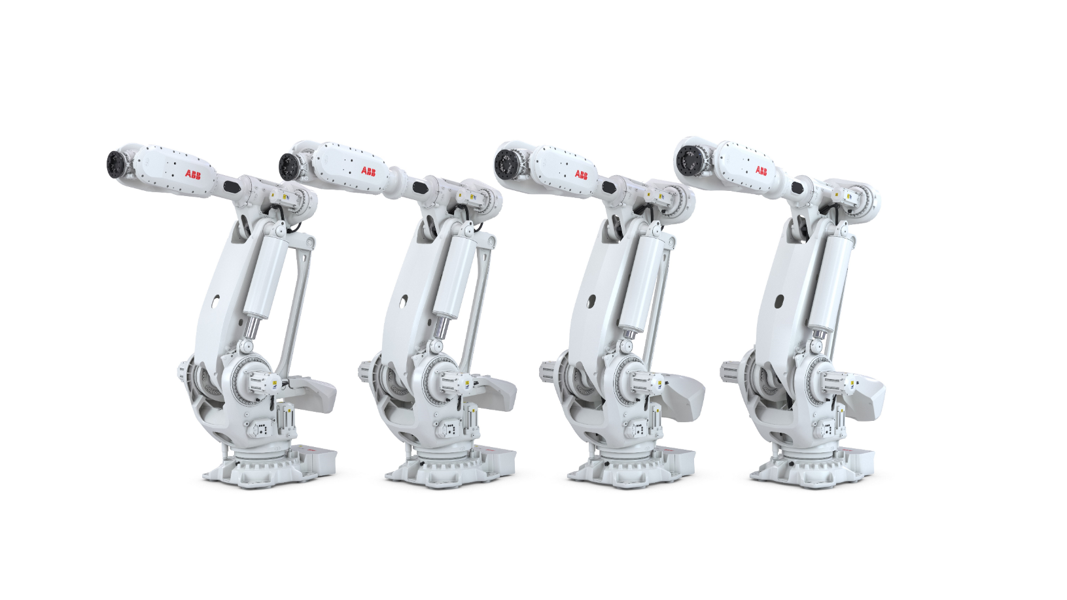
The IRB 77X0 Range
ABB is expanding its large-size robot portfolio with more variants in the IRB 77X0 range, still offering market leading speed and accurate performance. This done in an energy efficient way to minimize environmental impact.
Based on a new modular platform, the IRB 77X0’s are offered with the OmniCore controller V250XT/V400XT and features RobotWare 7.
IRB 77X0’s are general purpose robot to be used for a variety of tasks like material handling, machine tending, and high precision assembly applications in electric vehicle battery production, automotive, and the general industries, but is supporting all industries and business lines.
We are also supporting a wide range of process applications.
Spotwelding is one key where the robots enables fast and accurate spotwelding with different sizes of welding guns sometimes combined with grippers. Also, high precision applications like Dispense and Laser processes. Due to its stiff design, it is ideal for applications applying high forces, such as friction stir welding or deburring

Slide 6
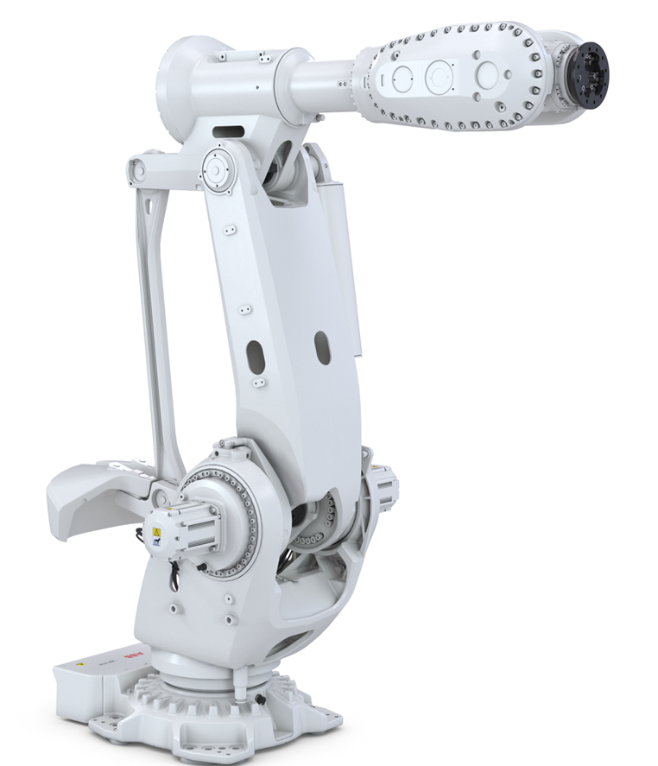
Shared Features
Protection
IP 67 protection as standard
Footprint
Standardized footprint
Built in features – guide pins for easy replacement,
Controller
Available with OmniCore V250XT and V400XT
Arm Load
Additional arm load – Std load 50 kg, flexibility to balance between wrist/arm load.
Mounting alternatives
Floor

Slide 7
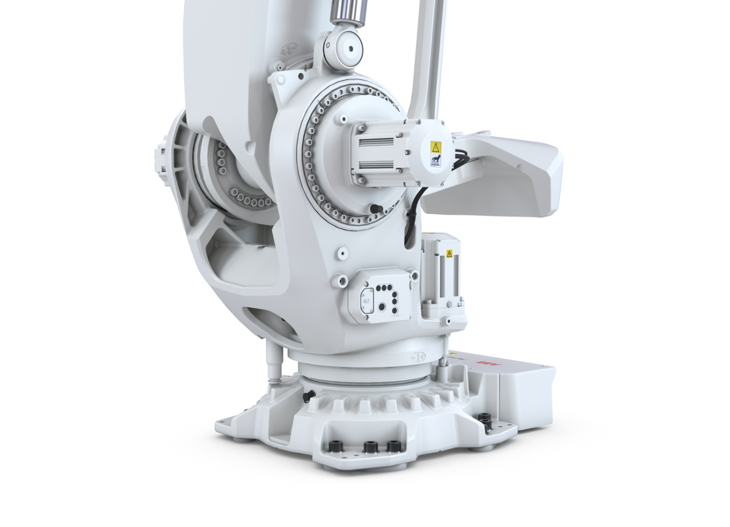
Shared Features
Footprint
  Standardized interface towards the floor, same for the IRB 77X0 as for the IRB 7600.
  Pitch diameter of screw circle 800 mm
  12 holes for M24 screws
  Guiding pin fittings for easier installation
  Footprint 1019 x 795

Slide 8

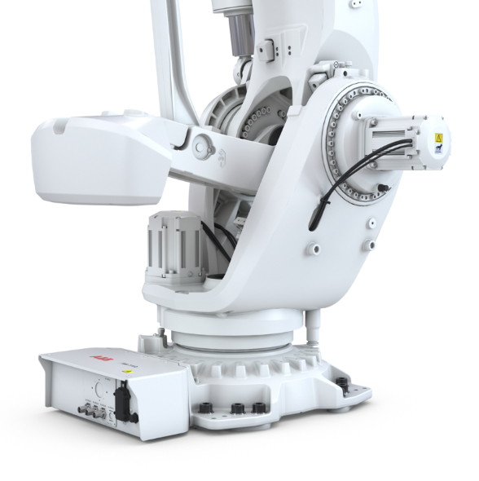
Shared Features
Swing radius
  IRB 7710: Front 774 mm / Back 720 mm
  IRB 7720: Front 774 mm / Back 772 mm
Swing radius front
Swing radius back

Slide 9
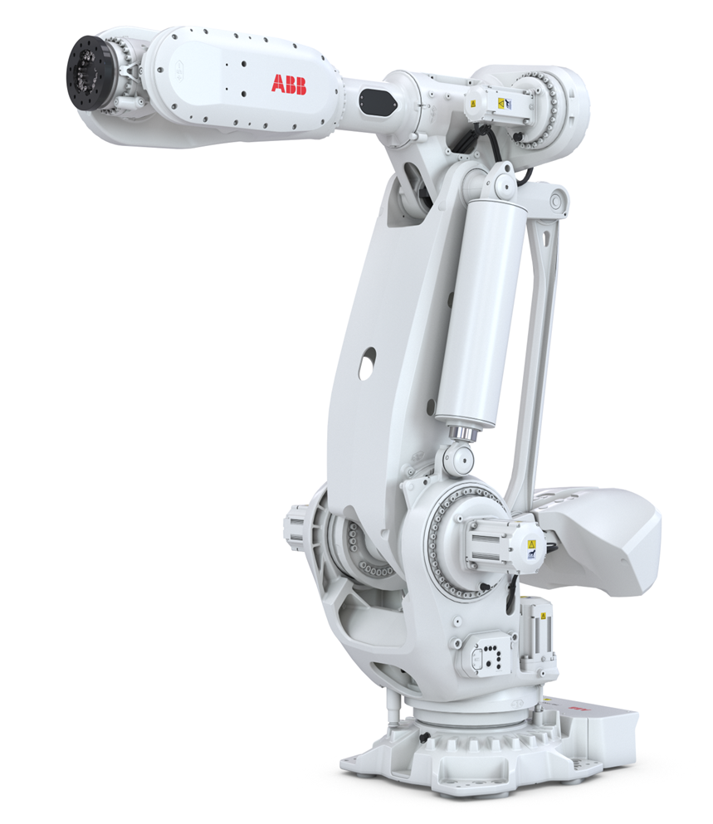
Main Tech Solutions
Motors
16-pole motor program | + Compactness, Performance
Brake release board for variable brake voltage | + Compactness, Energy Savings
Electronic box module and interface for brake release | + Modularity, Safety, Usability
Gearboxes
Z-series compact gearboxes ax 1-3 & 6 | + Compactness, Performance
Serviceability
Standardized maintenance and repair methods | + Serviceability
Standardized lifting tools 310-620kg | + Modularity, Serviceability
Mechanical Concept
Mechanical balanced axis 2 and 3 with P-rod | + Stiffness, Accuracy
Prepared for integrated upper arm Dress Pack | + Flexibility
Quality
Carry-over of IRB 6700 improvements (double seal in motors etc.) | + Quality
Increased static brake torque margin | + Quality
Poka Yoke motor connectors | + Quality
Drivers:
+ Performance
+ Compactness
+ Flexibility
+ Quality / Up-time
+ Energy efficiency

Slide 10
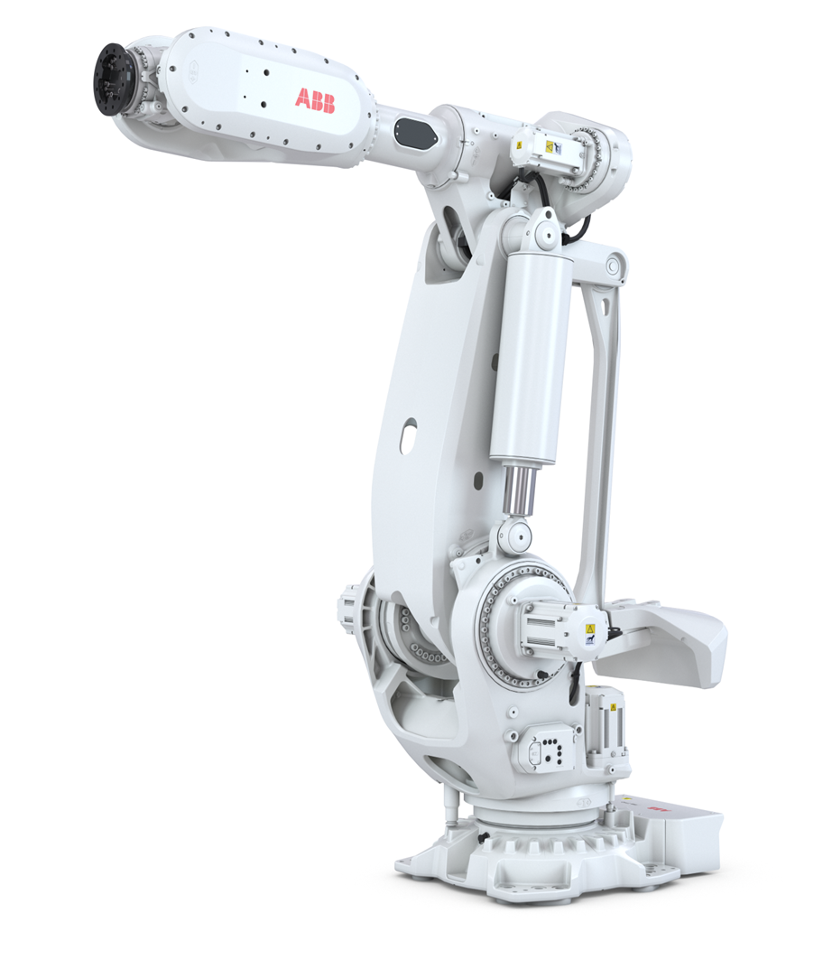
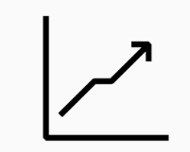
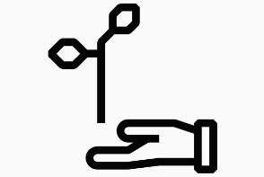
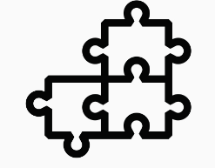
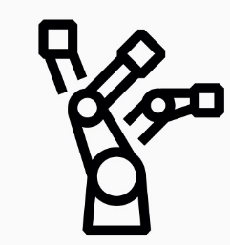
Main Benefits
The IRB 77X0 robots are offering a wide range of high performance
machines for multi-purpose customer applications.
Main benefits summarized below
Highest performance Class-leading repeatability of down to 0.05 mm, with outstanding cycle time and path accuracy thanks to OmniCoreTM motion control | Energy savings Up to 25% less energy consumption thanks to a lean design that is up to 15% more efficient, plus OmniCore TM power saving | Greater choice Modularity enables 16 powerful variants to meet different customer needs | Designed to last 8 of the robot variants are equipped with a LeanID Dress Pack that eliminates swinging cables and supports off-line programming

Slide 11
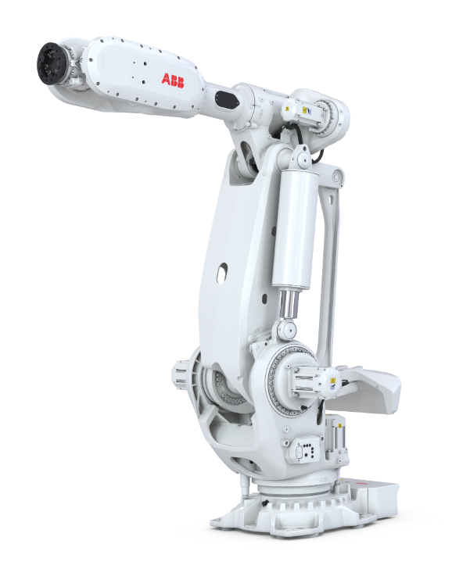
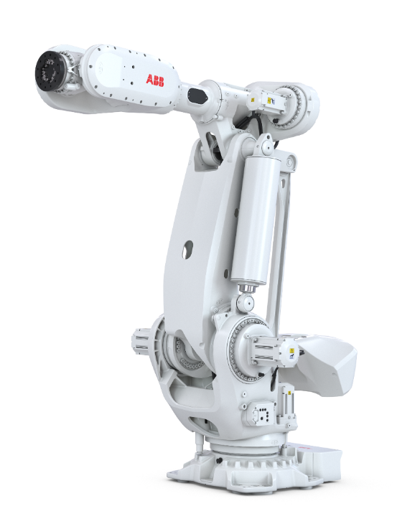
IRB 77X0 Standard Variants
Model | IRB 7710 | IRB 7720
Main applications | Spot Welding Material Handling, Assembly, Machining, Friction stir welding (high precision and contact force applications) | Spot Welding Material Handling, Assembly, Machining, Friction stir welding (high precision and contact force applications)
Configurations | 500kg / 2.85m 430kg / 3.1m 360kg / 3.3m 310kg / 3.5m | 620kg / 2.9m 530kg / 3.1m 510kg / 3.3m 450kg / 3.5m
Options | Foundry Plus | Foundry Plus

Slide 12
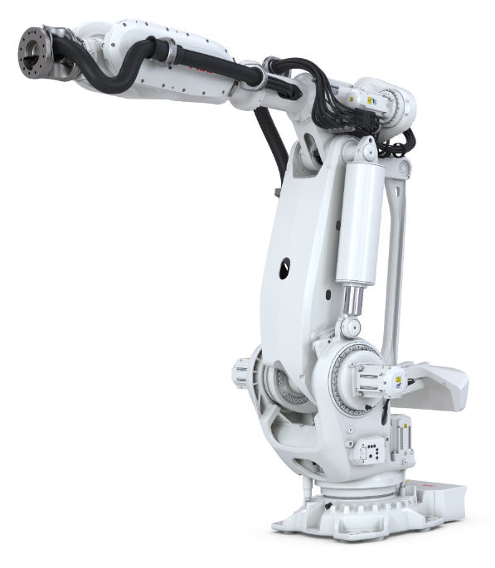
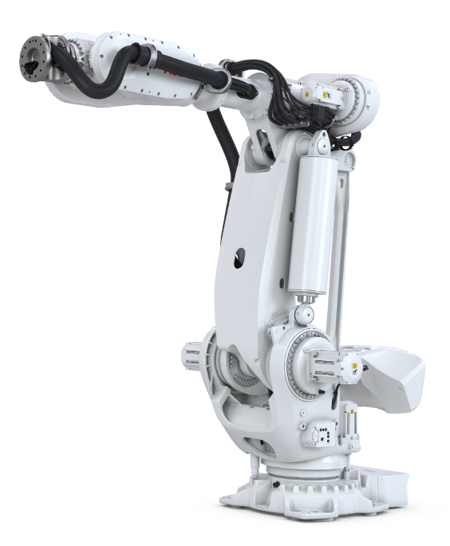
IRB 77X0 Lean ID Dress Pack Variants
Model | IRB 7710 | IRB 7720
Main applications | Spot Welding Material Handling, Assembly, Machining, Friction stir welding (high precision and contact force applications) | Spot Welding Material Handling, Assembly, Machining, Friction stir welding (high precision and contact force applications)
Configurations | 400kg / 2.85m LID 390kg / 3.1m LID 325kg / 3.3m LID 280kg / 3.5m LID | 560kg / 2.9m LID 480kg / 3.1m LID 400kg / 3.3m LID 400kg / 3.5m LID
Options | Lean ID SW/MH/Empty Conduit, MH3 Foundry Plus | Lean ID SW/MH/Empty Conduit, MH3 Foundry Plus

Slide 13
02. IRB 7710 Variants

Slide 14
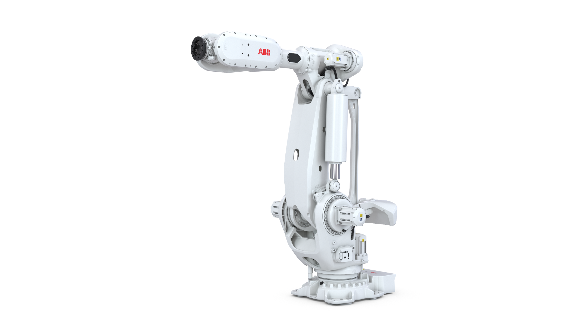
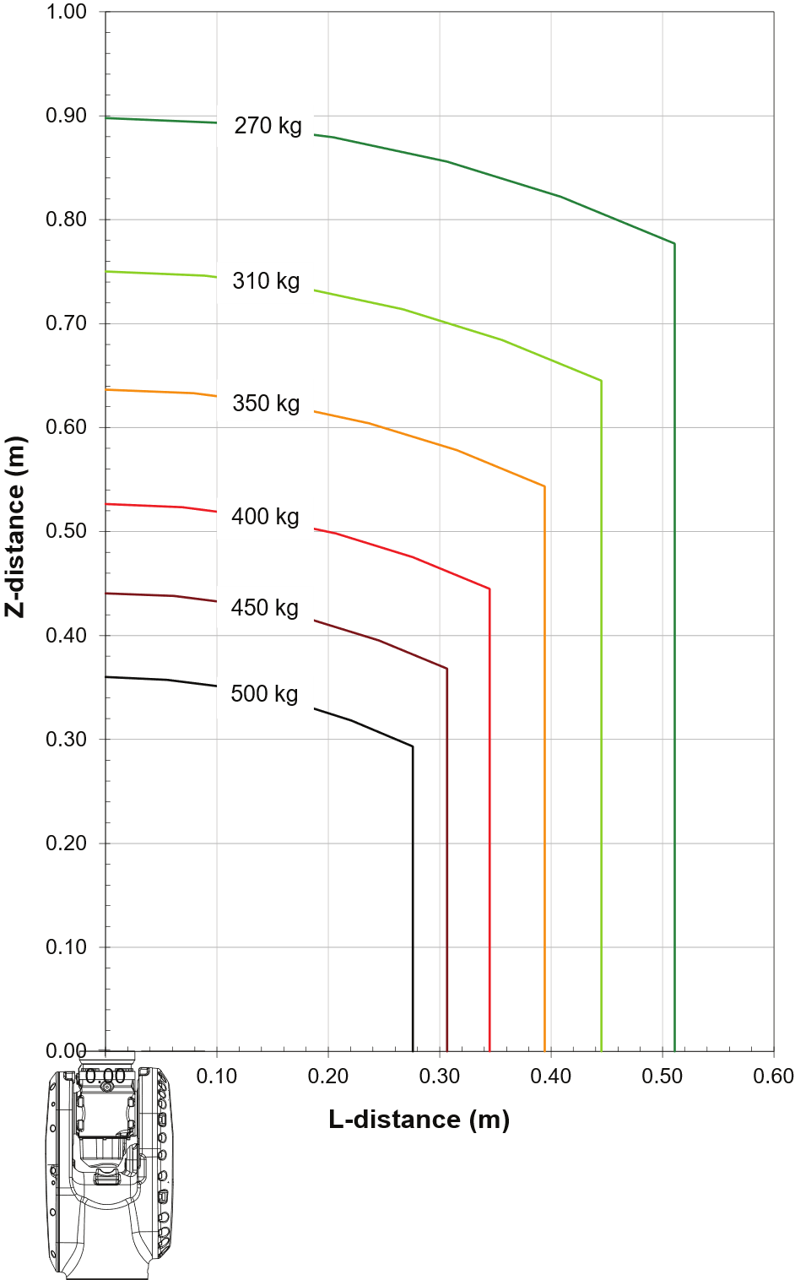
IRB 7710
Options number: 3300-369 – 500kg / 2.85m
Load Diagram
Armload: Upper Arm 50kg

Slide 15
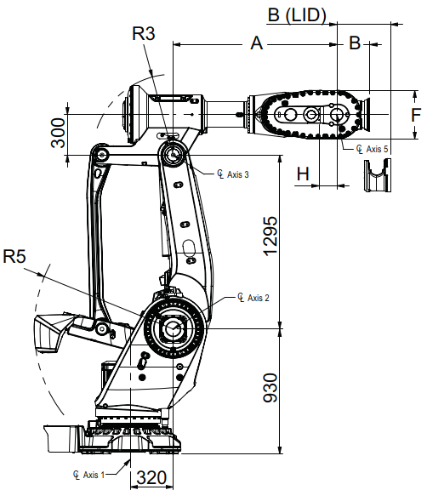
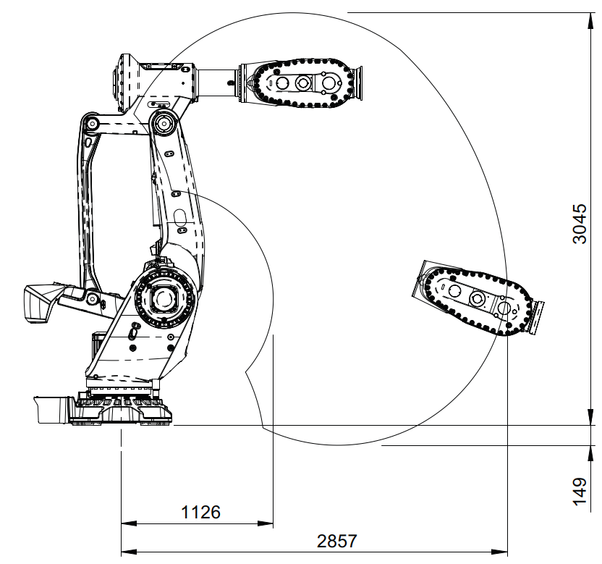
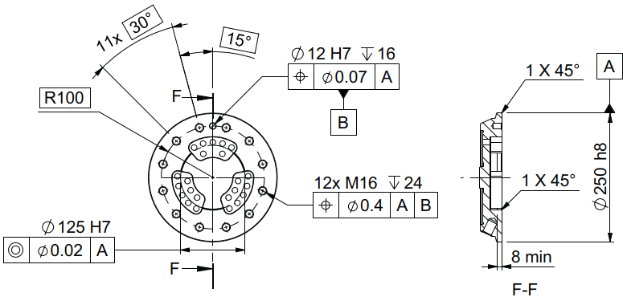
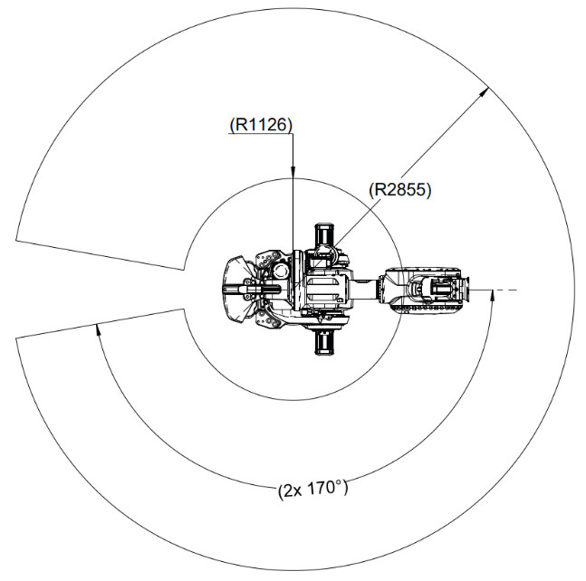
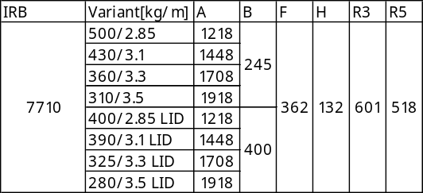
IRB 7710
Options number:
3300-369 – 500kg / 2.85m
Working Range
  Axis 1 ±170°
  Axis 2 +85.2°/-65°
  Axis 3 +130°/-27°
  Axis 4 ±300°
  Axis 5 ±130°
  Axis 6 ±360°
Weight
  2130kg
  Height
  2740mm

Slide 16
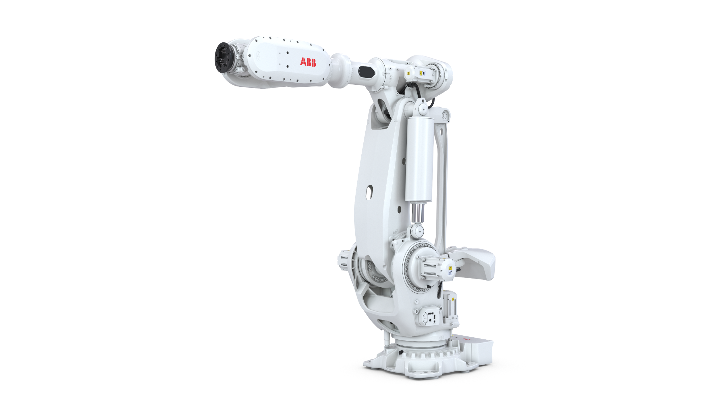
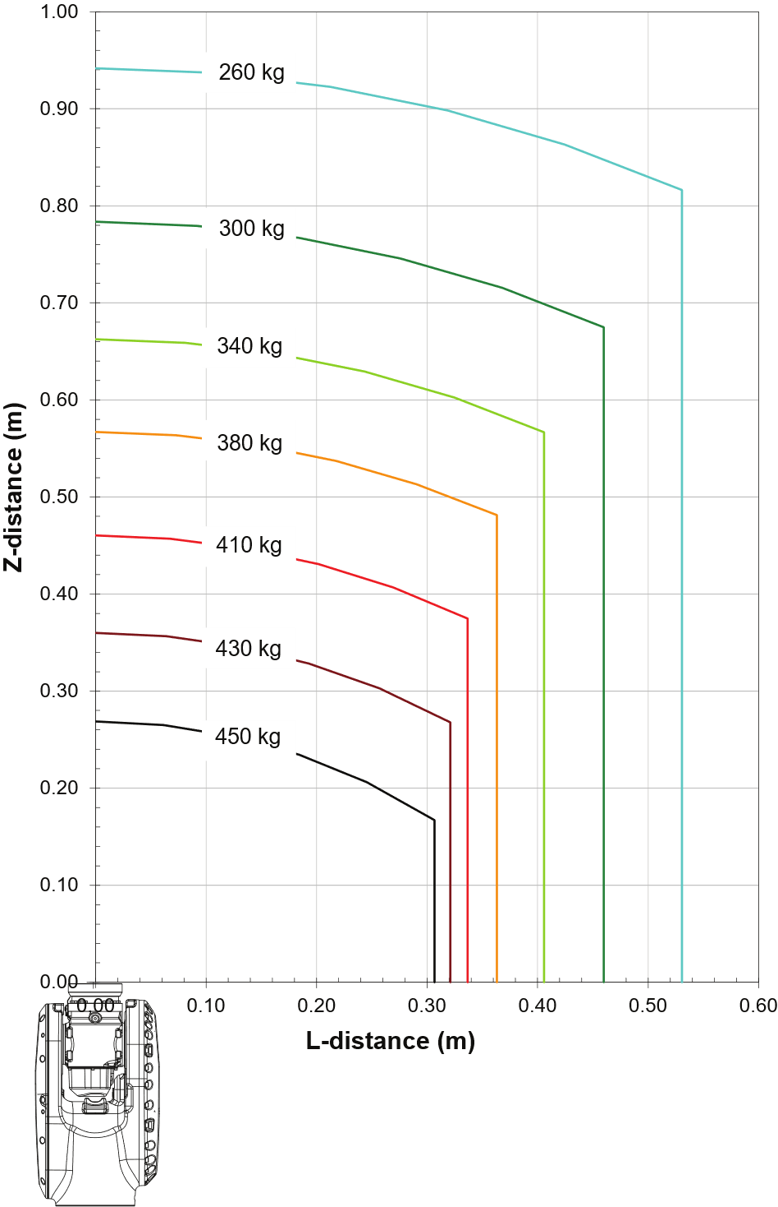
IRB 7710
Options number: 3300-370 – 430kg / 3.1m
Load Diagram
Armload: Upper Arm 50kg

Slide 17
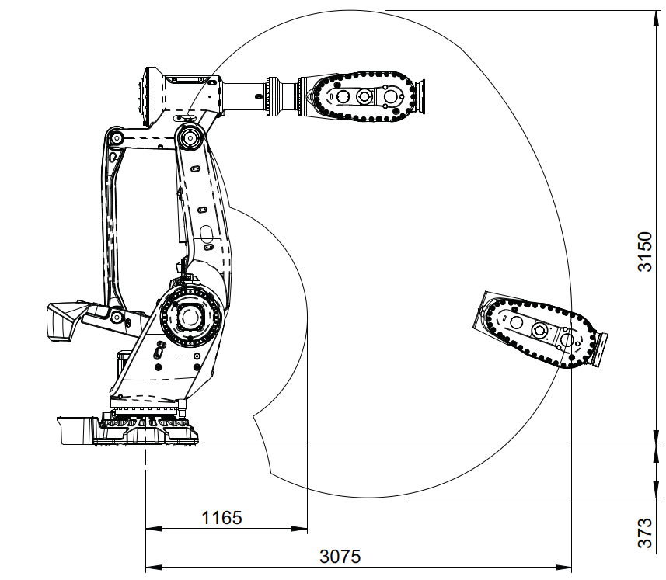
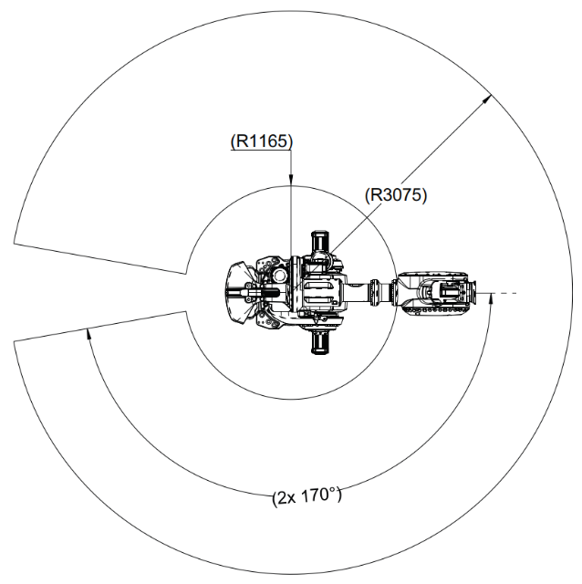
IRB 7710
Options number:
3300-370 – 430kg / 3.1m
Working Range
  Axis 1 ±170°
  Axis 2 +85.2°/-65°
  Axis 3 +130°/-27°
  Axis 4 ±300°
  Axis 5 ±130°
  Axis 6 ±360°
Weight
  2160kg
  Height
  2740mm

Slide 18
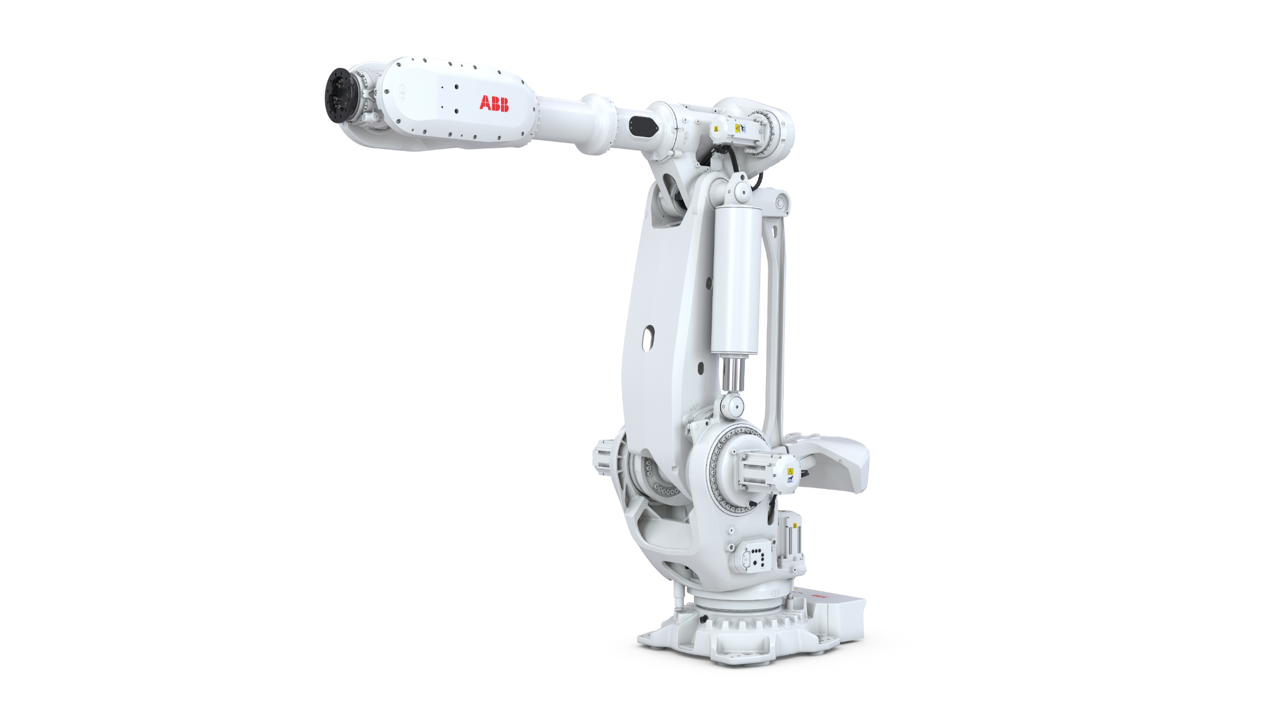
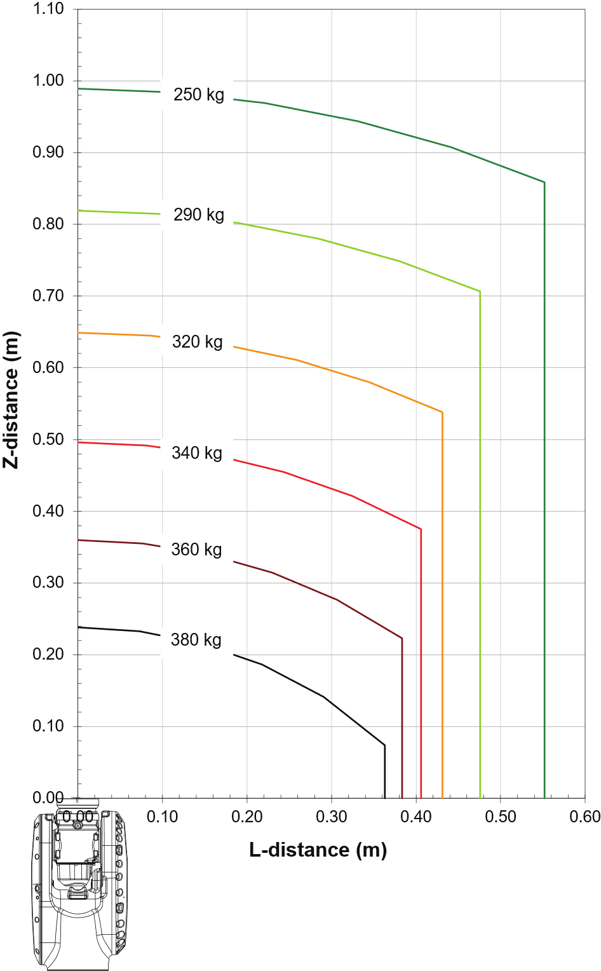
IRB 7710
Options number: 3300-371 – 360kg / 3.3m
Load Diagram
Armload: Upper Arm 50kg

Slide 19
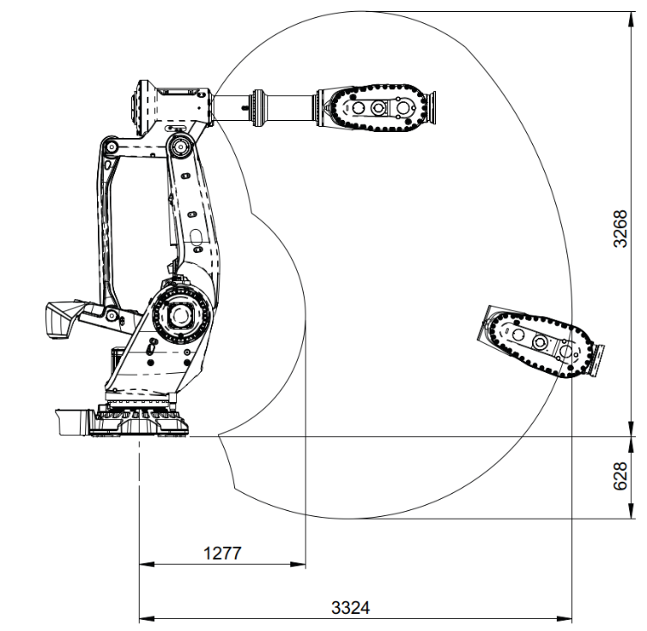
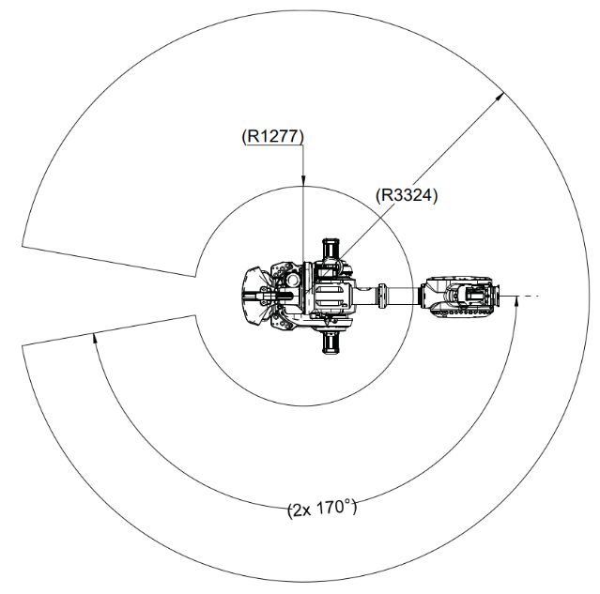
IRB 7710
Options number:
3300-371 – 360kg / 3.3m
Working Range
  Axis 1 ±170°
  Axis 2 +85.2°/-65°
  Axis 3 +130°/-27°
  Axis 4 ±300°
  Axis 5 ±130°
  Axis 6 ±360°
Weight
  2170kg
  Height
  2740mm

Slide 20
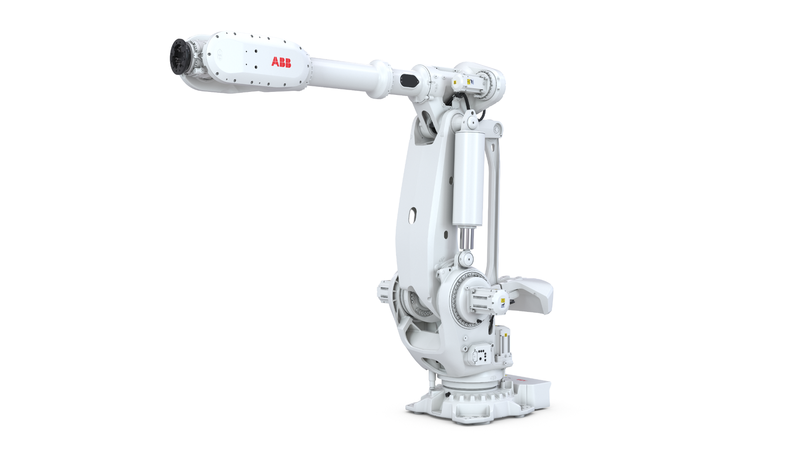
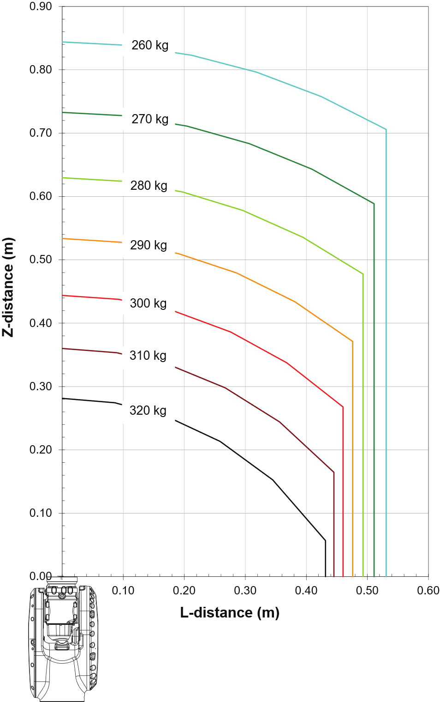
IRB 7710
Options number: 3300-372 – 310kg / 3.5m
Load Diagram
Armload: Upper Arm 50kg

Slide 21
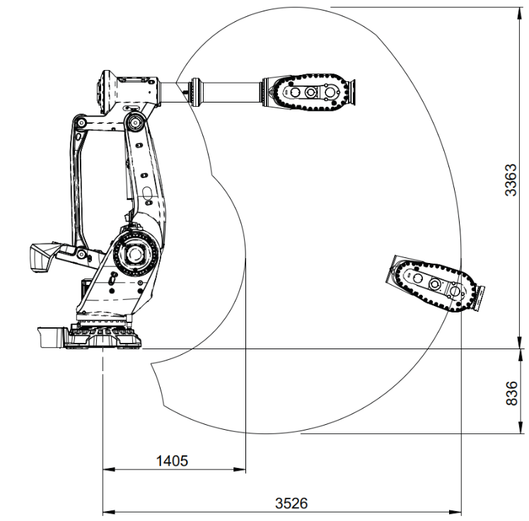
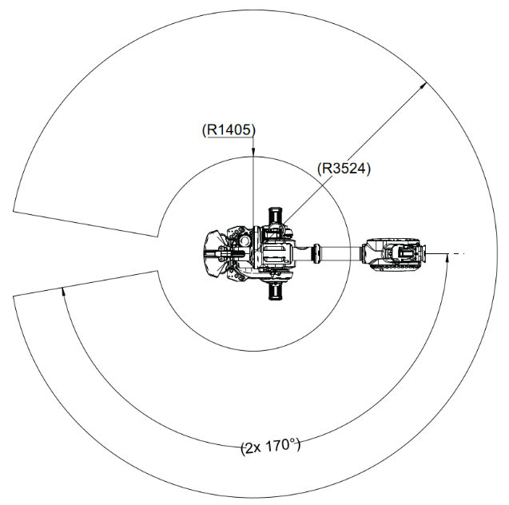
IRB 7710
Options number:
3300-372 – 310kg / 3.5m
Working Range
  Axis 1 ±170°
  Axis 2 +85.2°/-65°
  Axis 3 +130°/-27°
  Axis 4 ±300°
  Axis 5 ±130°
  Axis 6 ±360°
Weight
  2180kg
  Height
  2740mm

Slide 22
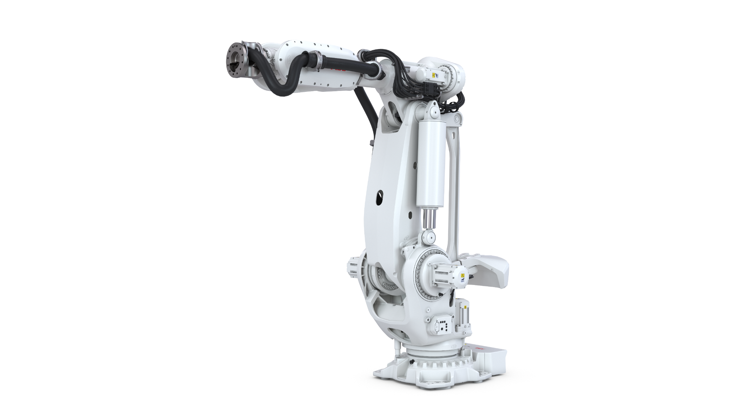
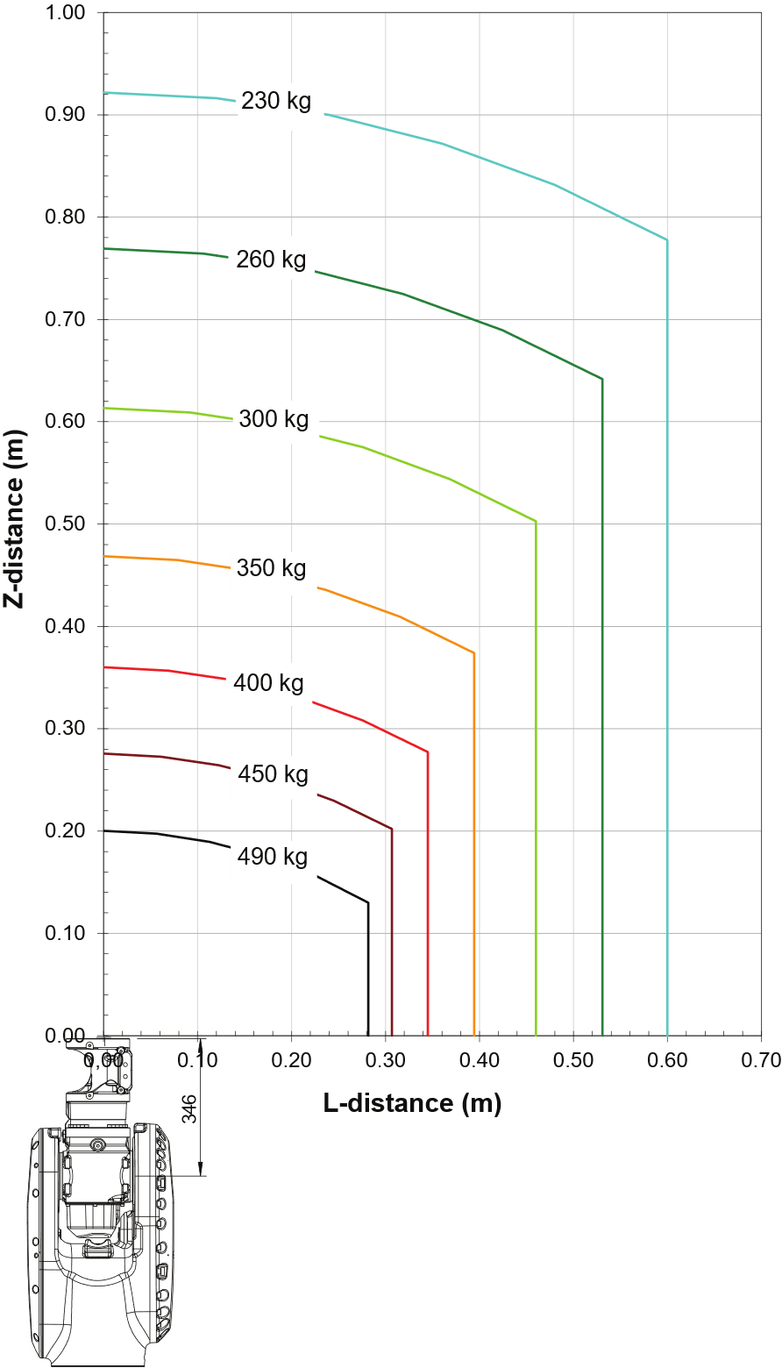
IRB 7710
Options number: 3300-373 – 400kg / 2.85m LID
Load Diagram
Armload: Upper Arm 50kg

Slide 23
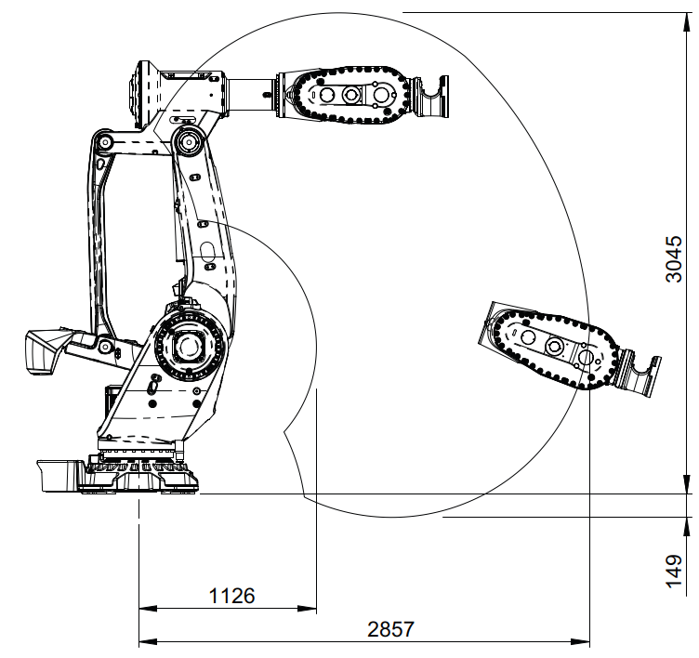
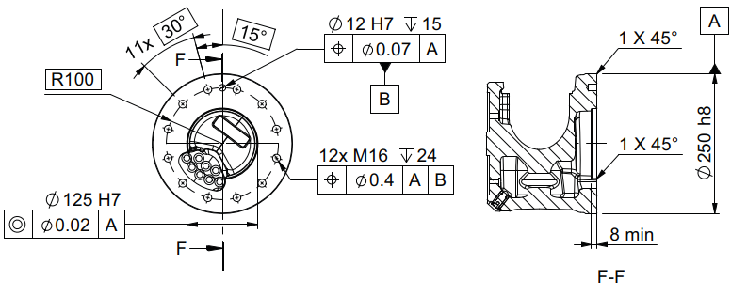
IRB 7710
Options number:
3300-373 – 400kg / 2.85m LID
Working Range
  Axis 1 ±170°
  Axis 2 +85.2°/-65°
  Axis 3 +130°/-27°
  Axis 4 ±300°
  Axis 5 ±130°
  Axis 6 ±360°
Weight
  2210kg
  Height
  2740mm

Slide 24
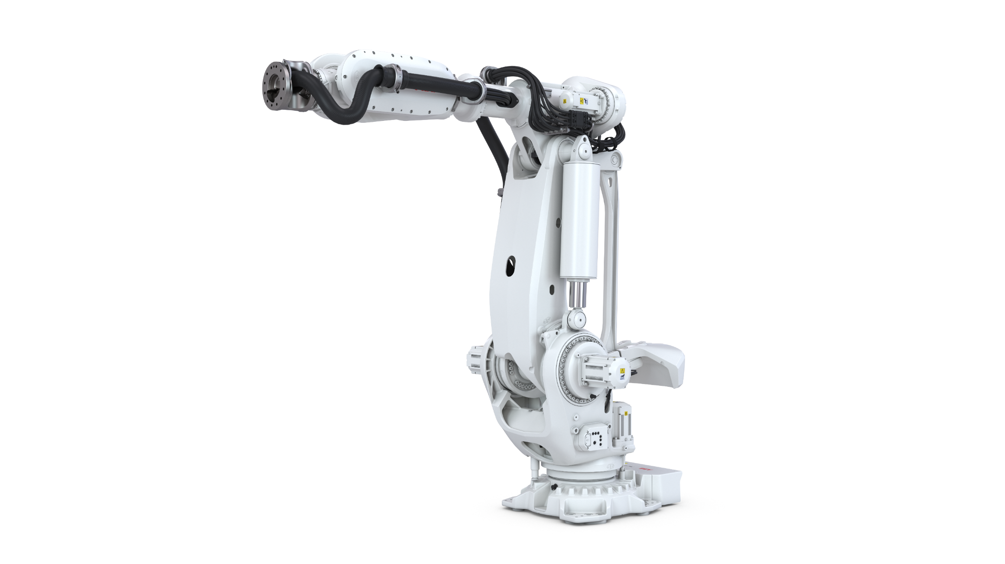
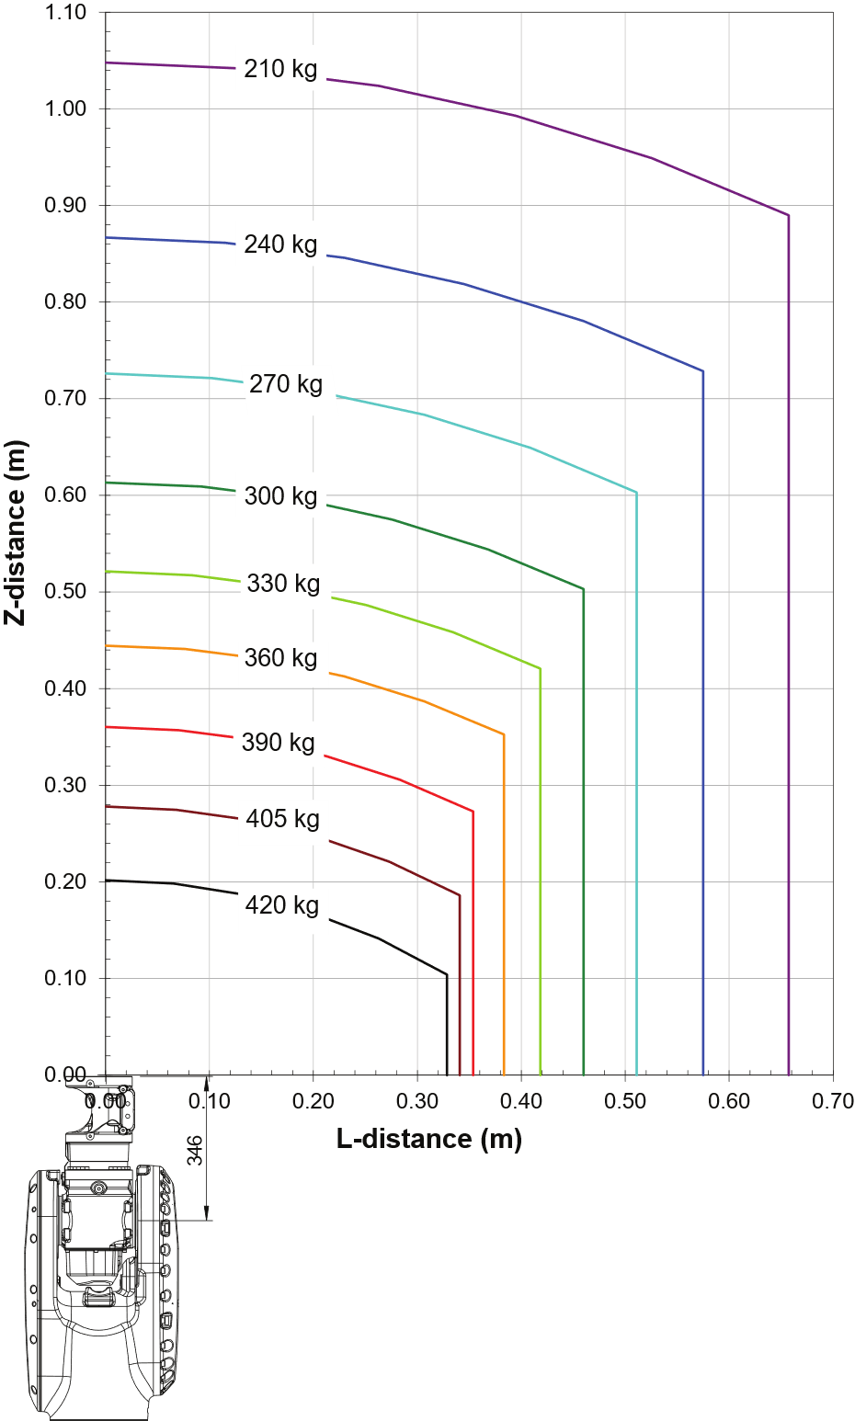
IRB 7710
Options number: 3300-374 – 390kg / 3.1m LID
Load Diagram
Armload: Upper Arm 50kg

Slide 25
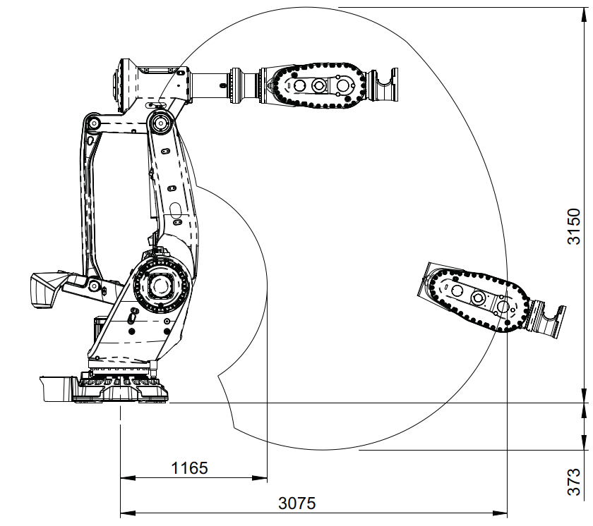
IRB 7710
Options number:
3300-374 – 390kg / 3.1m LID
Working Range
  Axis 1 ±170°
  Axis 2 +85.2°/-65°
  Axis 3 +130°/-27°
  Axis 4 ±300°
  Axis 5 ±130°
  Axis 6 ±360°
Weight
  2230kg
  Height
  2740mm

Slide 26
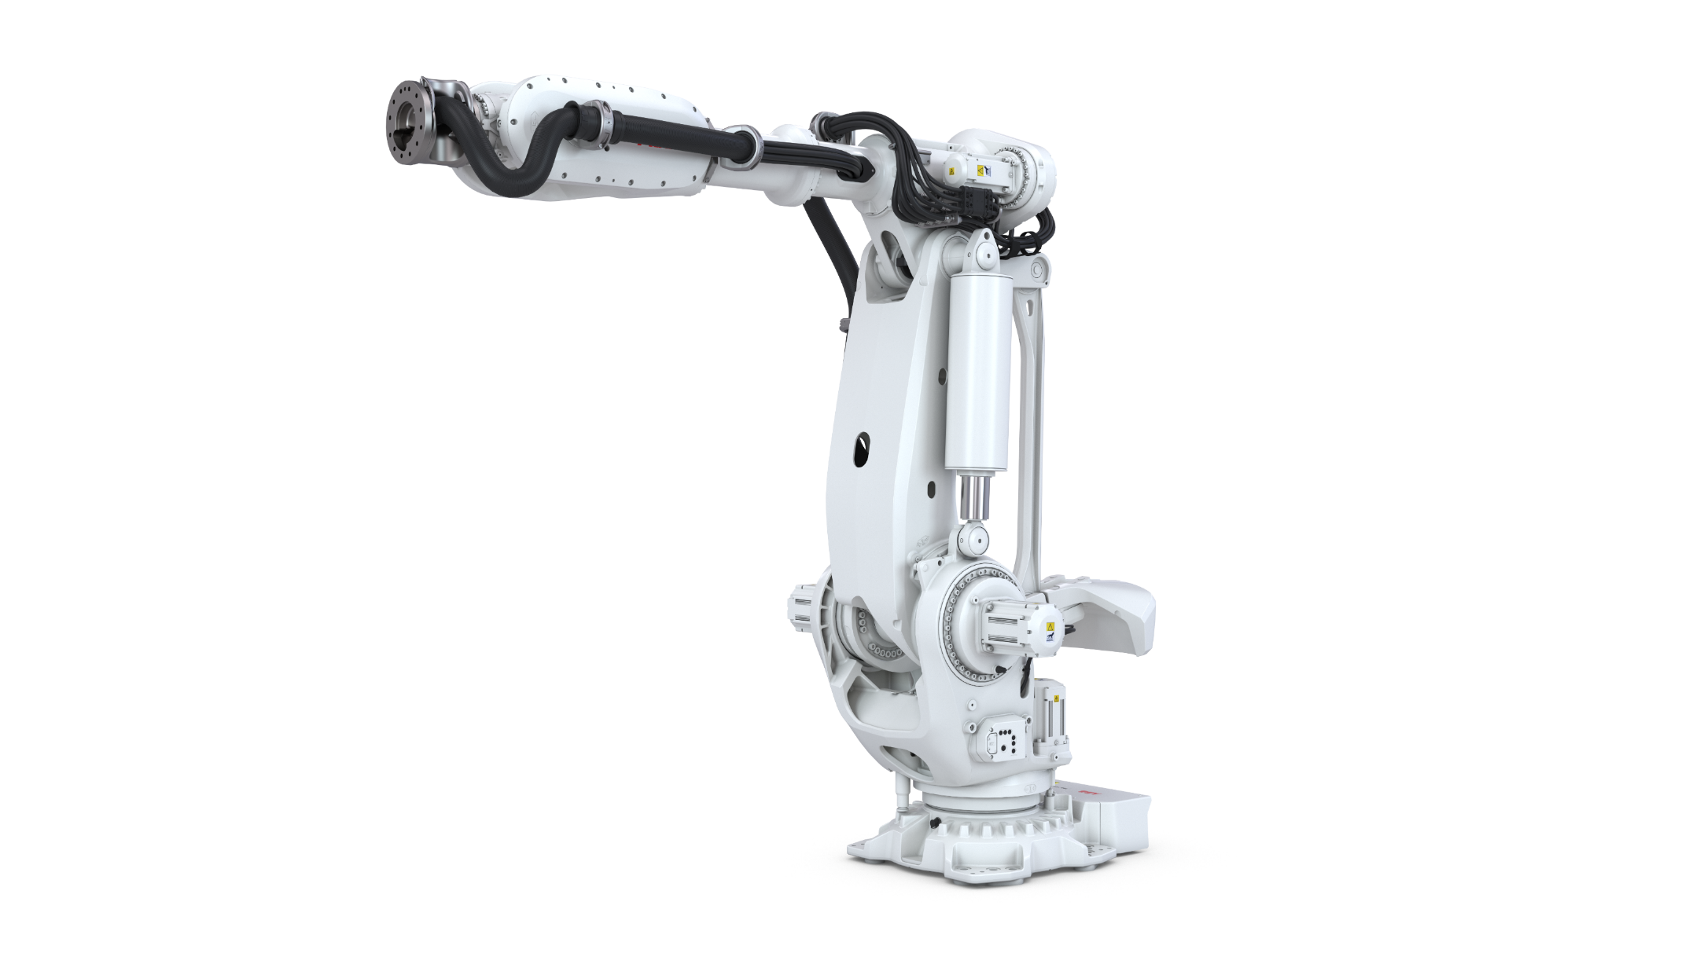
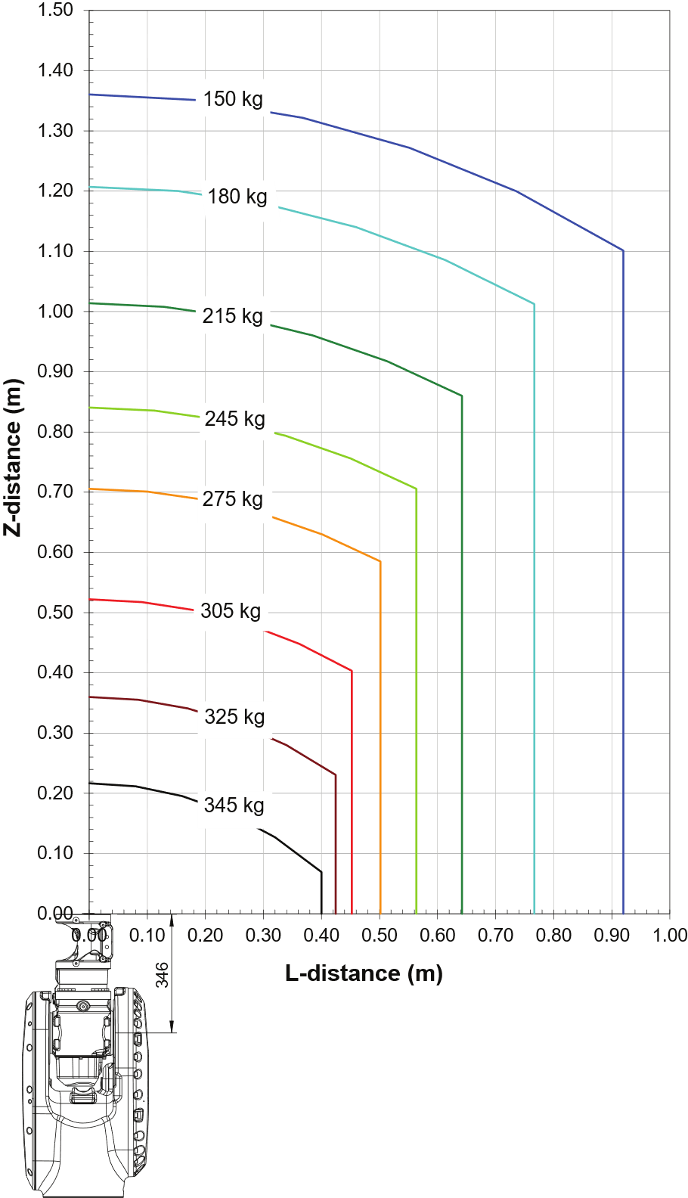
IRB 7710
Options number: 3300-375 – 325kg / 3.3m LID
Load Diagram
Armload: Upper Arm 50kg

Slide 27
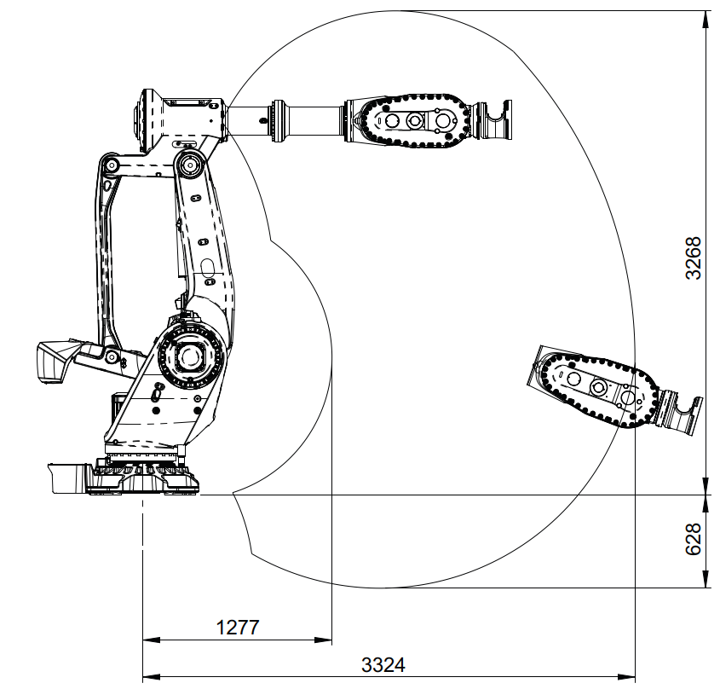
IRB 7710
Options number:
3300-375 – 325kg / 3.3m LID
Working Range
  Axis 1 ±170°
  Axis 2 +85.2°/-65°
  Axis 3 +130°/-27°
  Axis 4 ±300°
  Axis 5 ±130°
  Axis 6 ±360°
Weight
  2240kg
  Height
  2740mm

Slide 28
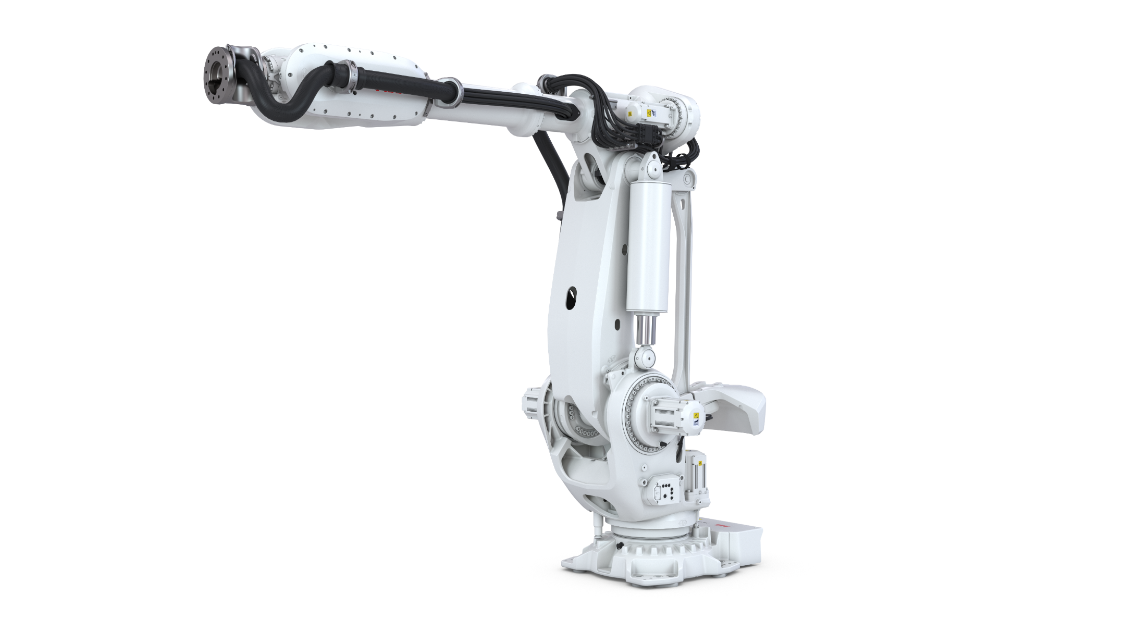
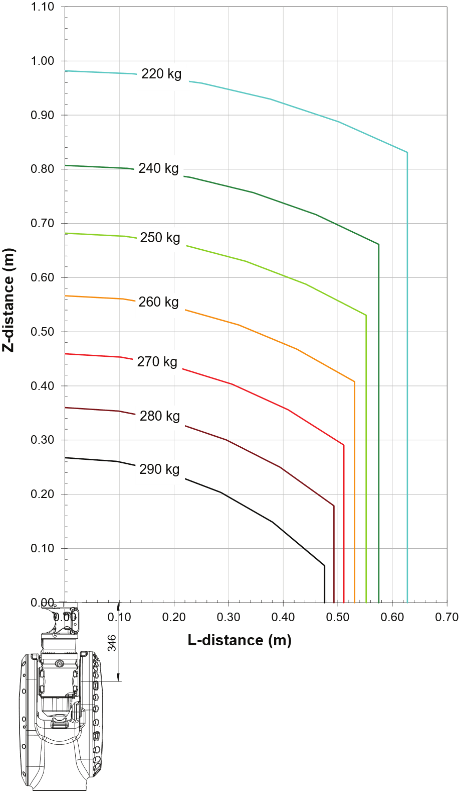
IRB 7710
Options number: 3300-376 – 280kg / 3.5m LID
Load Diagram
Armload: Upper Arm 50kg

Slide 29
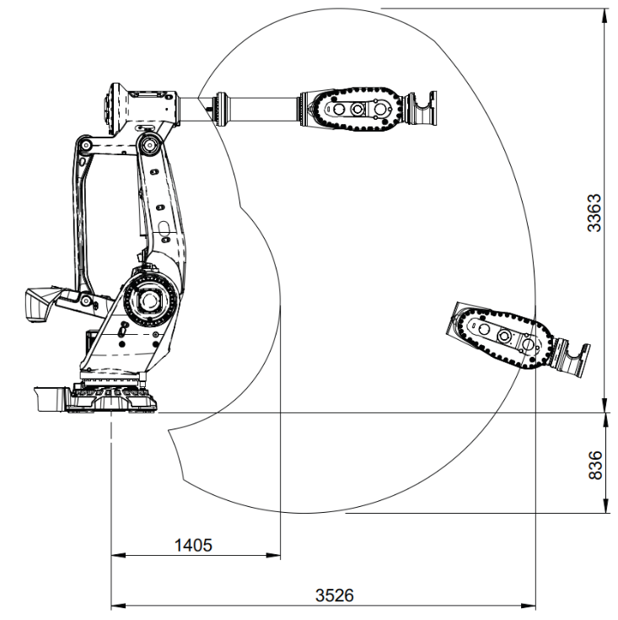
IRB 7710
Options number:
3300-376 – 280kg / 3.5m LID
Working Range
  Axis 1 ±170°
  Axis 2 +85.2°/-65°
  Axis 3 +130°/-27°
  Axis 4 ±300°
  Axis 5 ±130°
  Axis 6 ±360°
Weight
  2250kg
  Height
  2740mm

Slide 30
03. IRB 7720 Variants

Slide 31
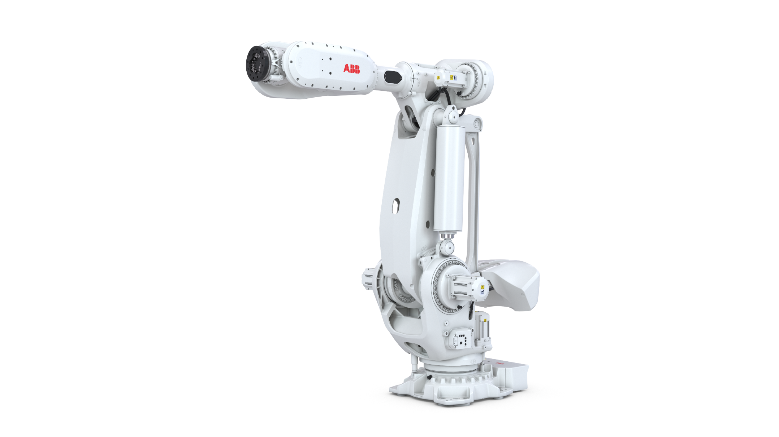
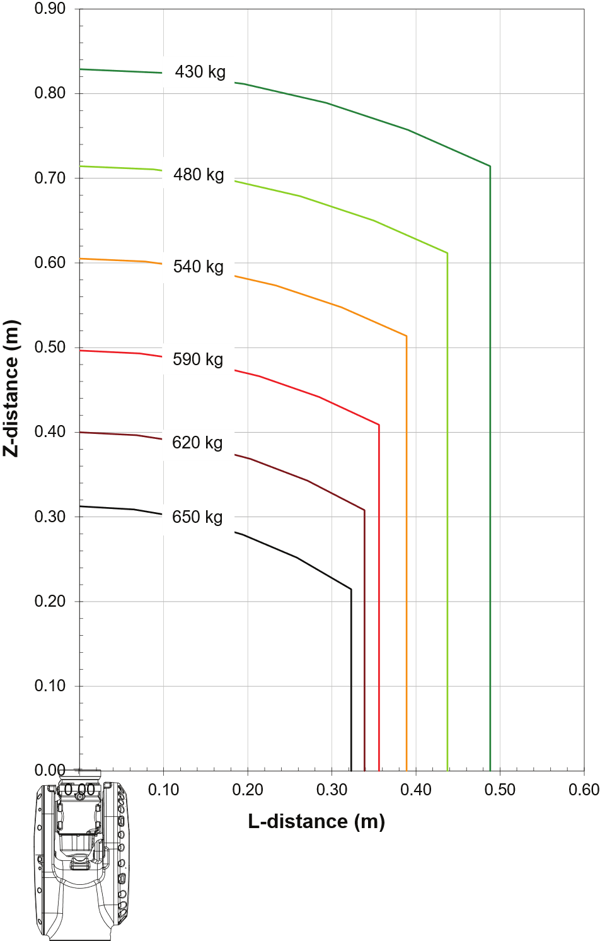
IRB 7720
Options number: 3300-377 – 620kg / 2.9m
Load Diagram
Armload: Upper Arm 50kg

Slide 32
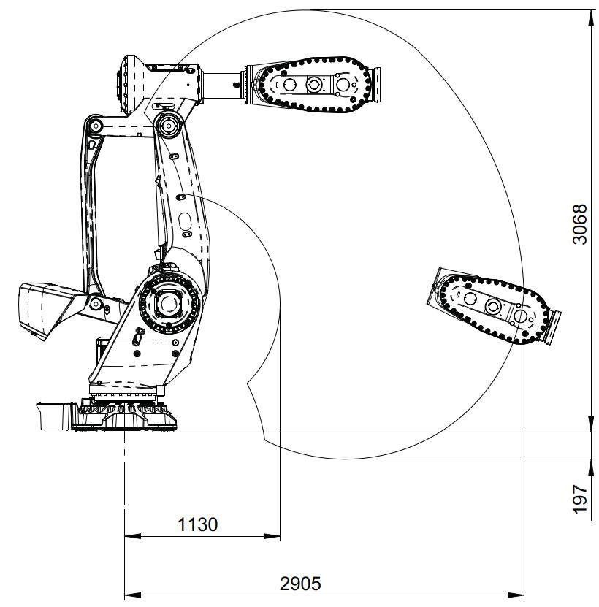
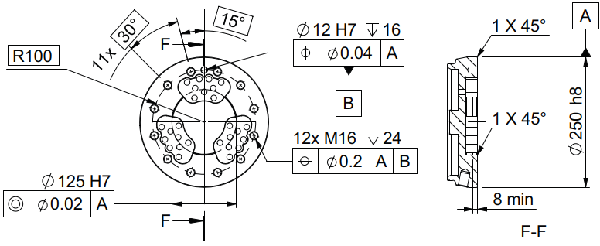


IRB 7720
Options number:
3300-377 – 620kg / 2.9m
Working Range
  Axis 1 ±170°
  Axis 2 +85.2°/-65°
  Axis 3 +130°/-27°
  Axis 4 ±300°
  Axis 5 ±130°
  Axis 6 ±360°
Weight
  2590kg
  Height
  2740mm

Slide 33


IRB 7720
Options number: 3300-378 – 530kg / 3.1m
Load Diagram
Armload: Upper Arm 50kg

Slide 34


IRB 7720
Options number:
3300-378 – 530kg / 3.1m
Working Range
  Axis 1 ±170°
  Axis 2 +85.2°/-65°
  Axis 3 +130°/-27°
  Axis 4 ±300°
  Axis 5 ±130°
  Axis 6 ±360°
Weight
  2620kg
  Height
  2740mm

Slide 35


IRB 7720
Options number: 3300-379 – 510kg / 3.3m
Load Diagram
Armload: Upper Arm 50kg

Slide 36


IRB 7720
Options number:
3300-379 – 510kg / 3.3m
Working Range
  Axis 1 ±170°
  Axis 2 +85.2°/-65°
  Axis 3 +130°/-27°
  Axis 4 ±300°
  Axis 5 ±130°
  Axis 6 ±360°
Weight
  2540kg
  Height
  2740mm

Slide 37


IRB 7720
Options number: 3300-380 – 450kg / 3.5m
Load Diagram
Armload: Upper Arm 50kg

Slide 38


IRB 7720
Options number:
3300-380 – 450kg / 3.5m
Working Range
  Axis 1 ±170°
  Axis 2 +85.2°/-65°
  Axis 3 +130°/-27°
  Axis 4 ±300°
  Axis 5 ±130°
  Axis 6 ±360°
Weight
  2550kg
  Height
  2740mm

Slide 39


IRB 7720
Options number: 3300-381 – 560kg / 2.9m LID
Load Diagram
Armload: Upper Arm 50kg

Slide 40


IRB 7720
Options number:
3300-381 – 560kg / 2.9m LID
Working Range
  Axis 1 ±170°
  Axis 2 +85.2°/-65°
  Axis 3 +130°/-27°
  Axis 4 ±300°
  Axis 5 ±130°
  Axis 6 ±360°
Weight
  2670kg
  Height
  2740mm

Slide 41


IRB 7720
Options number: 3300-382 – 480kg / 3.1m LID
Load Diagram
Armload: Upper Arm 50kg

Slide 42

IRB 7720
Options number:
3300-382 – 480kg / 3.1m LID
Working Range
  Axis 1 ±170°
  Axis 2 +85.2°/-65°
  Axis 3 +130°/-27°
  Axis 4 ±300°
  Axis 5 ±130°
  Axis 6 ±360°
Weight
  2690kg
  Height
  2740mm

Slide 43


IRB 7720
Options number: 3300-383 – 400kg / 3.3m LID
Load Diagram
Armload: Upper Arm 50kg

Slide 44

IRB 7720
Options number:
3300-383 – 400kg / 3.3m LID
Working Range
  Axis 1 ±170°
  Axis 2 +85.2°/-65°
  Axis 3 +130°/-27°
  Axis 4 ±300°
  Axis 5 ±130°
  Axis 6 ±360°
Weight
  2620kg
  Height
  2740mm

Slide 45


IRB 7720
Options number: 3300-384 – 400kg / 3.5m LID
Load Diagram
Armload: Upper Arm 50kg

Slide 46

IRB 7720
Options number:
3300-384 – 400kg / 3.5m LID
Working Range
  Axis 1 ±170°
  Axis 2 +85.2°/-65°
  Axis 3 +130°/-27°
  Axis 4 ±300°
  Axis 5 ±130°
  Axis 6 ±360°
Weight
  2630kg
  Height
  2740mm

Slide 47
04. IRB 77X0 Options

Slide 48

Base Protection
Options number: 3350-670
Purpose and Value
The manipulators are offered with different protection level. The basic design, option Base 67, is well prepared for normal or tough environment. This includes electrical design following the IP 67 standard and stainless-steel screw used for all add-on parts after painting.
Limitations & Dependencies
—
Ingress Protection
  IP 67

Slide 49


Foundry Plus 2 Protection
Options number: 3352-10
Nitrile rubber
gaskets
Purpose and Value
For harsh environments, such as a foundry, the Foundry Plus2 67 option is recommended. This includes extra cable protection, more seals, and coverage for unused connections. The manipulator is finished with a more durable paint and rust preventive.
The main features include:
  Upgraded paint specialized for harsh environments
  UV-resistant polymer covers, either PCABS thermo-plastic or PA66 nylon.
  Steel sheet cover
  Nitrile rubber gaskets
  Sikaflex sealant
  Stainless steel screws
  Protection plugs for certain unused holes
Limitations & Dependencies
Option Foundry Plus2 67 requires option Upper Arm Cover 3316-1
Ingress Protection
IP 67
Upgraded paint
Covers
Nickel-phosphorus
coating

Slide 50

Foundry Plus 2 – Color Coating
Further clarifications option: 3352-10
Purpose and Value
The robots are available in 2 standard colors (Graphite White and Orange).
For the Foundry applications or in general for extra tough environment the Orange color is recommended as it mitigates the risk of color changes over time better than any other color.

Slide 51

Foundry Plus 2 – Turning Disc
Further clarifications option: 3352-10
Purpose and Value
In the Foundry Plus 2 Protection option, the turning disc is treated with a nickel-phosphorus coating that further reduces corrosion risk in tough environments.

Slide 52


Foundry Plus 2 – Covers
Further clarifications option: 3352-10
Purpose and Value
In the Foundry Plus 2 Protection option, additional covers are added to protect hoses/cables and other parts of the manipulator from liquids, hot metal spits and similar.
Compatible with Dress Packs.

Slide 53


Foundry Plus 2 – Gaskets
Further clarifications option: 3352-10
Purpose and Value
Gaskets are upgraded to nitrile rubber gaskets to better withstand harsh environment.

Slide 54

Color Options
Options number: 209-X
Purpose and Value
For our robots, Graphite White is the standard
default color, option 209-202. However, the robots are offered in ABB Orange as one additional standard color, option 209-1.
Custom-made coloring according to the RAL color systems can be provided.
Limitations & Dependencies
  This is only valid for base manipulators; accessories has a standard color. Normal spare parts are only offered in standard colors

Slide 55

Foundry Cable Guard
Options number: 3315-1
Purpose and Value
The manipulator could be equipped with additional cable guards for extra tough environmental conditions with as example metals spits, frequent weld spatter. These additional cover will prolong cable lifetime and simplify service/maintenance as the robot are kept cleaner under the covers.
Limitations & Dependencies
  Recommended for 3352-10 Foundry Plus 2 to achieve best protection of the manipulator harness and Dress Pack harness.
  Requires Upper Arm Cover 3316-1

Slide 56

Upper Arm Cover
Options number: 3316-1
Purpose and Value
The manipulator could be equipped with additional upper arm covers, option 3316-1, for environmental conditions where you want to further seal of the upper arm in wet or dirty conditions. These additional cover will prolong cable lifetime and simplify service/maintenance as the robot are kept cleaner under the covers.
Made out of UV-resistant PA66 nylon.
Limitations & Dependencies
  Mandatory for option 3352-10 Foundry Plus 2
  Mandatory for option 3315-1 Foundry Cable Guard
  Mandatory for upper arm Dress Pack options

Slide 57

Forklift Device
Options number: 3318-1 on base
Purpose and Value
The manipulator can be delivered with a forklift device, option 3318-1. This device allows a fork truck to be used when the manipulator must be moved. The forklift loops are placed on the base which enables a low lifting point.
Instructions on how to mount the devices is included in the kit.
Limitations & Dependencies
  To be removed after installation / use
  Preparations and consideration at use specified in product manuals
  Delivered on pallets including bolts

Slide 58


7th Axis Resolver Connection
Options number: 3322-1 On base, 3322-2 In servo Dress Pack
Purpose and Value
The manipulator could be prepared to support an additional servo motor drive, e.g., to enable track motion or servo tools. The option includes connection of one extra resolver channel beside the 6 axis that are used in the basic robot.
Used to connect an external axis resolver feedback from the motor to the control system.
There are two different alternatives.
  Resolver signal for one additional motor are routed to the foot of the robot, option 3322-1
  Resolver signals for one additional motor are routed via the Dress Pack to the tool, option 3322-2
Limitations & Dependencies
  Only one extra motor possible
  Option 3322-2 In servo Dress Pack is required for servo options of Dress Pack base-axis 3
Option 3322-1 On base
Option 3322-2 In servo Dress Pack

Slide 59




Additional drive units • Robot held servo tool • Stationary servo tool
Options number 3062-1, 3068-1, 3068-2, 3206-x
OmniCore V250XT
Purpose & value
Included in servo-dress pack selection
Matching legacy dress pack with single wire-solution (low power)
Floor cable – single motor, low power
  OmniCore V250XT controller is available with up to 3 ADU (additional Drive Unit) and up to 6 ADU with V400XT for use with robot held OR stationary servo motor. Typically for Spotwelding, servo gripper, stationary transport or other.
ADU 1
M03:07
Servo tool
MDU
M03:06/11
M04:03/02
ADU 1
SMB
M08:06
M06:09
Limitations & Dependencies
OmniCore V250XT
Only valid for V250XT and V400XT
Option uses only one ADU
This option is available for the following robots: IRB 2600, 4600, 57X0, 6650S, 6700, 67X0, 67X0S, 6760, 460, 660, 7600, 77X0
Floor cable – single motor, low power
Requires “connection on base” on the manipulator
ADU 1
M03:07
MDU
M03:06/11
M04:03/02
SMB
Servo tool
M08:06
M06:09
ADU 1

Slide 60

Limited Working Range Axis 1
Options number: 3323-1
Purpose and Value
Used to mechanically restrict the motion range of axis 1.
The manipulator can be equipped with adjustable stops which mechanically limit the working range on axis 1. The mechanical stops are delivered alongside the robot. The stops can be mounted in 15-degree increments. Assembly instructions are covered in the product manual.
Limitations & Dependencies
  Not compatible with 3324-1 Extended working range

Slide 61

Extended Working Range Axis 1
Options number: 3324-1
Purpose and Value
The working range of the manipulator can be increased on axis one by removing the mechanical stop, increasing the range to ±220°. This allows the user to reach critical points behind the robot.
The option Extended work range enables an extension of the working range for axis one, through a software configuration. With this option installed, the working range can exceed the standard range limited by the mechanical stop on axis one. The working range shall be limited through the option SafeMove.
The mechanical stop are assembled at delivery and could be removed once other safety measures has been performed. Removal process are stated in the product manual.
Limitations & Dependencies
  Not compatible with 3325-xx Dress Pack Spotwelding
  Requires 3043-X SafeMove
X

Slide 62

Motor Cooling Fans
Options number: 3320-1 for axis 1, 3321-1 for axis 2, 3346-1 for axis 3
Purpose and Value
The manipulator could be delivered with fans for axis one, two and three. This is to handle cases with high duty cycle and/or high surrounding temperature.
There are three different alternatives:
Cooling fans axis 1, option 3320-1, placed directly on the axis 1 motor base
Cooling fans axis 2 option 3321-1, placed directly on the axis 2 on robot frame
Cooling fans axis 3 option 3346-1, placed directly on the axis 3 on other side of robot frame
To be used to avoid overheating of motor and gear in applications with intensive motion (high average speed and/or high average torque and/or short wait time) of axis one, two and three
Limitations & Dependencies
  IP 54 valid for cooling fan
  “Gearbox Heat Prediction” tool is available in RobotStudio to determine the need of fans
  Max. 2 motor cooling fans can be selected
  Not compatible with 3352-10 Foundry Plus 2 67

Slide 63

Dress Pack - Overview
Purpose and Value
The IRB 77X0 robots can be equipped with different Dress Packs. The Dress Packs are well integrated into the robot system with focus on long life length and large working range and accurate off-line simulations. ​
​
The Dress Pack is designed as a complete system including mainly 5 main building blocks with connection points in between: ​
  Preparations for the Dress Pack inside the robot controller cabinet​.
  Floor cables from cabinet to base of robot​.
  Lower arm Dress Pack from base of robot to rear part of the upper arm (axis 3).​
  Upper arm Dress Pack from rear part of upper arm (axis 3) to the tool flange (axis 6).​
  Connections kits to simplify local made interface solutions (available for base, axis 3 and axis 6).​
​
The upper arm Dress Pack consists of two design solutions, LeanID (LID) and MH3.
The LeanID solution is available for both Material Handling and Spotwelding. The MH3 solution also supports only Material Handling. ​
The LeanID solution could also be supplied as "Empty Conduit". This to support local made "customized" Dress Pack content.​
The different Dress Pack solutions are supported by offering complete CAD models to download to support simulation and simplify the steps from virtual environment to actual programs. ​
​More customer values could be found in other sales document.​
​
​Customer benefits
  The Dress Pack is modularly built with the aim to offer a complete solution.
  It is possible to buy separate sections.
  More customer values could be found in other sales document.

Slide 64

Dress Pack - Overview
Details
Design details
Further details on the design and option structure will be found in the coming slides.
The main difference between LeanID and MH3 is that LeanID is guided across the axis 6 center of rotation by utilizing a process turning disc (PTD) instead of the standard turning disc. This allows for a controlled and predictable motion pattern of the Dress Pack.

Slide 65

Dress Pack

Slide 66

Dress Pack

Slide 67




Overview Dress Pack - Controller and Manipulator options
Connection to Dress Package, Principal structure – Material Handling
Electronic HW and RW
Connection in controller
Floor cable
Manipulator Dress Pack MH
Parallel signals
Parallel signals
Base to Ax3
Ax3 to Ax6
3055-2
3201-x
3325-11 Parallel
MH3:
3326-11 Parallel
LID MH:
3326-31 Parallel
Parallel signals
+ Industrial Ethernet fieldbus
3020-x PROFInet
3024-x EtherNet/IP
3066-x CC-Link IE
3075-x EtherCat
Cable to LAN
3060-1
3202-x Ethernet
3205-x CC-Link
3210-x EtherCat
Base to Ax3
Ax3 to Ax6
Cable to WAN
3325-13 Ethernet
3325-14 CC-Link
3325-15 EtherCat
MH3:
3326-13 Ethernet
3326-14 CC-Link
3326-15 EtherCat
LID MH:
3326-33 Ethernet
3326-34 CC-Link
3326-35 EtherCat

Slide 68
Overview Dress Pack - Controller and Manipulator options
Connection to Dress Package, Principal structure – Spot Welding
Electronic HW and RW
Connection in controller
Floor cable
Manipulator Dress Pack SW
Parallel signals
Parallel signals
Base to Ax3
Ax3 to Ax6
3055-2
3201-x
3325-61 Parallel
3326-61 Parallel
Parallel signals
+ Industrial Ethernet fieldbus
3020-x PROFInet
3024-x EtherNet/IP
3066-x CC-Link IE
3075-x EtherCat
Cable to LAN
3060-1
3202-x Ethernet
3205-x CC-Link
3210-x EtherCat
Base to Ax3
Ax3 to Ax6
Cable to WAN
3325-63 Ethernet
3325-64 CC-Link
3325-65 EtherCat
LID:
3326-63 Ethernet
3326-64 CC-Link
3326-65 EtherCat

Slide 69

Dress Pack - base-axis 3
Options number: 3325-xx
Purpose and value
Dress Pack harness from the base up to axis 3 are routed in different ways depending on choosing Material Handling (MH) or Spot Welding (SW). MH is routed through the Lower Arm whilst the SW is routed outside the same. SW has also a protective conduit stretching from the Frame up to the Arm housing.
Options number
  3325-11 MH Parallel
  3325-13 MH Ethernet
  3325-14 MH CC-Link
  3325-15 MH EtherCat
  3325-61 SW Parallel-Servo
  3325-63 SW Ethernet-Servo
  3325-64 SW CC-Link-Servo
  3325-65 SW EtherCat-Servo
Limitations & Dependencies
  3325-61, -63, -64 & -65 (SW Dress Pack) not compatible with option 3324-1
  Extended Working Range Axis 1.
  3325-61, -63, -64 & -65 (SW Dress Pack) only optional if Floor cable is chosen.
Recommendations
  Complement with corresponding Floor cable.
  Complement with compatible Dress Pack axis 3-6, Empty Conduit or Connection kit
  Complement with option 3352-10 Foundry Plus2 67 and 3315-1 Foundry Cable Guard to protect exposed sections of the Dress Pack harness.
MH/SW

Slide 70




Dress Pack – base-axis 3 – Material Handling
Further clarification option: 3325-xx
Purpose and value
Connector plates and connectors for the harness is included when choosing a “Dress Pack – base-axis 3”, both at the base and at the axis 3 interface. Here is an explanation of the different connections and when they are used.
Axis 3
Base
Axis 3
Pos | Description | Application
A | Customer Power | MH/SW
B | Customer Signal | MH/SW
C | Servo Feedback (when option 3322-1 On base is selected) | MH/SW
D | ETHERNET (M12 connector, when Ethernet communication is selected) | MH/SW
E | PROC 1 (1/2” Hose) | MH/SW
F | FE (Functional Earth, when EtherNet communication is selected) | MH/SW
Pos | Description | Application
A | Customer Power | MH/SW
B | Customer Signal | MH/SW
C | ETHERNET (M12 connector, when Ethernet communication is selected) | MH/SW
D | PROC 1 (1/2” Hose) | MH/SW
E | FE (Functional Earth, when EtherNet communication is selected) | MH/SW
Base

Slide 71

Dress Pack – axis 6 – Material Handling
Further clarification option: 3326-xx
Purpose and value
Connectors for external Dress Pack (MH3) and LeanID is included when choosing an upper arm Dress Pack. Here is an explanation of the connections for axis 6 and when they are used.
Axis 6
Pos | Description | Application
A | Customer Power | MH/SW
B | Customer Signal | MH/SW
C | ETHERNET (M12 connector, when Ethernet communication is selected) | MH/SW
D | PROC 1 (1/2” Hose) | MH/SW
E | FE (Functional Earth, when Ethernet communication is selected) | MH/SW

Slide 72


Dress Pack – base-axis 3 – Spot Welding
Further clarification option: 3325-xx
Purpose and value
Connector plates and connectors for the harness is included when choosing a “Dress Pack – base-axis 3”, both at the base and at the axis 3 interface. Here is an explanation of the different connections and when they are used.
Axis 3
Base
Axis 3
Pos | Description | Application
A | Customer Power | MH/SW
B | Customer Signal | MH/SW
C | Servo Feedback (when Resolver Axis 7:th is selected) Servo Power (when Servo is selected) | MH SW
D | ETHERNET (M12 connector, when Ethernet communication is selected) | MH/SW
E | Weld Power | SW
F | PROC 1 (1/2” Hose) | MH/SW
G | PROC 2-4 (1/2” Hose) | SW
H | FE (Functional Earth, when Ethernet communication is selected) | MH/SW
Pos | Description | Application
A | Customer Power | MH/SW
B | Customer Signal | MH/SW
C | Servo Feedback (when Servo is selected) | SW
D | Servo Power (when Servo is selected) | SW
E | Weld Power | SW
F | ETHERNET (M12 connector, when Ethernet communication is selected) | MH/SW
G | PROC 1 (1/2” Hose) | MH/SW
H | PROC 2-4 (1/2” Hose) | SW
I | FE (Functional Earth, when Ethernet communication is selected) | MH/SW
Base

Slide 73

Dress Pack – axis 6 – Spot Welding
Further clarification option: 3326-xx
Purpose and value
Connectors for external Dress Pack (MH3) and LeanID is included when choosing an upper arm Dress Pack. Here is an explanation of the connections for axis 6 and when they are used.
Axis 6
Pos | Description | Application
A | Customer Power | MH/SW
B | Customer Signal | MH/SW
C | ETHERNET (M12 connector, when Ethernet communication is selected) | MH/SW
D | PROC 1 (1/2” Hose) | MH/SW
E | FE (Functional Earth, when Ethernet communication is selected) | MH/SW
F | Servo Power (when Servo is selected) | SW
G | Servo Feedback (when Servo is selected) | MH/SW
H | Weld Power (3x) | SW
I, J, K | PROC 2-4 (1/2” Hose) | MH/SW

Slide 74



Dress Pack - axis 3-6
Options number: 3326-xx
Options number
  3326-11 MH3 Parallel
  3326-13 MH3 Ethernet
  3326-14 MH3 CC-Link
  3326-15 MH3 EtherCat
  3326-30 MH LID Empty Conduit
  3326-31 MH LID Parallel
  3326-33 MH LID Ethernet
  3326-34 MH LID CC-Link
  3326-35 MH LID EtherCat
  3326-50 SW LID Empty Conduit
  3326-61 SW LID Parallel-Servo
  3326-63 SW LID Ethernet-Servo
  3326-64 SW LID CC-Link-Servo
  3326-65 SW LID EtherCat-Servo
MH3
  IRB 7710-500/2.85
  IRB 7710-430/3.1
  IRB 7710-360/3.3
  IRB 7710-310/3.5
  IRB 7720-620/2.9
  IRB 7720-530/3.1
  IRB 7720-510/3.3
  IRB 7720-450/3.5
SW / MH LID
  IRB 7710-400/2.85 LID
  IRB 7710-390/3.1 LID
  IRB 7710-325/3.3 LID
  IRB 7710-280/3.5 LID
  IRB 7720-560/2.9 LID
  IRB 7720-480/3.1 LID
  IRB 7720-400/3.3 LID
  IRB 7720-400/3.5 LID
SW/MH LID Empty Conduit
  IRB 7710-400/2.85 LID
  IRB 7710-390/3.1 LID
  IRB 7710-325/3.3 LID
  IRB 7710-280/3.5 LID
  IRB 7720-560/2.9 LID
  IRB 7720-480/3.1 LID
  IRB 7720-400/3.3 LID
  IRB 7720-400/3.5 LID
MH3
SW / MH LID
Limitations & Dependencies
Standard variant of manipulator mandatory for MH3 options.
LID variant of manipulator mandatory for SW/MH LID (incl. Empty conduit) options.
Smaller conduit size for “MH3” (Ø52).
SW / MH LID Empty Conduit

Slide 75



Dress Pack – MH/SW LID Empty Conduit
Further clarification option: 3326-xx
Purpose and Value
The IRB 77X0 robots can be equipped with the LeanID (LID) Empty Conduit option. This is an option enabling the customer to route their own cables and hoses through the protected tubes and guiding of a LeanID upper arm.
The protective conduit has a diameter of 70mm.
Options number
  3326-30 MH LID Empty Conduit
  3326-50 SW LID Empty Conduit
Limitations & Dependencies
  LID variant of manipulator mandatory for both options on LID Empty Conduit.
  Dress Pack base – axis 3 mandatory
Ø70
Hose and cable retainer
(incl. fillers)

Slide 76




Connector Kits Base
Options number: 333X-X
Purpose and value
If the customer wish to make an own floor cable for the Dress Pack, a connection kit is available. The kit contains the connectors that will fit to the corresponding ones on the base.
Options number
3330-2 CP/CS bus,
Proc 1 base
3331-1 Weld Proc 2-4 base
3332-1 FB7 on base
Limitations & Dependencies
-
3330-2 CP/CS bus, Proc 1 base
3331-1 Weld Proc 2-4 base
3332-1 FB7 on base
Base

Slide 77



Connector Kits Axis 3
Options number: 3333-X
Purpose and value
If the customer wish to make an own upper arm cable for the Dress Pack (axis 3-6), a connection kit is available. The kit contains the connectors that will fit to the corresponding ones on the axis 3 connection plate.
Options number
3333-2 CP/CS bus,
Proc 1 axis3
3333-3 CP/CS Proc1,
Servo & FB
Limitations & Dependencies
-
3333-2 CP/CS bus, Proc 1 axis 3
3333-3 CP/CS Proc1, Servo & FB
Axis 3

Slide 78




Connector Kits Axis 6
Options number: 333X-X
Purpose and value
A connection kit is available for customers to facilitate the connection between axis 6 and the customer’s tool. The kit contains the connectors that will fit to the corresponding ones on the base.
Options number
  3334-2 CP/CS bus,
  Proc 1 axis6
  3334-3 CP/CS Proc1,
  Servo & FB
  3335-1 Weld Proc 2-4 axis 6
Limitations & Dependencies
-
3334-2 CP/CS bus, Proc 1 axis6
3335-1 Weld Proc 2-4 axis 6
3334-3 CP/CS Proc1, Servo & FB
Axis 6

