Slide 1


Slide 2
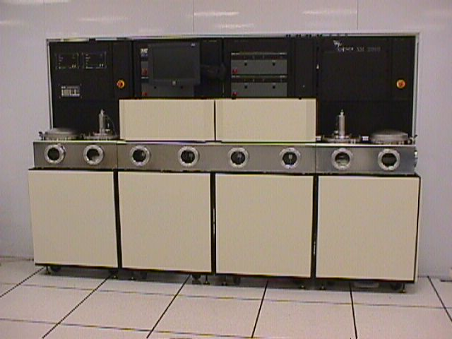
Chambers
XM 90 and XM 2000 use the same chamber and frames
Keeping the mechanical items the same allows for no alignment changes
No new process development needed

Slide 3
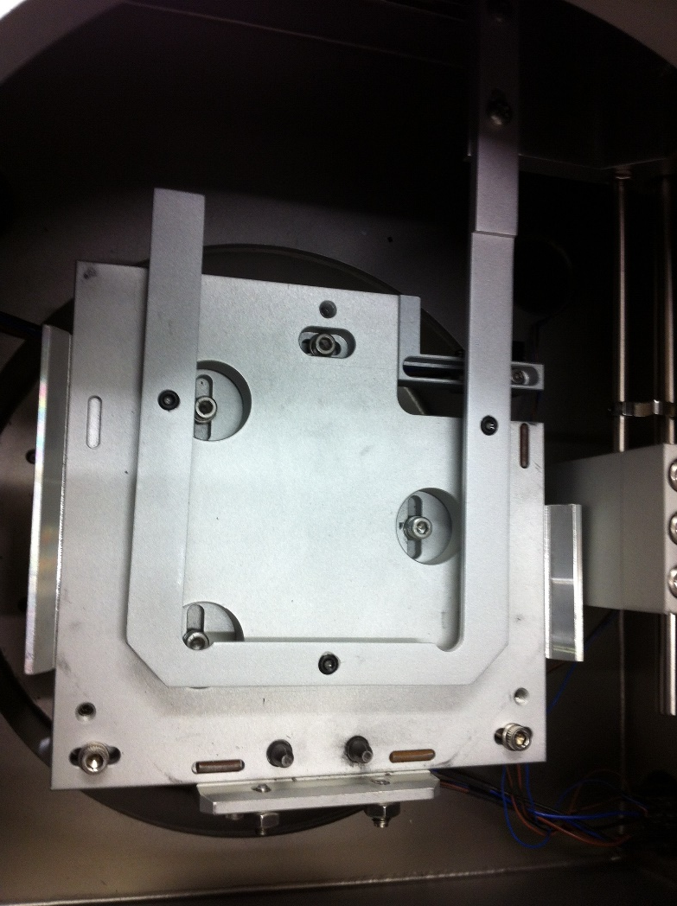
Indexers
XM 90 and XM 2000 use the same indexers
No need to realign for wafer transfer

Slide 4
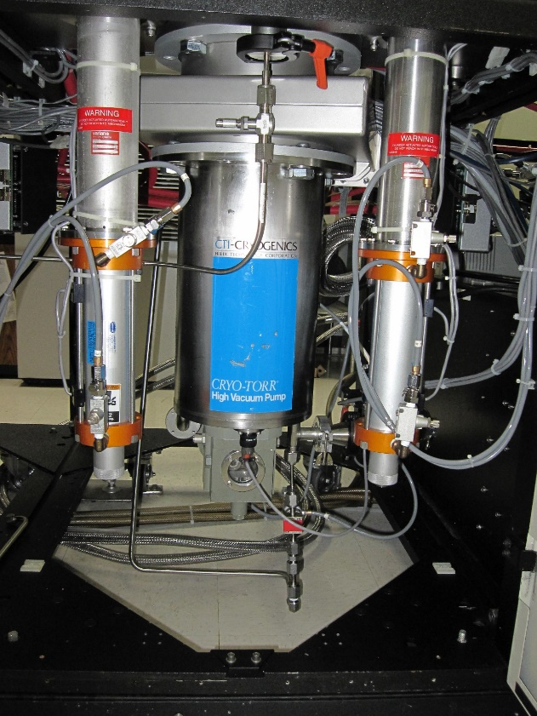
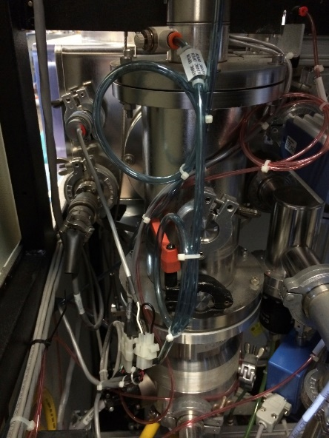
Pumps
XM 90 and XM 2000 use the same Turbos and Cryopump
No change in pumping or vacuum

Slide 5
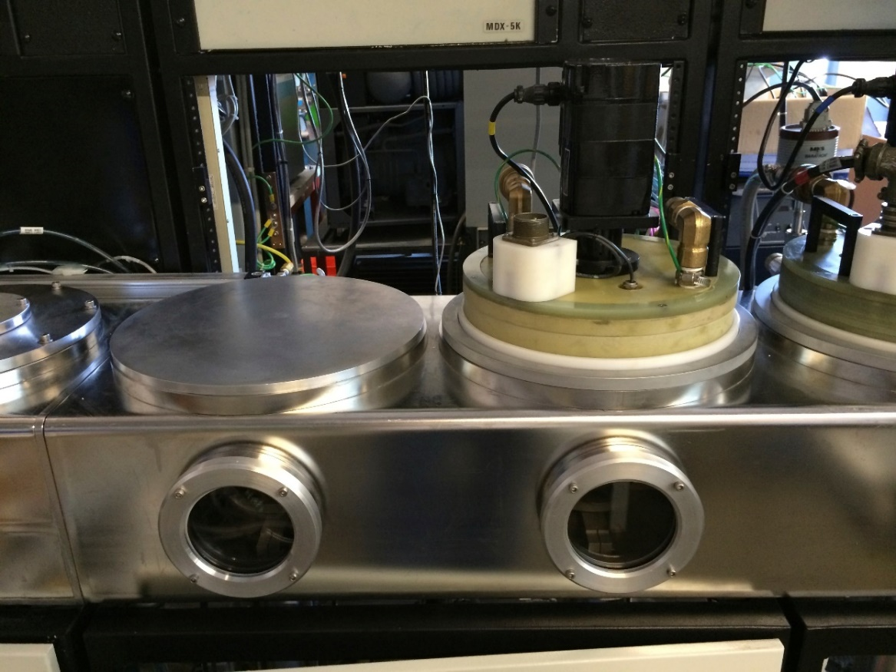
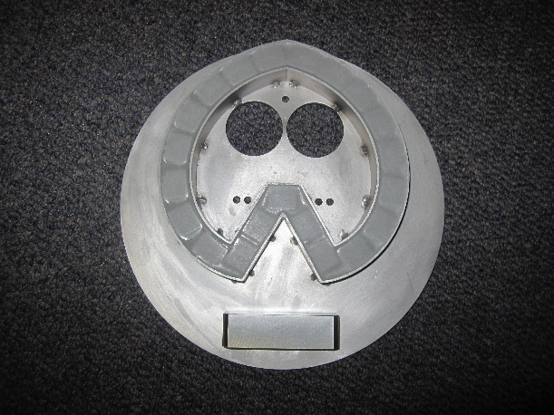
Target Assembly
XM 90 and XM 2000 use the same Target Assy but Tarasemi has new magnet design
Better deposition rates

Slide 6
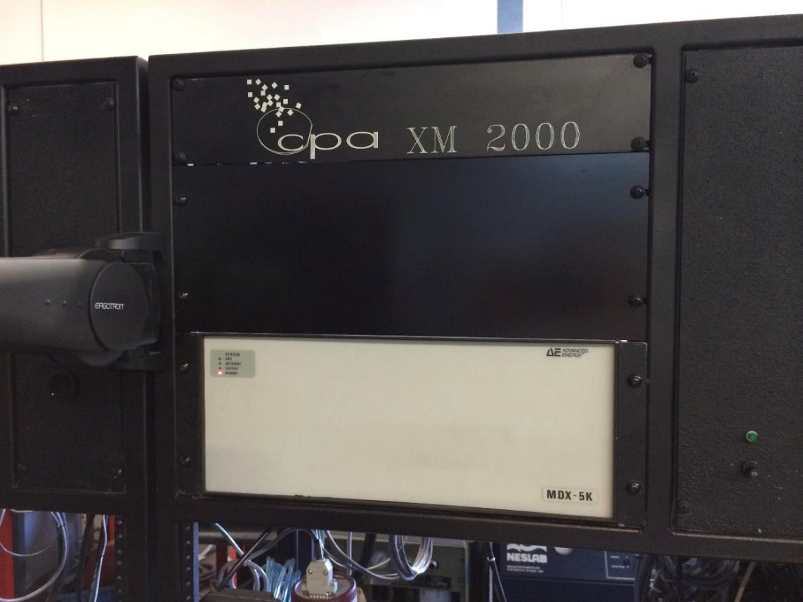
Power Supplies
XM 90 and XM 2000 use the same Power Supplies
No need to change process from current process since output from power supplies does not change

Slide 7
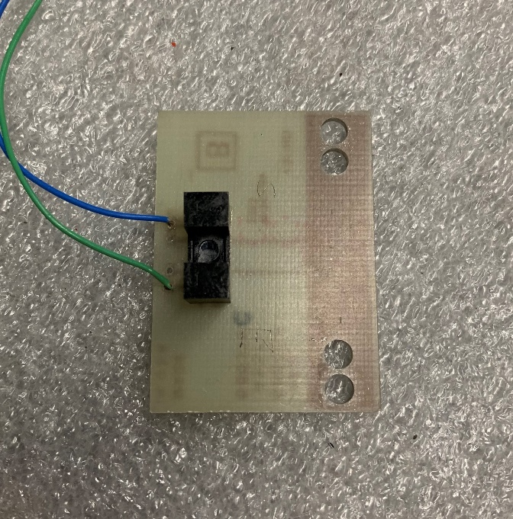
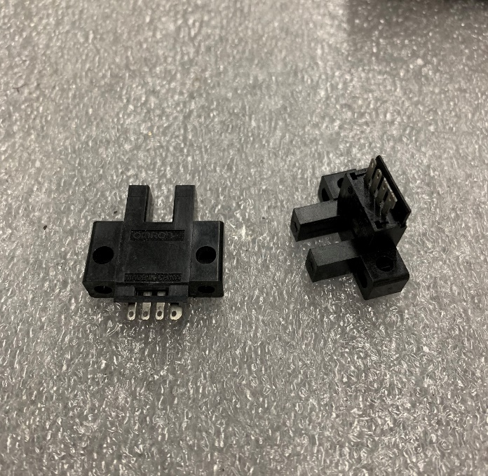
Sensors
Original XM
Old and outdated
New Sensors
Supported

Slide 8
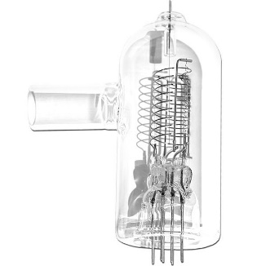
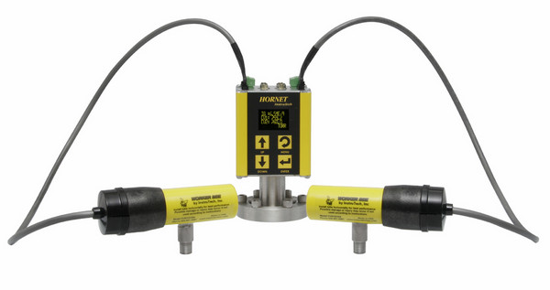
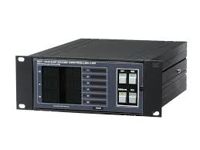
Gauges
Original Granville Phillips
Needs Controller for Comms
New Instrutech
Direct feed to PLC

Slide 9
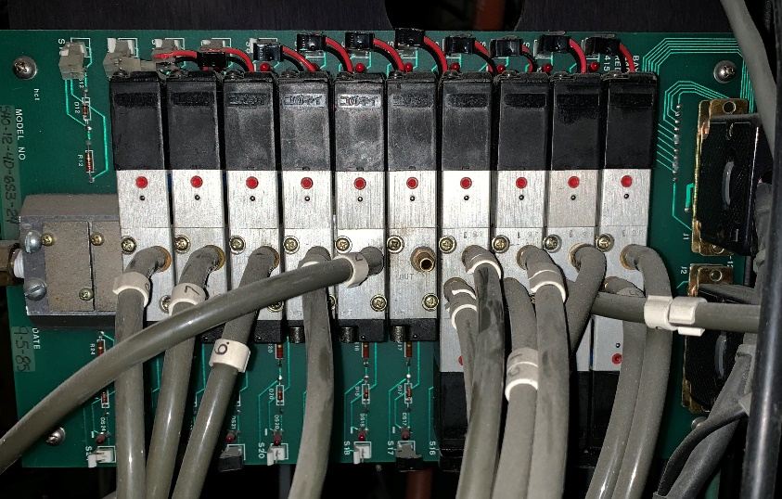
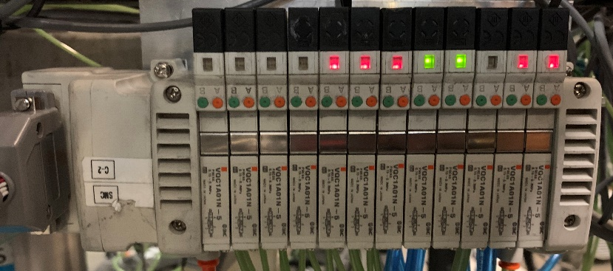
Air Manifold
Original Air Manifold
Mounted on circuit board
Not supported
New Air Manifold
Modular connections
Supported

Slide 10
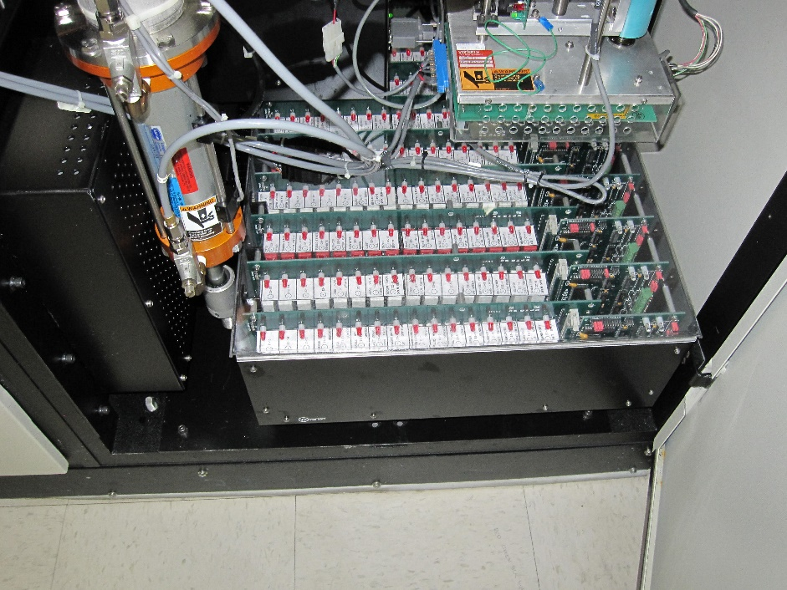
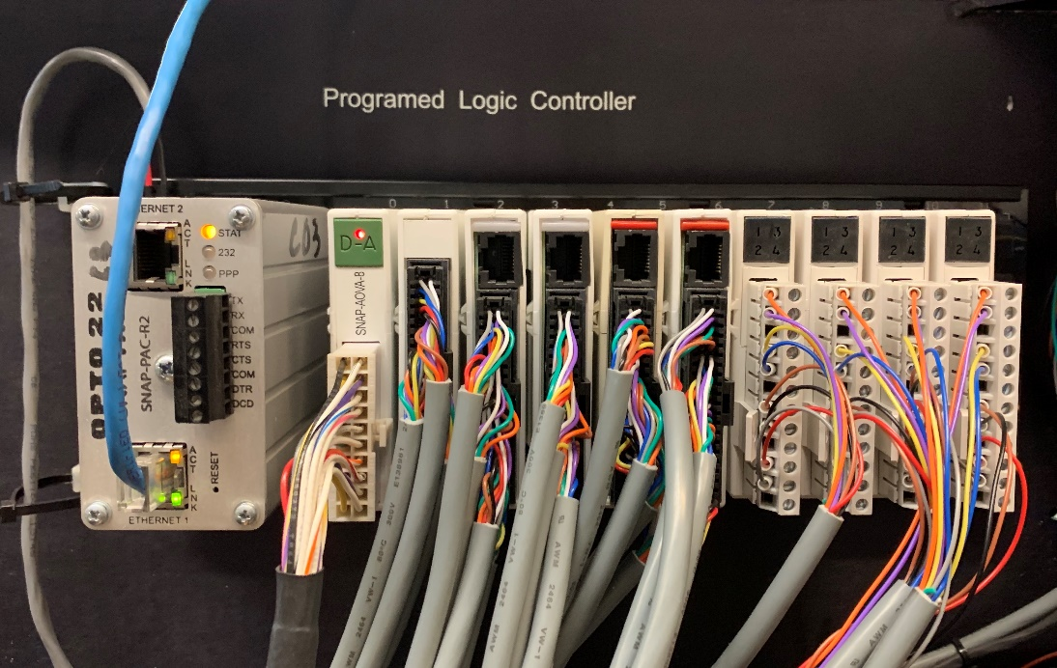
PLC
Original Controls
Outdated and not supported
New PLC
Opto 22 with warranty

Slide 11
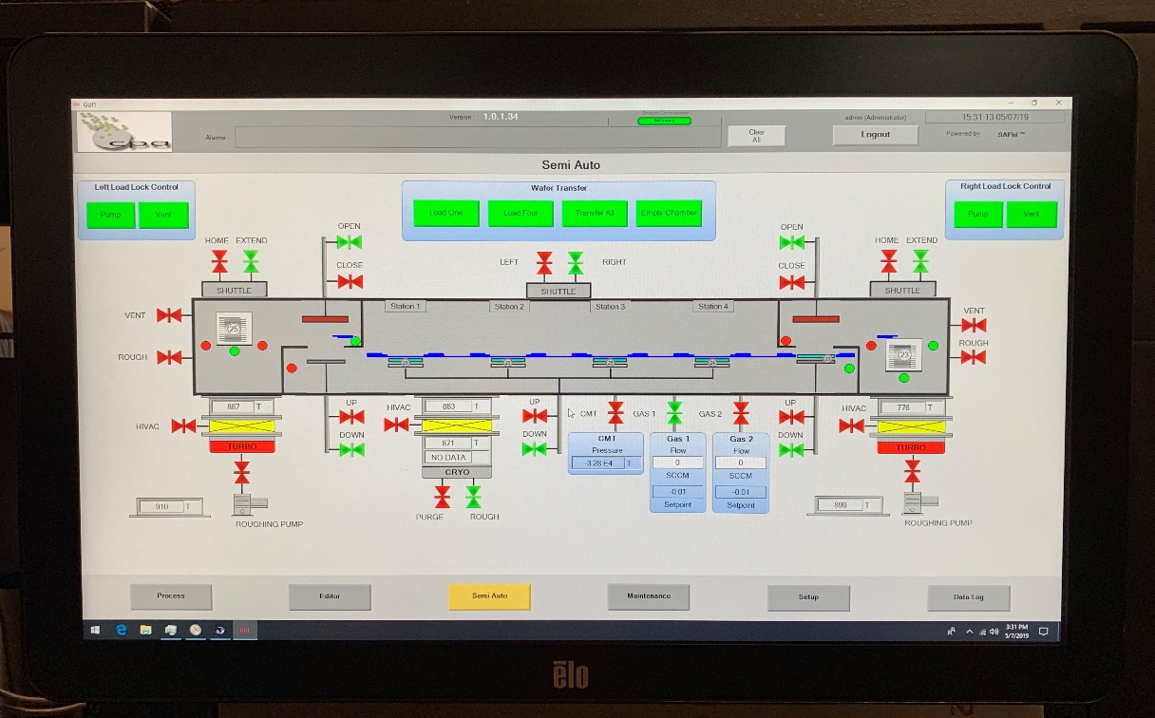
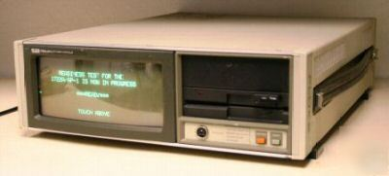
Touchscreen
Original Fluke 1722
Obsolete and not supported
Holds program
New ELO Touchscreen
Supported and display only

Slide 12
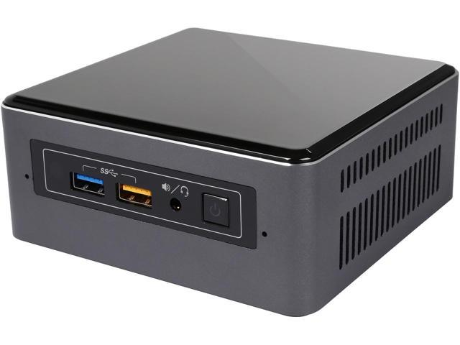
Software
Original Varian
Software was designed in 1989
No way to update
Everything is stored in Fluke
New Tarasemi
Comes with windows 10 on Intel computer
Tarasemi stores backup on cloud
Can be supported and upgraded via internet connection
Increases thru-put
Comes with log in capabilities to limit access
Comes with Auto, Semi auto, maintenance, and I/o screens
Comes with capability of Data logging and network interface

