Slide 1
Bollegraaf HBC80 Baler
Serial number 3076, Year 2013, Hours 47710
Needs partial reline, ram wheels, flap shaft & one pre-press shaft.
Have List of Spare parts
Has minor hydraulic leaks
See prior years oil samples
One owner, in original installation Location.
Buyer responsible for disassembly, removal & transportation.
Asking $85K.

Slide 2
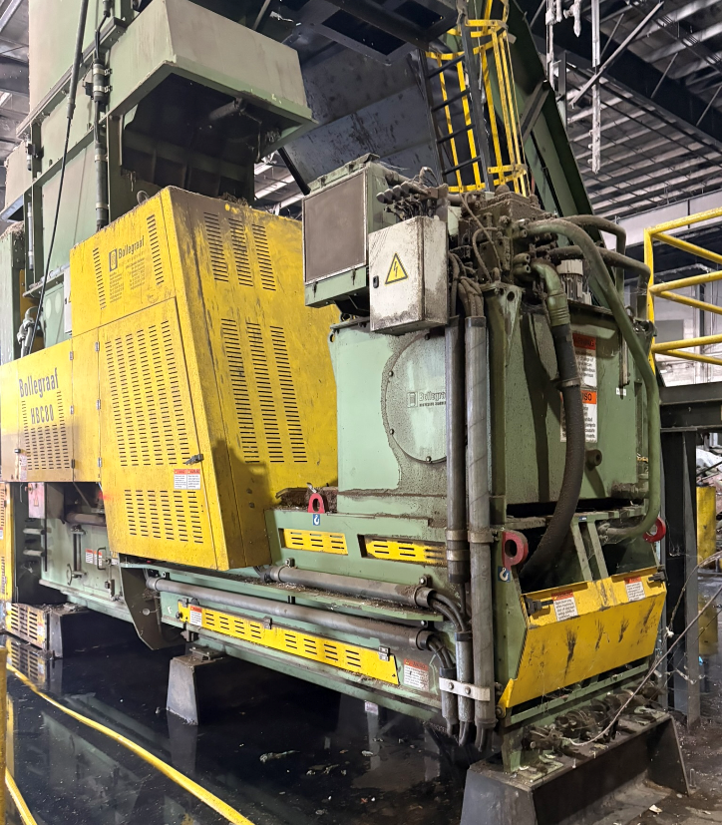

Slide 3
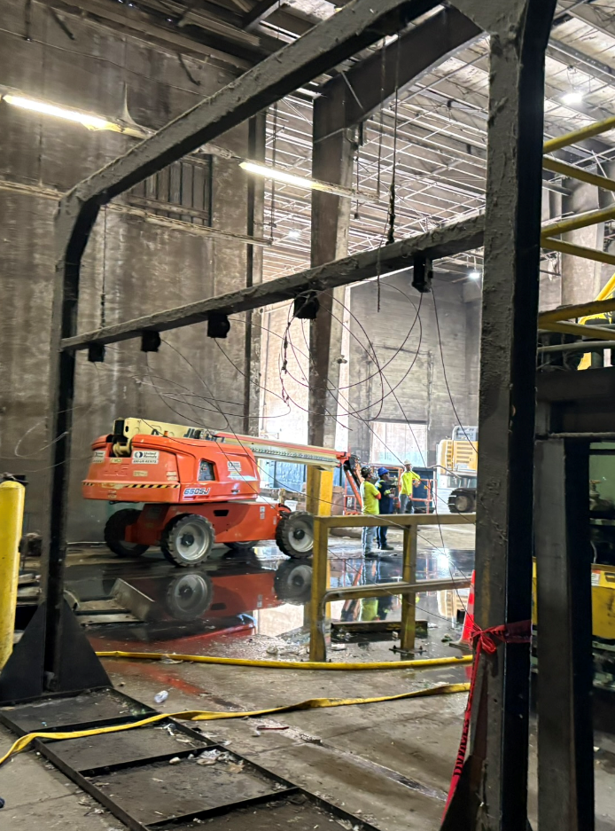

Slide 4
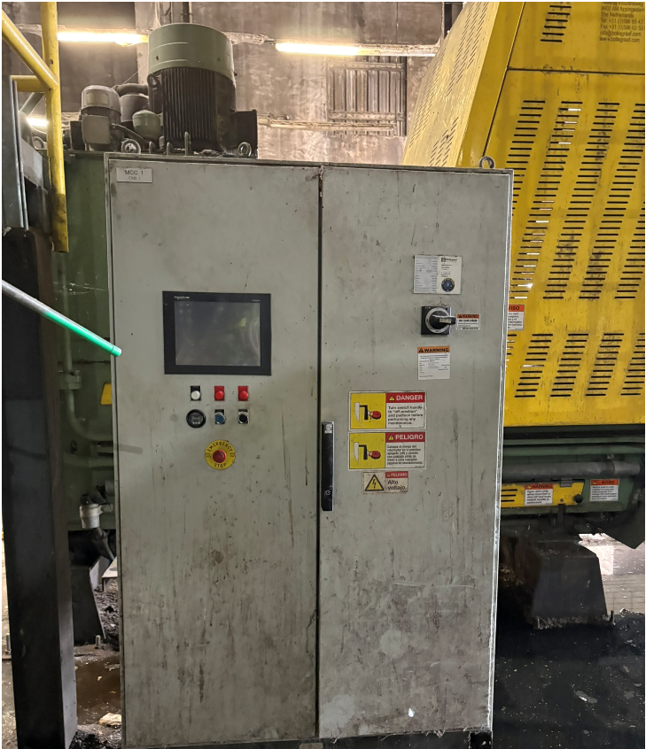

Slide 5
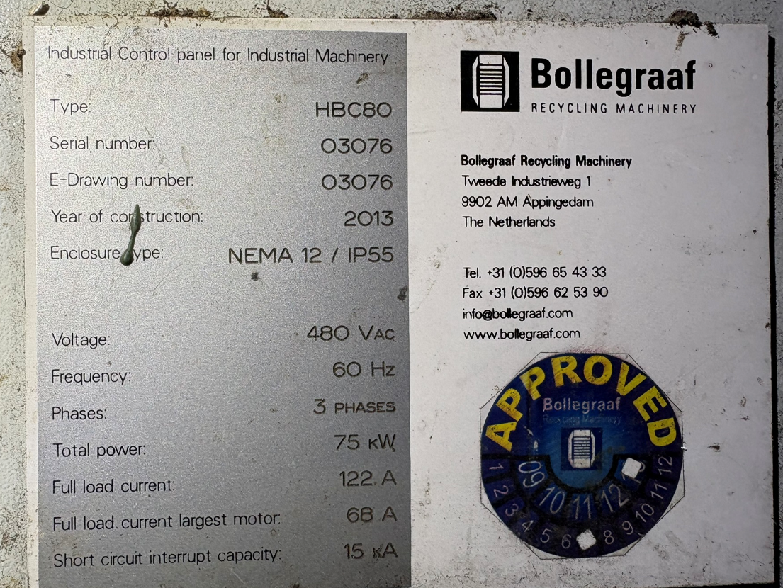

Slide 6
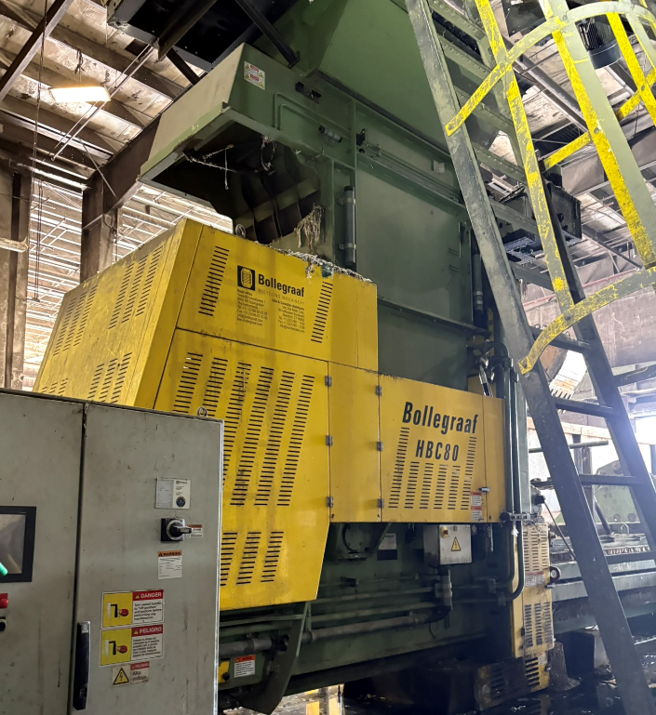

Slide 7
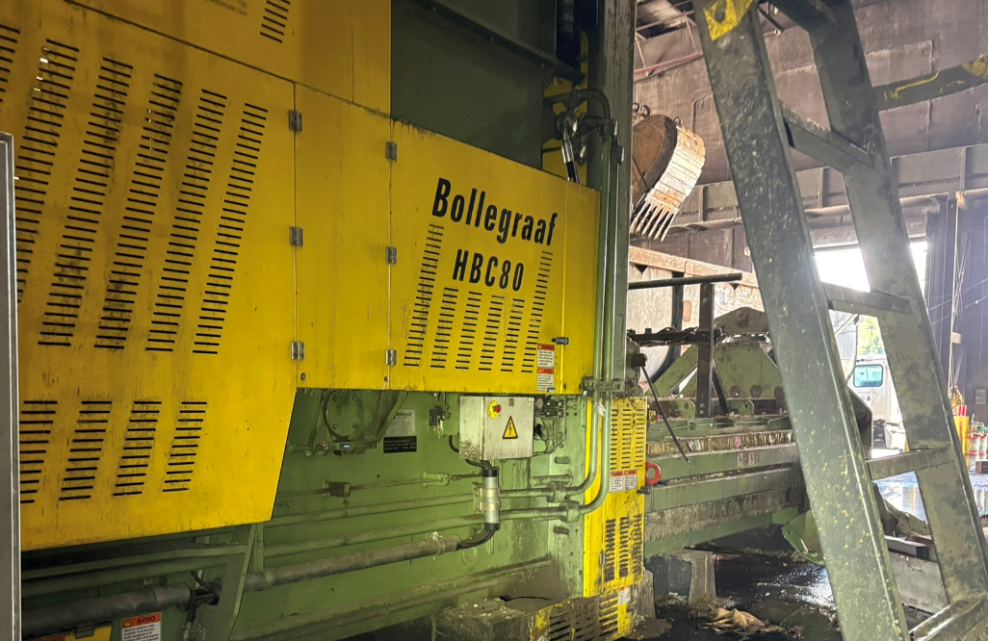

Slide 8
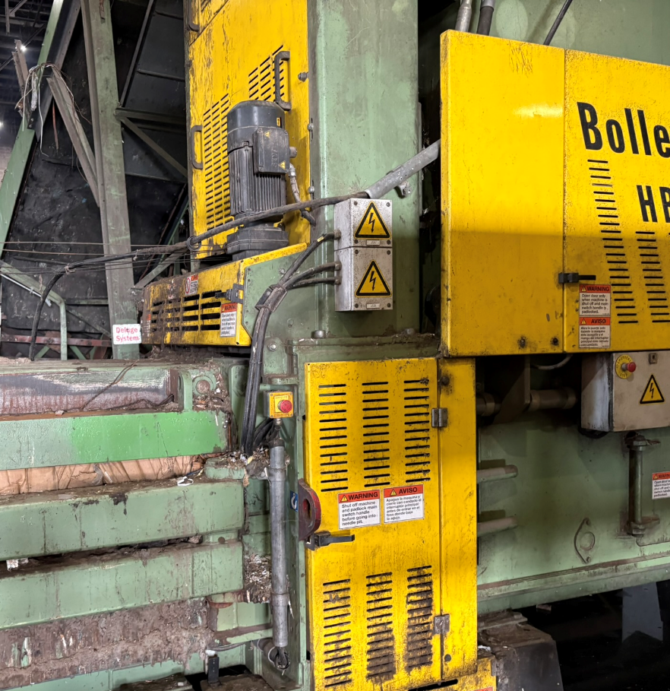

Slide 9
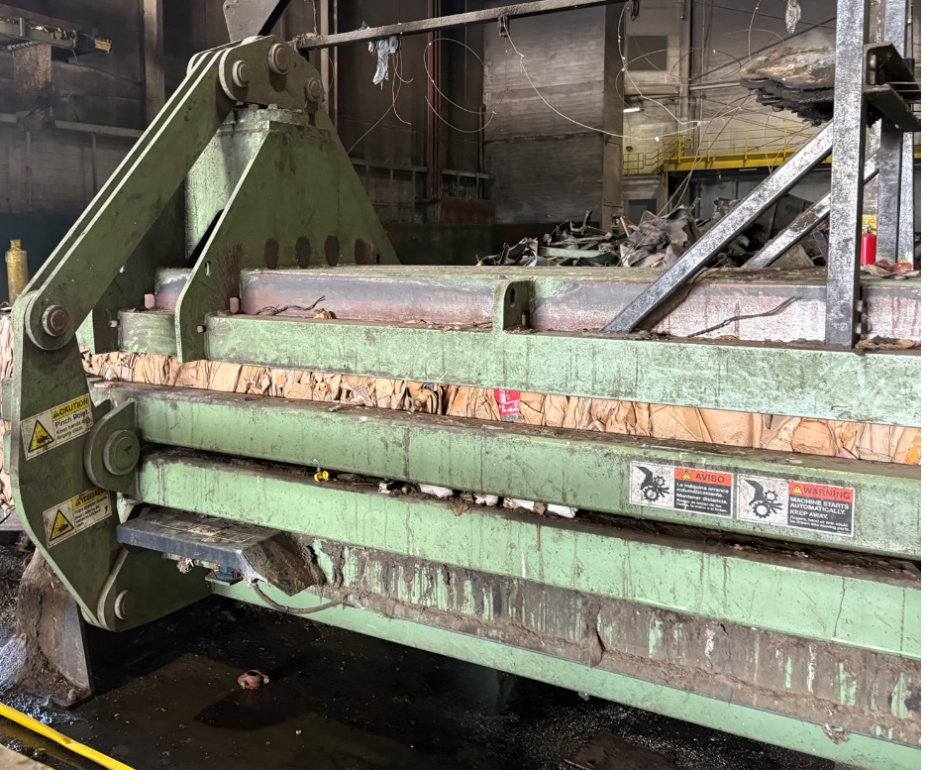

Slide 10
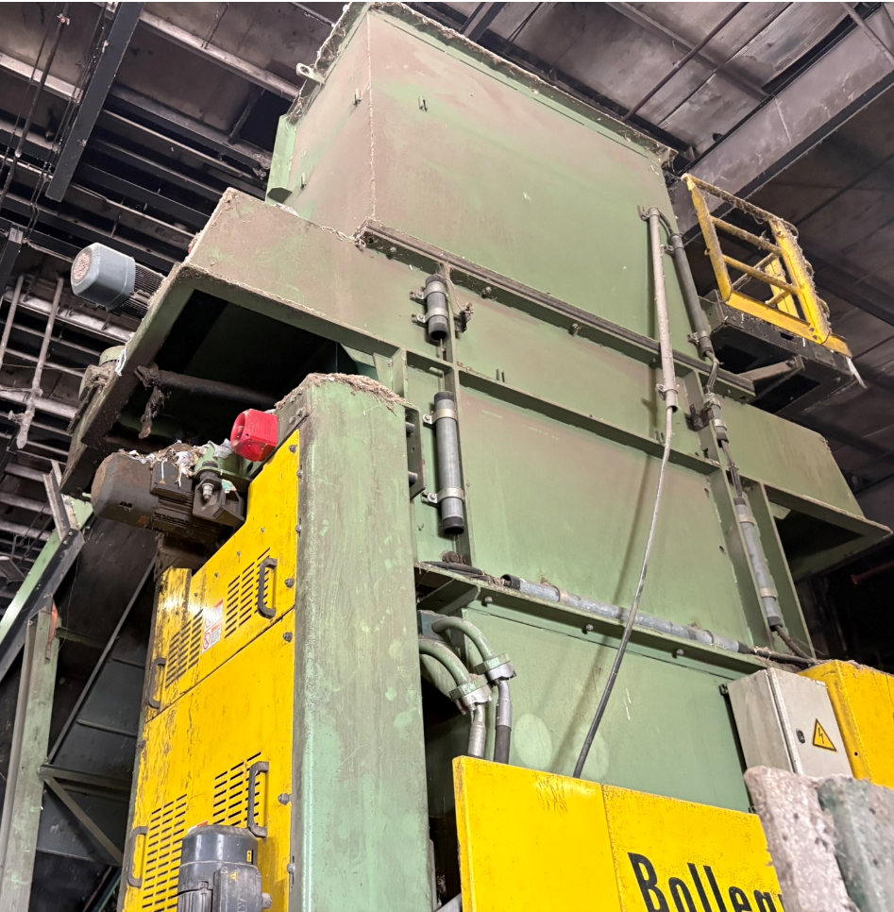

Slide 11
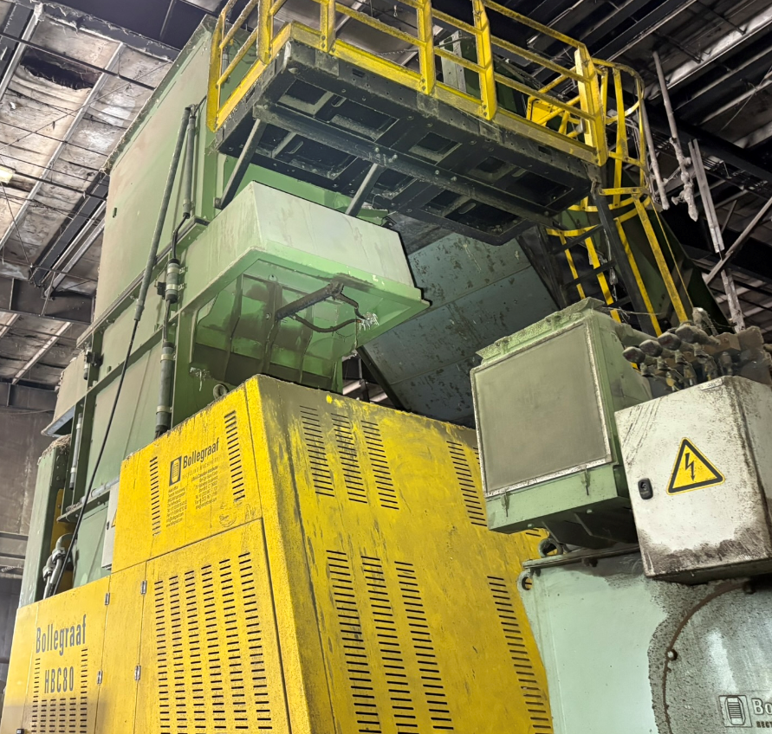

Slide 12
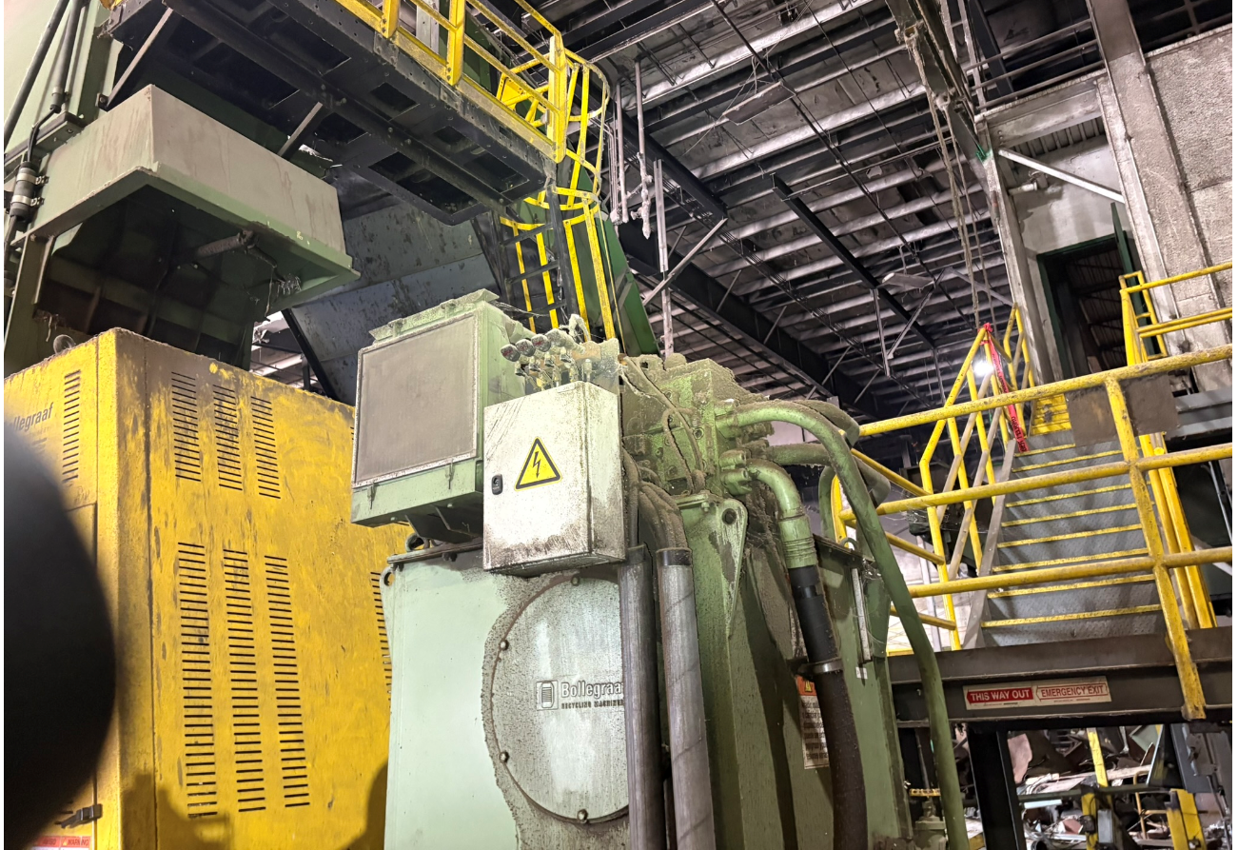

Slide 13
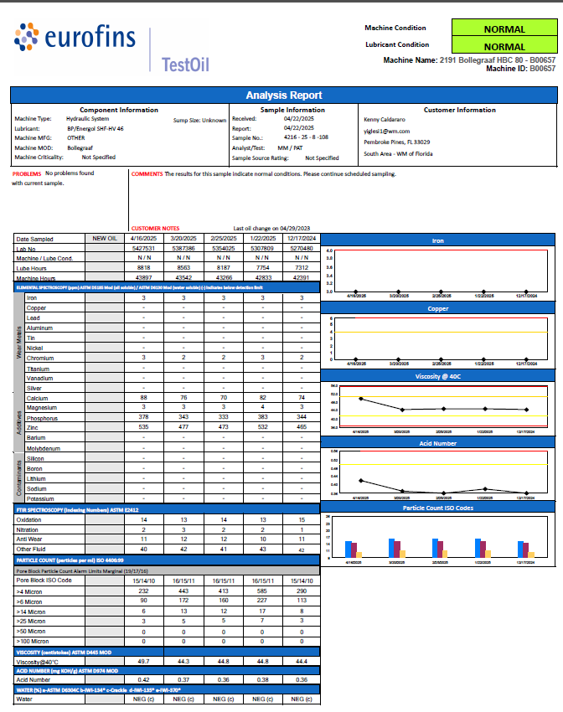


Slide 14
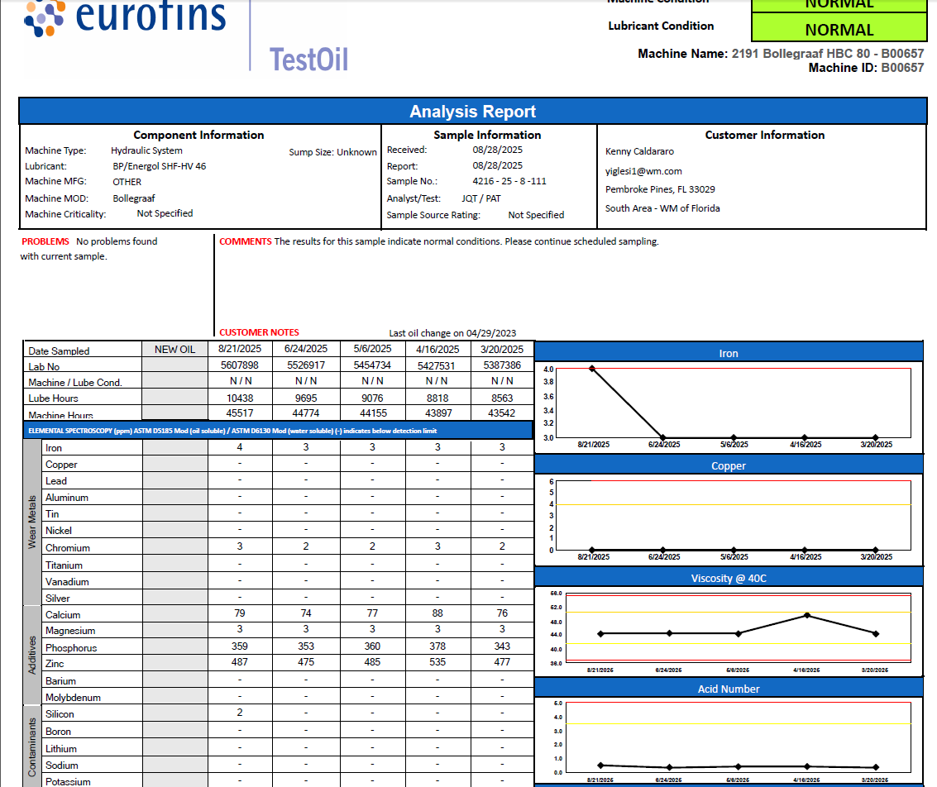


Slide 15
