Slide 1



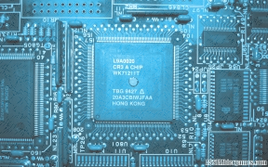
SPEL Semiconductor Limited
Chennai , India
Capabilities Presentation
Nov 3, 2023

Slide 2
Content
About Us
OSAT Services
Turnkey Solutions & Value Added services
Package Portfolio
Bill of Material
Assembly & Test Capability
Road Map
Cost & Communication
Quality
Customers
Team
Logistics
Our USP
Contact

Slide 3
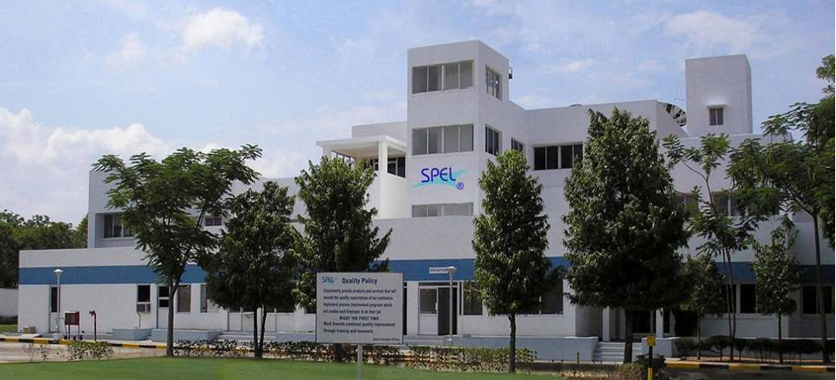
About Us
Valingro is involved in creating companies concentrating on global competitiveness, leveraging global opportunities and acquiring global capabilities
Natronix Semiconductor Technology Private Limited headquartered in Singapore is a member of the Valingro Group
Natronix Semiconductor Technology Private Limited has its OSAT presence in India through its subsidiary SPEL Semiconductor Limited
SPEL is the first IC Assembly & Test facility in India which commenced commercial production in 1989
SPEL has customers covering all major application segments
SPEL is ISO 9001, ISO 14001 & IATF (TS) 16949 Certified and 100% Export Oriented unit.
Natronix-Sg has targeted further acquisitions within OSAT and D&V segments.

Slide 4
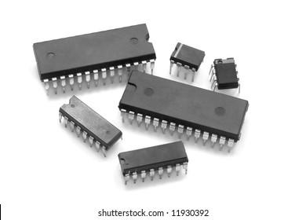
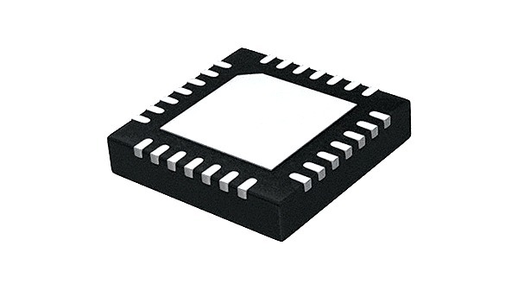
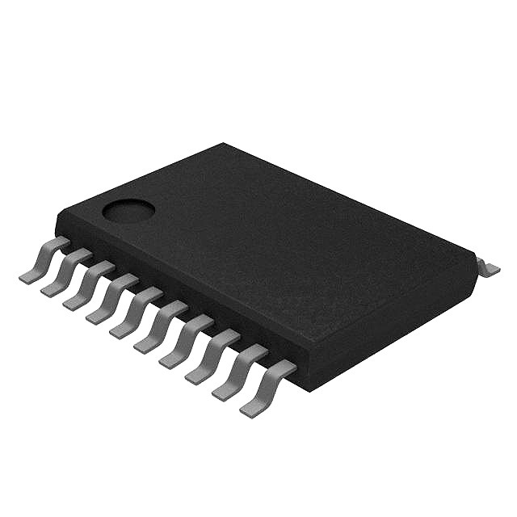
OSAT Services
Full Turnkey Solutions
Assembly
Testing & Packing
Value Added Services
1. Design :
Package design
Lead frame design
2. Assembly :
Tin / Lead plating
Open Cavity Packaging
Wettable Flank in 9 TDFN, 32 QFN, 52 QFN Assembly
Die level Tape and reel process
3. Others :
Failure analysis & Reliability testing
Test Program Development & Product Characterization
Drop shipments across the globe

Slide 5
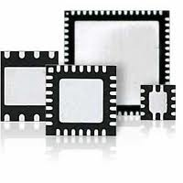
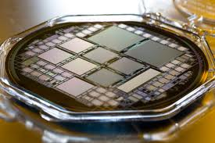
Package Portfolio
Process | Package Thickess | Body Size in mm | Lead-Pitch | Lead-Count
Saw Singulated QFN / DFN | 0.40 mm 0.50 mm 0.75 mm 0.90 mm | 0.6 x 1 to 12 x 12 | 0.40 mm 0.50 mm 0.65 mm | 2 ~ 100 pins
QFN Capability
PACKAGE
150 MIL ; 300 MIL SOIC
150 MIL QSOP ; VSOP
173 MIL TSSOP
300 MIL SSOP
150 MIL MILLIPAQ
300 MIL PDIP
225 MIL SIP
LEAD COUNT
7/8/14/16; 16/20
16/20/24/28; 40/48
8/20/24/38
48/56
80
8/14/16
8
JEDEC STANDARD
MS-012 ; MS-013
MS-137 ; MS-154
MO-153
MO-118
MO-154
MS-001
NA
Leaded
TEST PLATFORM | Credence ASL 1000 | Eagle ETS 364 / 88 | Verigy V50
DIGITAL | ✔ | ✔ | ✔
MIXED SIGNAL | ✔ | ✔ | ✔
ANALOG | ✔ | ✔
Test Platforms

Slide 6
Packages List

Slide 7
Bill of Material
Material | Leaded / QFN / DFN | Supplier
Lead frame | C7025, Olin 194, EFTECH & NiPdAu Pre-plated | DCI (Malaysia), QPL (HK), NKQ (China), Fullriver (China)
Die Attach Epoxy | CRM1076NS | Sumitomo (Singapore)
Screen print Epoxy | Non Conductive 8006 Conductive 8008 | Henkel (Korea)
Gold Wire | 0.8 to 2.0 mil | Tanaka, Heraeus (Singapore)
Bare Copper wire / PdCu wire | 0.8 to 2.0 mil | Tanaka (Singapore), Heraeus (Malaysia)
Mold Compound | G600, G633 & G770Series | Sumitomo (Singapore)

Slide 8
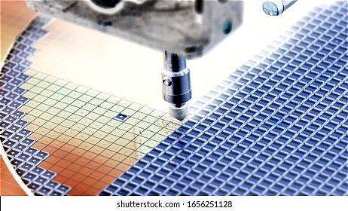
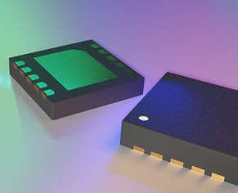
Technical Capabilities
Minimum die size : 10 Mils square
12” wafer assembly capability
Epoxy screen print capability
Apart from Gold wire Copper wire bonding (Bare Cu & Pd Coated) – 0.8 mil to 2.0 mil
Bond Pad Pitch : 40 microns
Low loop bonding : 4 mils
Ultra Thin packages : 0.4mm
Wafer mapping at Die Attach
Multi-die package assembly
Multi-site Test capability

Slide 9
Capacity
Package Category | Capacity / Month (Mln Units) | Remarks
Leaded | 1.7 | Twenty Lead Equivalent
QFN / DFN | 3.3 | Three Sq.MM Equivalent
32% of the Total Capacity is available for Copper Bonding
100 % power backup

Slide 10
Test Capability
PLLs & VCOs
Logic
Power Products
Clock Buffers
Industrial Analog
IPDs
Clock Drivers

Slide 11
ATE & Handlers
Sl. # | Equipment | Manufacturer | Model
1 | Testers | Teradyne | ETS364/ETS88
 |  | Credence | ASL1000
 |  | MCT | 2010, 2020
2 | Handlers | Micro Comp Tech | MCT 3608E, 5105
 |  | Micro Handling Corp | MH240, 245
 |  | Tesec Mapper | 3270-IH
 |  | Multitest | 8704, 9710 & 9928
 |  | SRM | XD248, XD244

Slide 12
Reliability Test
Sl # | Reliability Test | Test Specifications | Jedec Standard
1 | Burn-in Test | 125°C, 1000 Hrs | JESD22-A108
2 | Unbiased Temperature & Humidity | 85°C, 85% RH, 1000 Hrs | JESD22-A101
3 | Temperature Cycling Test | -65°C to 150°C, 500 cycles | JESD22-A104
4 | High Temperature Storage Life Test | 150°C, 1000 Hrs | JESD22-A103
5 | Unbiased HAST (UHAST) | 130°C , 85% RH, 96 Hrs | JESD22-A118
6 | Autoclave Test | 100% RH, 121°C, 96 Hrs | JESD22-A102
7 | Preconditioning & MSL Tests | - | JESD22-A113 & JESD-020
8 | Drop Test | - | JESD22-B111

Slide 13
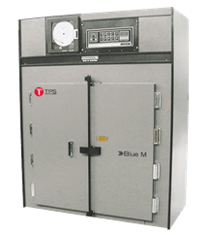
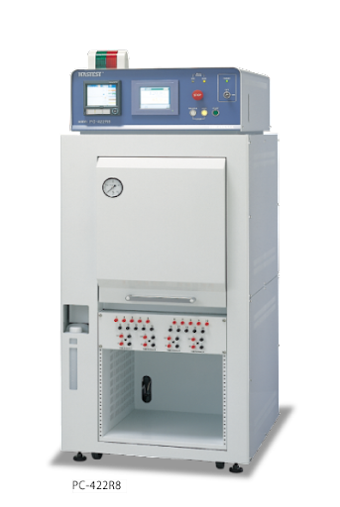
Reliability Equipment
Sl # | Reliability Equipment | Manufacturer
1 | Burn-in | Blue-M, USA
2 | Temperature & Humidity | Blue-M, USA
3 | Temperature Cycler | ESPEC, Japan
4 | Dry Heat (Class 100) Oven | Lab line, USA
5 | HAST | Hirayama, Japan
6 | Autoclave | Hirayama, Japan
7 | Solder Pot | HMP, USA
8 | Reflow Oven | Heller, USA
9 | Drop Test | Avex, USA

Slide 14
FA Equipment
Sl # | Equipment | Manufacturer
1 | LCR Meter | HP, USA
2 | Data Acquisition Unit | HP, USA
3 | RF MUX | HP, USA
4 | 40 Channel MUX | HP, USA
5 | V/I Source Meter | Keithley, USA
6 | Oscilloscope | Keithley, USA
7 | Pulse Generator | HP, Singapore

Slide 15
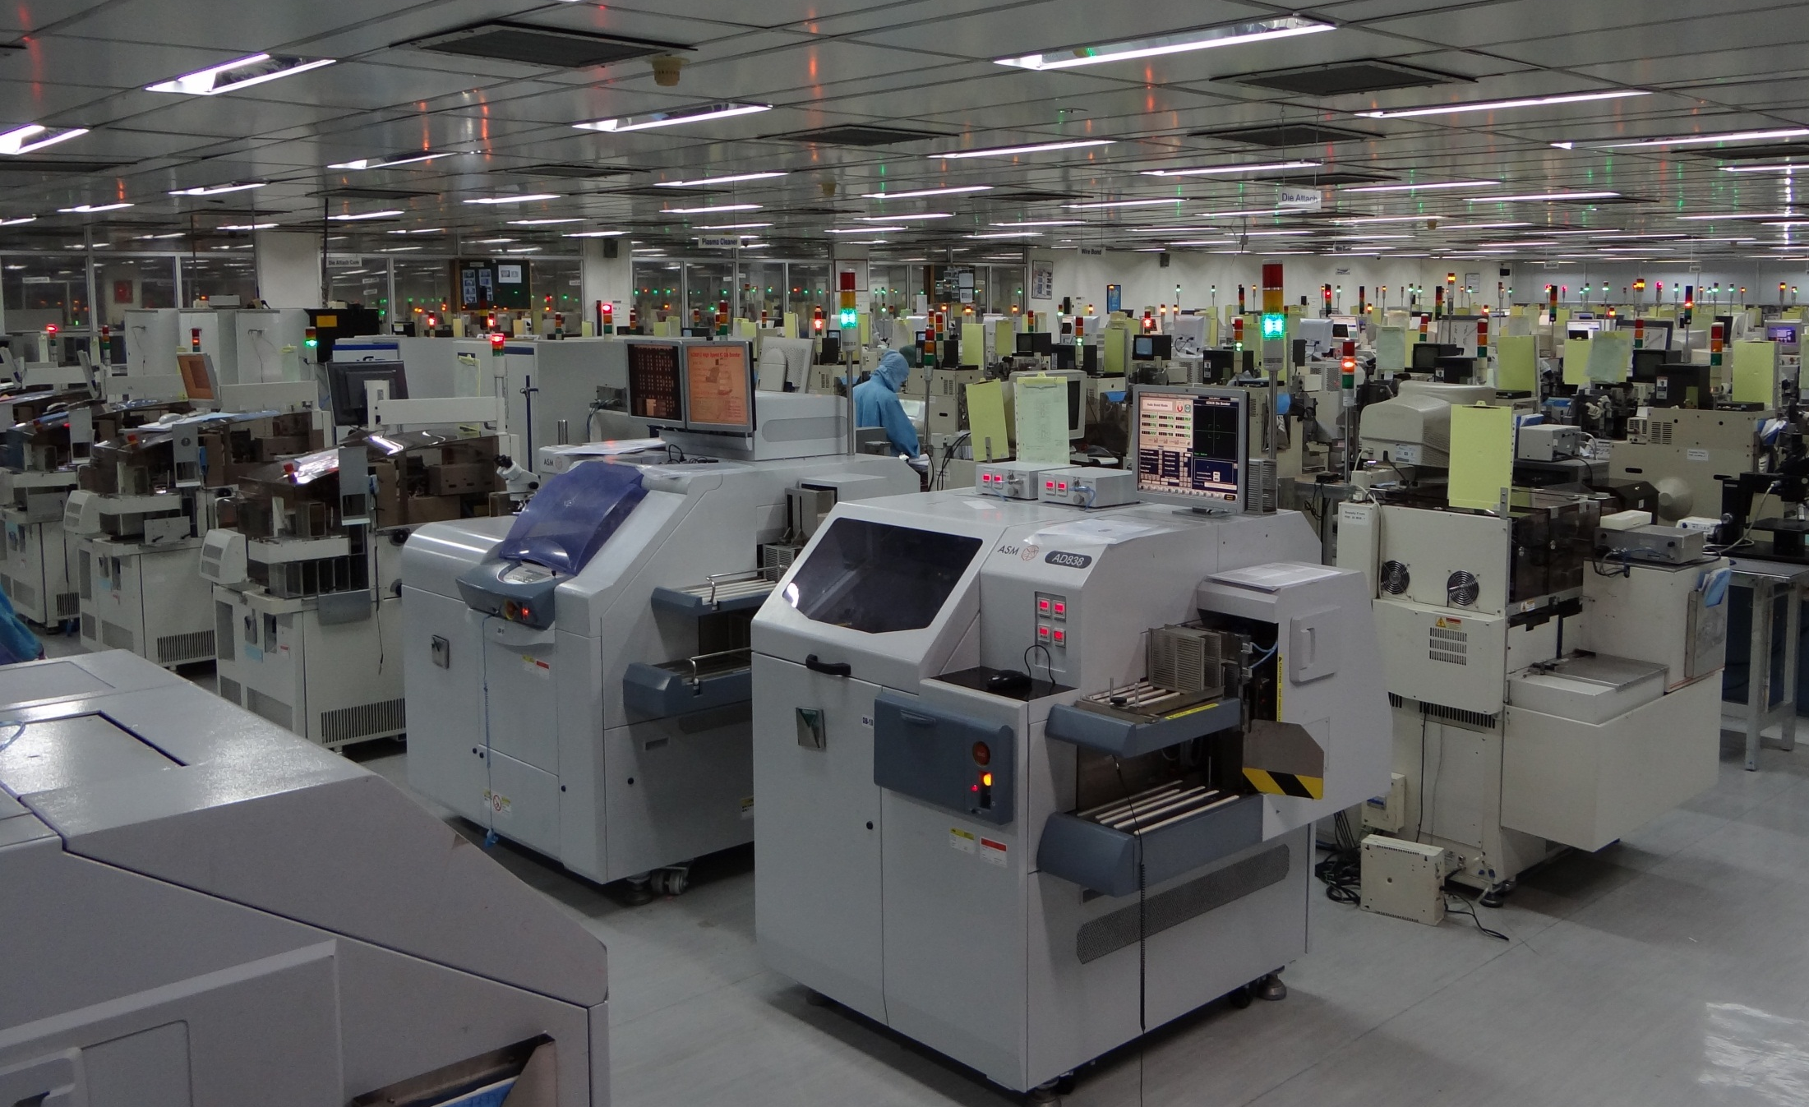
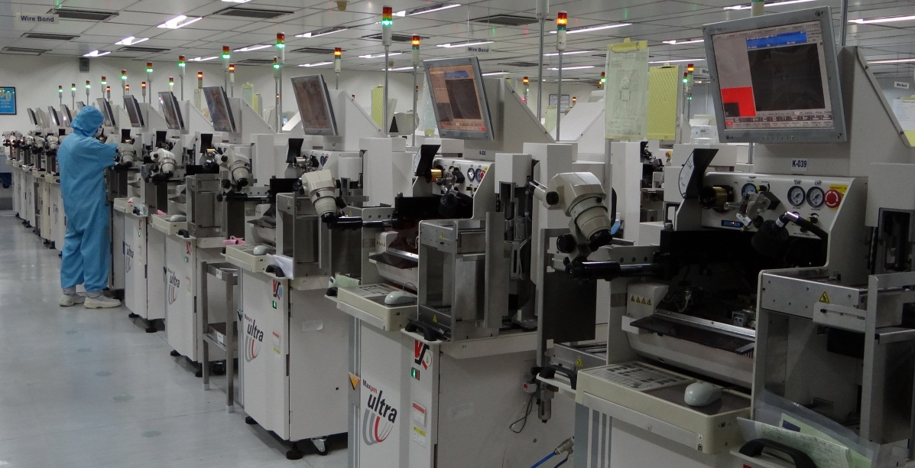
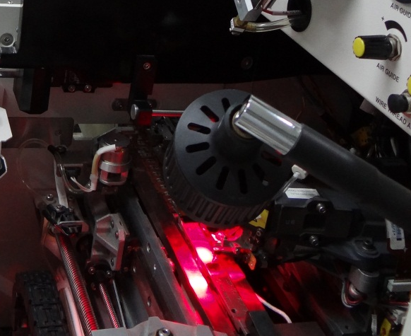
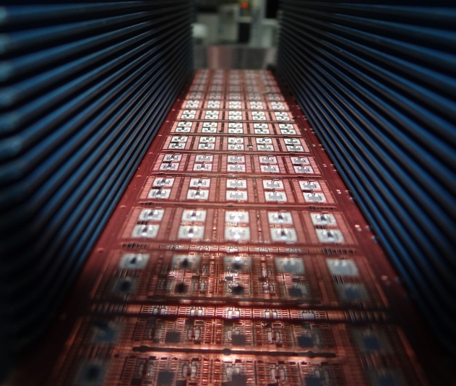
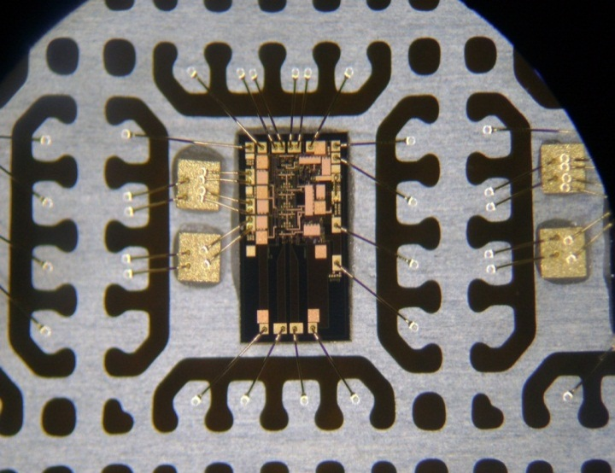
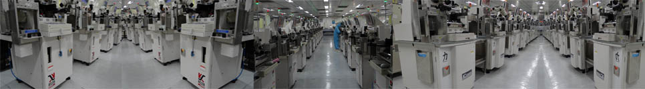
Site Area 362.854 K Sq Ft
Built Up Area 92,191 Sq Ft

Slide 16
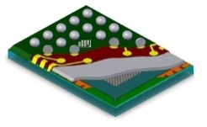
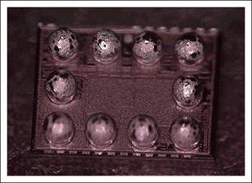
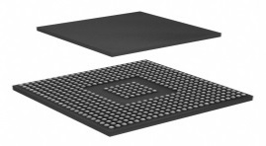
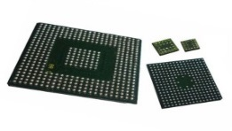
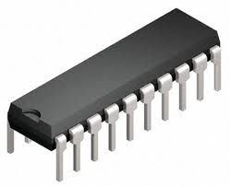
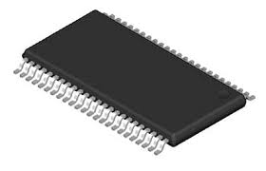
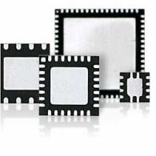


Package Roadmap
Planned
“2024-25”
WLCSP
WLCSP
BGA
Existing
CU
Leaded Package
QFN / DFN
Notes:
1/6/2024 1:07 PM
© 2006 Microsoft Corporation. All rights reserved.
This presentation is for informational purposes only. Microsoft makes no warranties, express or implied, in this summary.
16
1/6/2024 1:07 PM
© 2006 Microsoft Corporation. All rights reserved.
This presentation is for informational purposes only. Microsoft makes no warranties, express or implied, in this summary.
16

Slide 17

Cost Competitive
Packaging Cost
Substantial Cost Savings
Low Cost for new package development in QFN / DFN
Attractive amortization proposals for new package tooling
Test Cost
Low Development Charges – Onsite or Offshore
Low Production Costs
Attractive pricing for the consigned testers

Slide 18
Quality Policy
Consistently provide products and services that will
exceed the quality expectations of our Customers.
Implement process improvement programs which will enable each Employee to do their job
Right the first time.
Work towards continual quality improvement through training and teamwork
Quality methodologies are guided by International standards
Quality endeavour is to deliver best in high-class, defect-free solutions and services
Standardizing development activities to align with Customers requirements
Process robustness are built through ISO 9001:2015 standards accreditation
Zero Customer Return
Continuous Improvements through Industry Benchmarking
Effectively Implement PPAP, APQP, MSA, SPC & FMEA to ensure Outgoing Product Quality

Slide 19








































Customers

Slide 20








Customer Audits
End Customers
Customers

Slide 21

Manpower
Technically qualified operators & technicians
Skilled engineers & experienced Management
With total manpower of 160+ Employees
Low attrition rate (< 6%). Developed second-in-line in all functions starting from Supervisor level
Strong engineering database ensures that any attrition will not affect any process
Over 40% of the employees have over 15 years of service with SPEL
Low direct labor cost & management provides various Employee welfare schemes as a motivational activity through Employee Welfare Committee
Training cell providing comprehensive training (including soft skill & Customer focus) to all level at regular interval & conducts test to ensure the capability
Talent pool available from Local universities with electronics/semiconductor background

Slide 22
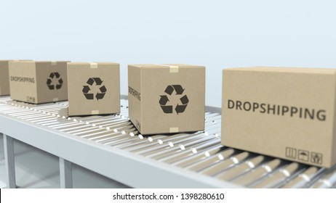

Logistics
One Stop Turnkey Destination :
Probe → B/G → Assembly → Test → T&R → Drop shipment
Turnaround time
Assembly 5 days with Linear Loading
Testing : 2 days
Fast Track Assembly in 2 days with Premium Charge
Factory Schedule : 24 x 7
Drop Ship to End-Customers
Daily Direct Flights to US, Europe & Asia Pacific :
2days Transit (Inbound / Outbound)
STAR eWIP - an online Semiconductor Tracking And Resourcing Software for
regular Customer WIP update

Slide 23
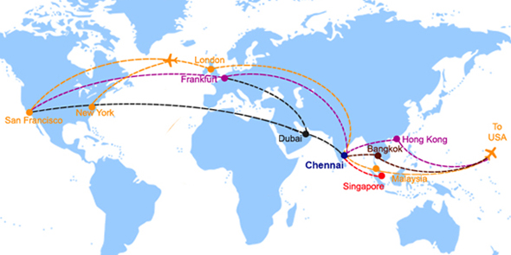
Connectivity

Slide 24

Quick Clearance
SPEL is awarded AEO (Authorized Economic Operator) Certificate by Central Board of Excise & Customs
Green Channel Status for Imports & Exports
Zero Customs Duty & No Open Inspection
Our Own Custom clearance office in Airport premises
Clearance within 6 Working hrs.
Easy Equipment Consignment In & Out of factory
Certified as Star Export house by Ministry of Commerce & Industry, Govt. of India
Accredited Client Programme (ACP) status from Board of Excise & Customs enables faster clearance

Slide 25
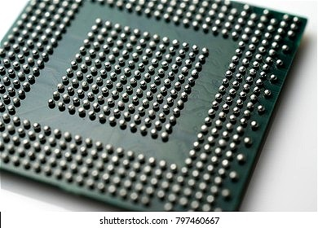
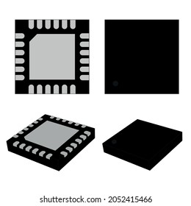
Recent Developments
Adding few more QFN packages with minimum sizes
Qualified for Silver bonding
Packaged die to die bonding & PCB bonding for domestic Customers
Pursuing to acquire assembly houses for BGA & WLCSP packages
Increasing Cu volume to 32% and plan to improve further
Added Wettable Flank packages for better solderability

Slide 26
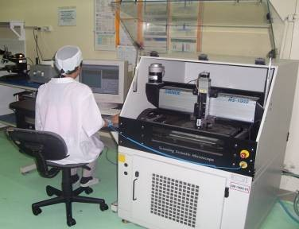
Failure Analysis Capability
Internal / external inspection
High / low power microscope
X-RAY
SOFTEX 100
Decapsulation
DECAP AS2000
Autoclave
NAPCO 8110-TD test chamber
Open / short test
TEXTRONICS curve tracer
85% / 85oC moisture soak
ENVIRO SYSTEM chamber
Temperature cycle
ENVIRO SYSTEM chamber
Polisher / grinder
SBT–MODEL 900

Slide 27
Final Test Summary
Integrated test and TNR handlers
SRM S248 – SOT
SRM XD16 – SOT
SRM S12 – SOT
VECTOR T20 – SOT
QMT 1500 – SOT
SRM 248XS – TDFN
ASM FT2030 FLEXIPACK – SOIC
SRM 244XS – SOIC
ISMECA –NX16 – DFN ( 0402)
Test handlers (SOIC/PDIP)
MCT 3608/5100
MT 8305/8588/8704
AETRIUM 2020 DTS
TNR handlers (SOIC)
G6 Visdynamics
Systemation TO 485 with 3D vision
STI 8028 / ST 60

Slide 28

Our USP
Excellent Value proposition
Low cost Turnkey services
Provides one stop solution for all QFN & Leaded packages
Excellent Customer service
Dedicated Customer account engineers. Interacting on daily basis with Customers in real time basis. No need of any resident engineer for any of the Customer
Package Portfolio covering major application segments
Has test platforms for all products
New package development and prototype assembly
Has talented team to provide solutions
Test engineering support
Developing test programs for all needs
On-Time delivery
Potential market growth in India
Govt’s policy initiations, Incentive schemes, Encouraging indigenous manufacturing, Consumer consumptions growth etc.

