Slide 1

TESCAN Ga FIB
24.05.2024

Slide 2

About TESCAN
24.05.2024

Slide 3
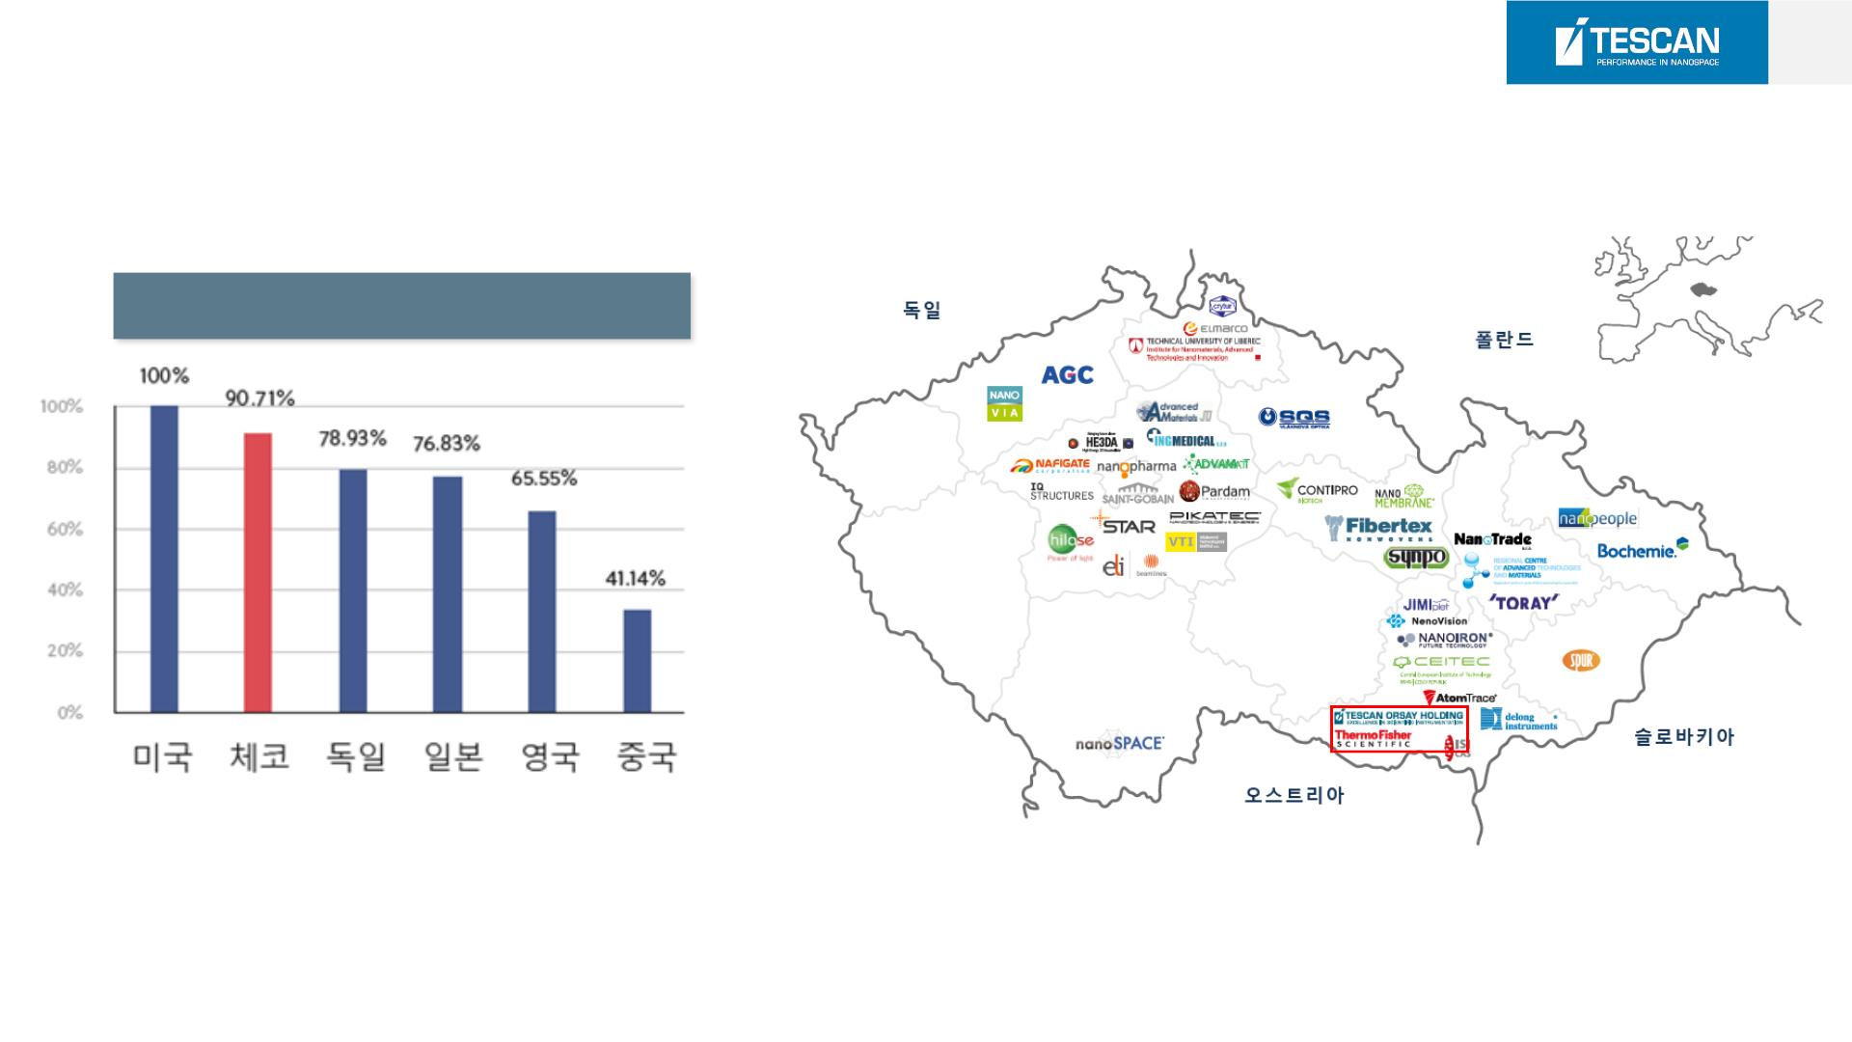
3
TESCAN's History
Number of patents for nanotechnology
※ 연구개발 화학, 바이오 의약, 반도체, 전자기기 ICT 분야에서 기술특화지수

Slide 4
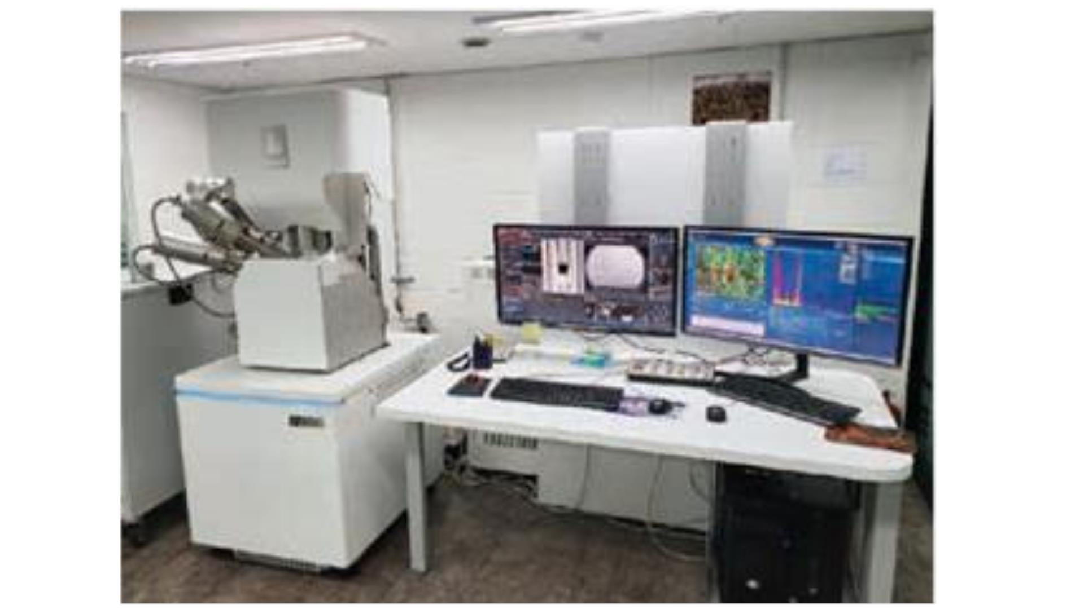
4
FIB Ga-FIB S 9000G Demo equipment

Slide 5

S9000G Features
24.05.2024

Slide 6
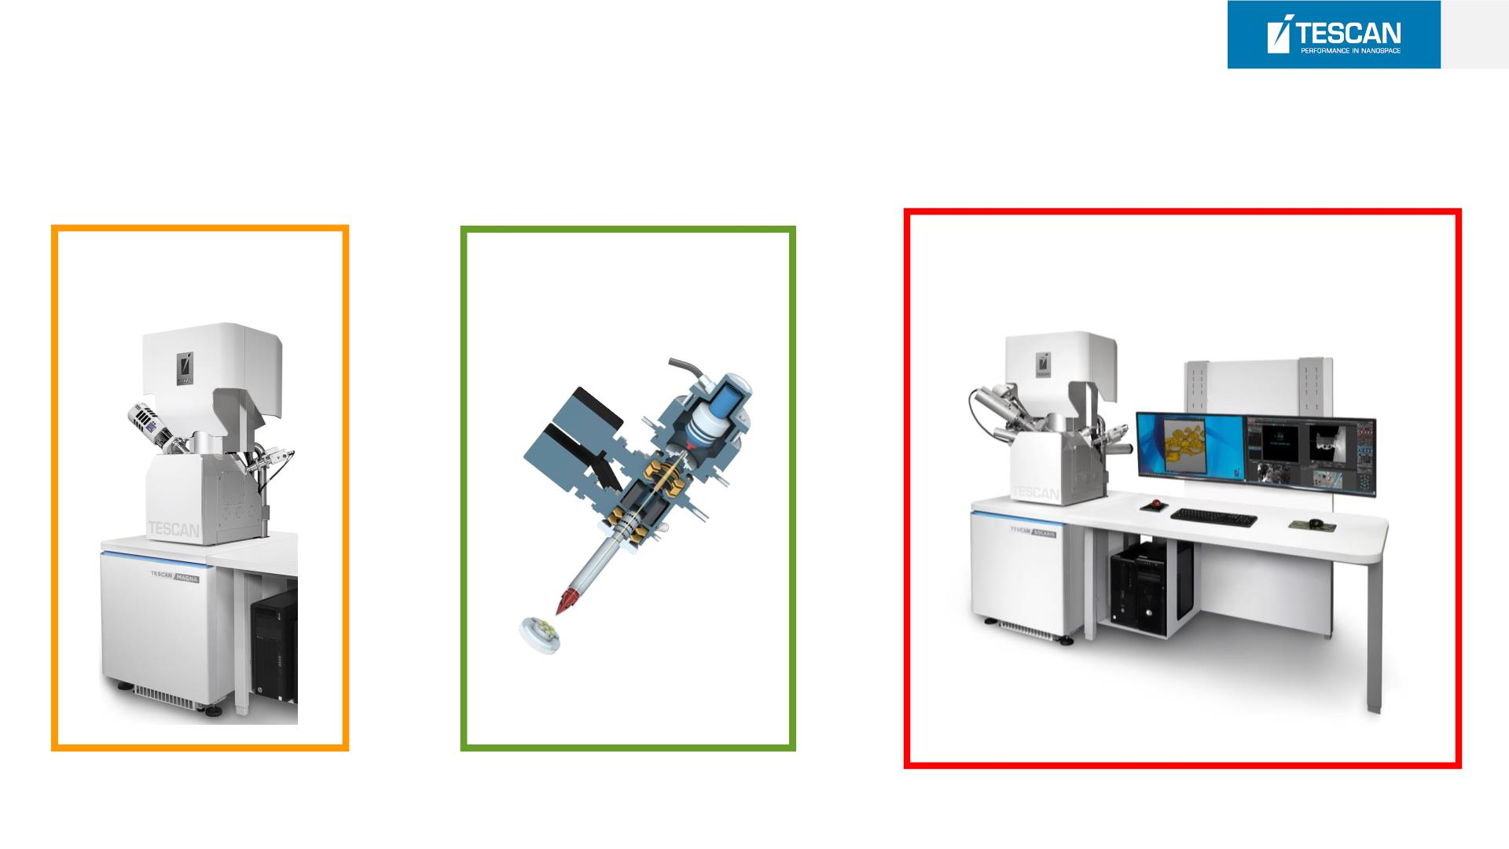
8
S 9000G
MAGNA SEM
S9000G FIB-SEM
OrageTM FIB
+ =

Slide 7
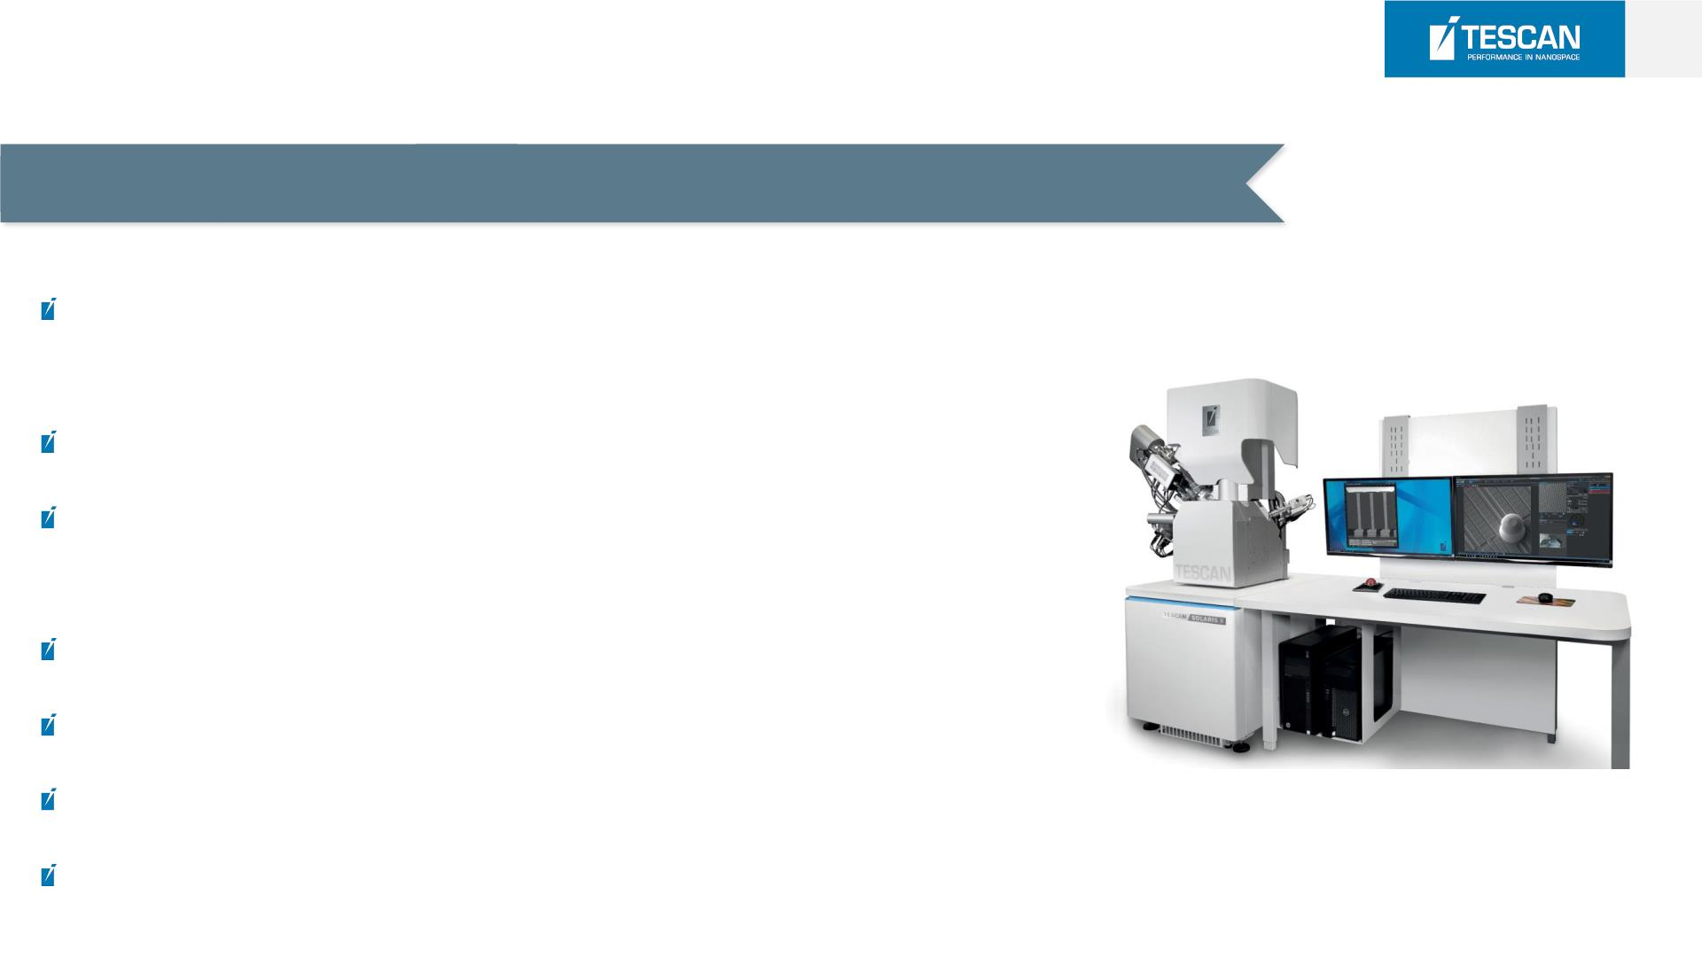
9
S 9000G
Solution for semi-automated high-quality TEM lamella preparation
Best resolution Ga+ FIB column for prototyping and fabrication of
nanostructures and functional devices
Crossover-free ultra-high resolution SEM imaging
UHR immersion optics for the best imaging performance at the FIB and
SEM beams coincidence point
High precision nanopatterning engine for both electron and ion beam
Multiple gas injection system options with a variety of precursor gases
Chamber extension options for up to 12“ wafer inspection
Easy-to-use modular software user interface

Slide 8
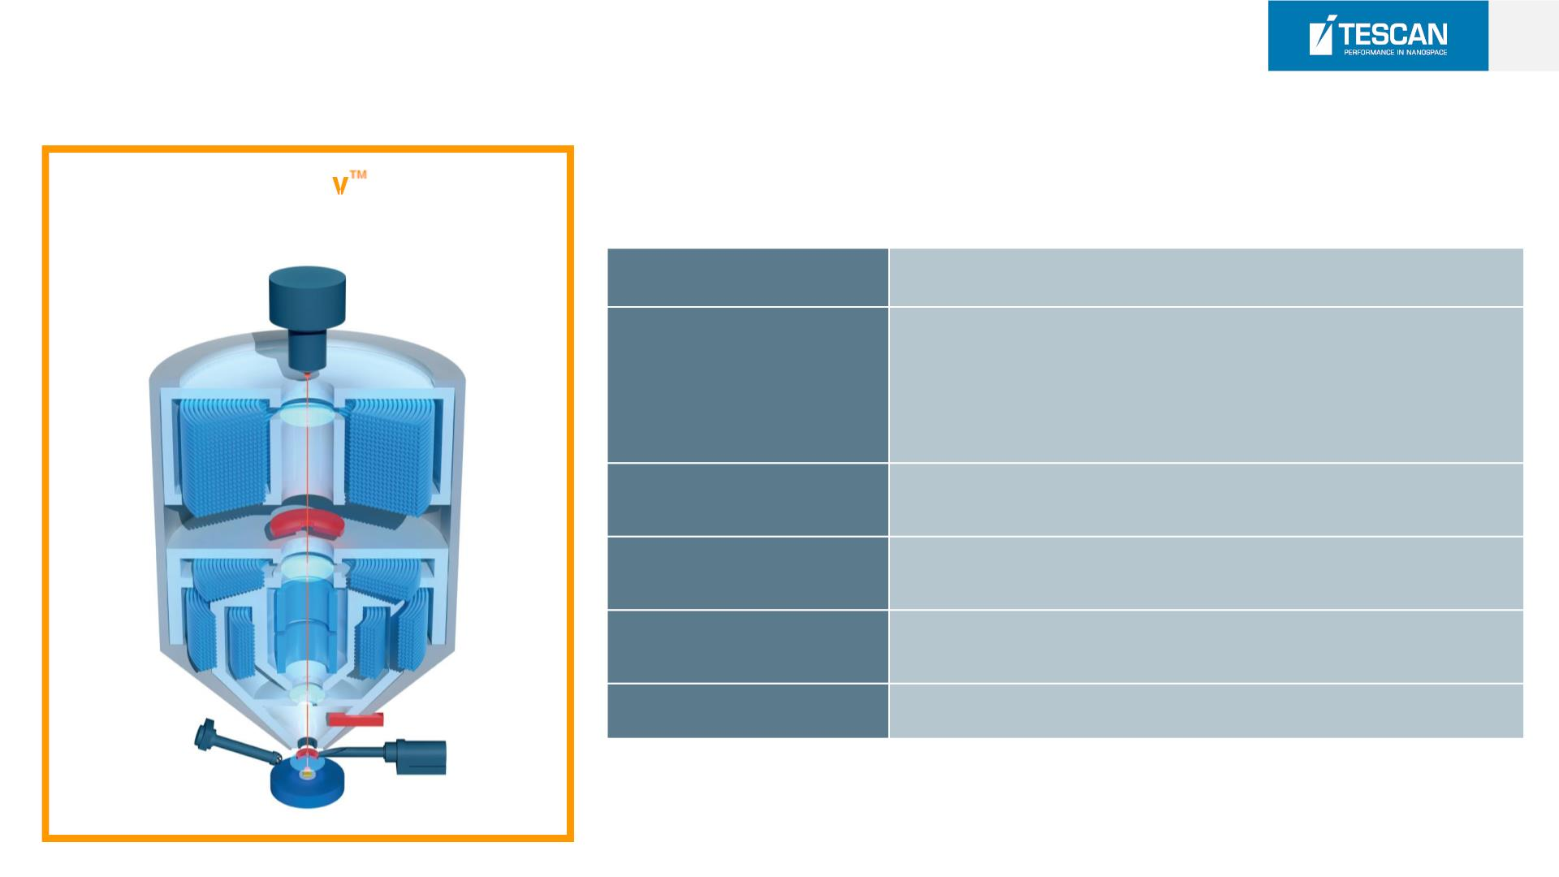
10
S9000G[MAGNA SEM Specification]
Trigla
Immersion lens UHR SEM
Electron Gun
High Brightness Schottky Emitter
0.6 nm @ 15 keV (Standard Mode)
0.9 nm @ 1 keV (BDM)
Resolution
0.5 nm @ 30 keV (STEM)
Magnification
@ 30kV
5× ~ 2,000,000×
Maximum
> 10 mm @ maximum WD
Field of View
Electron Beam
Energy
200 eV to 30 keV
2 pA to 400 nA
Probe Current

Slide 9
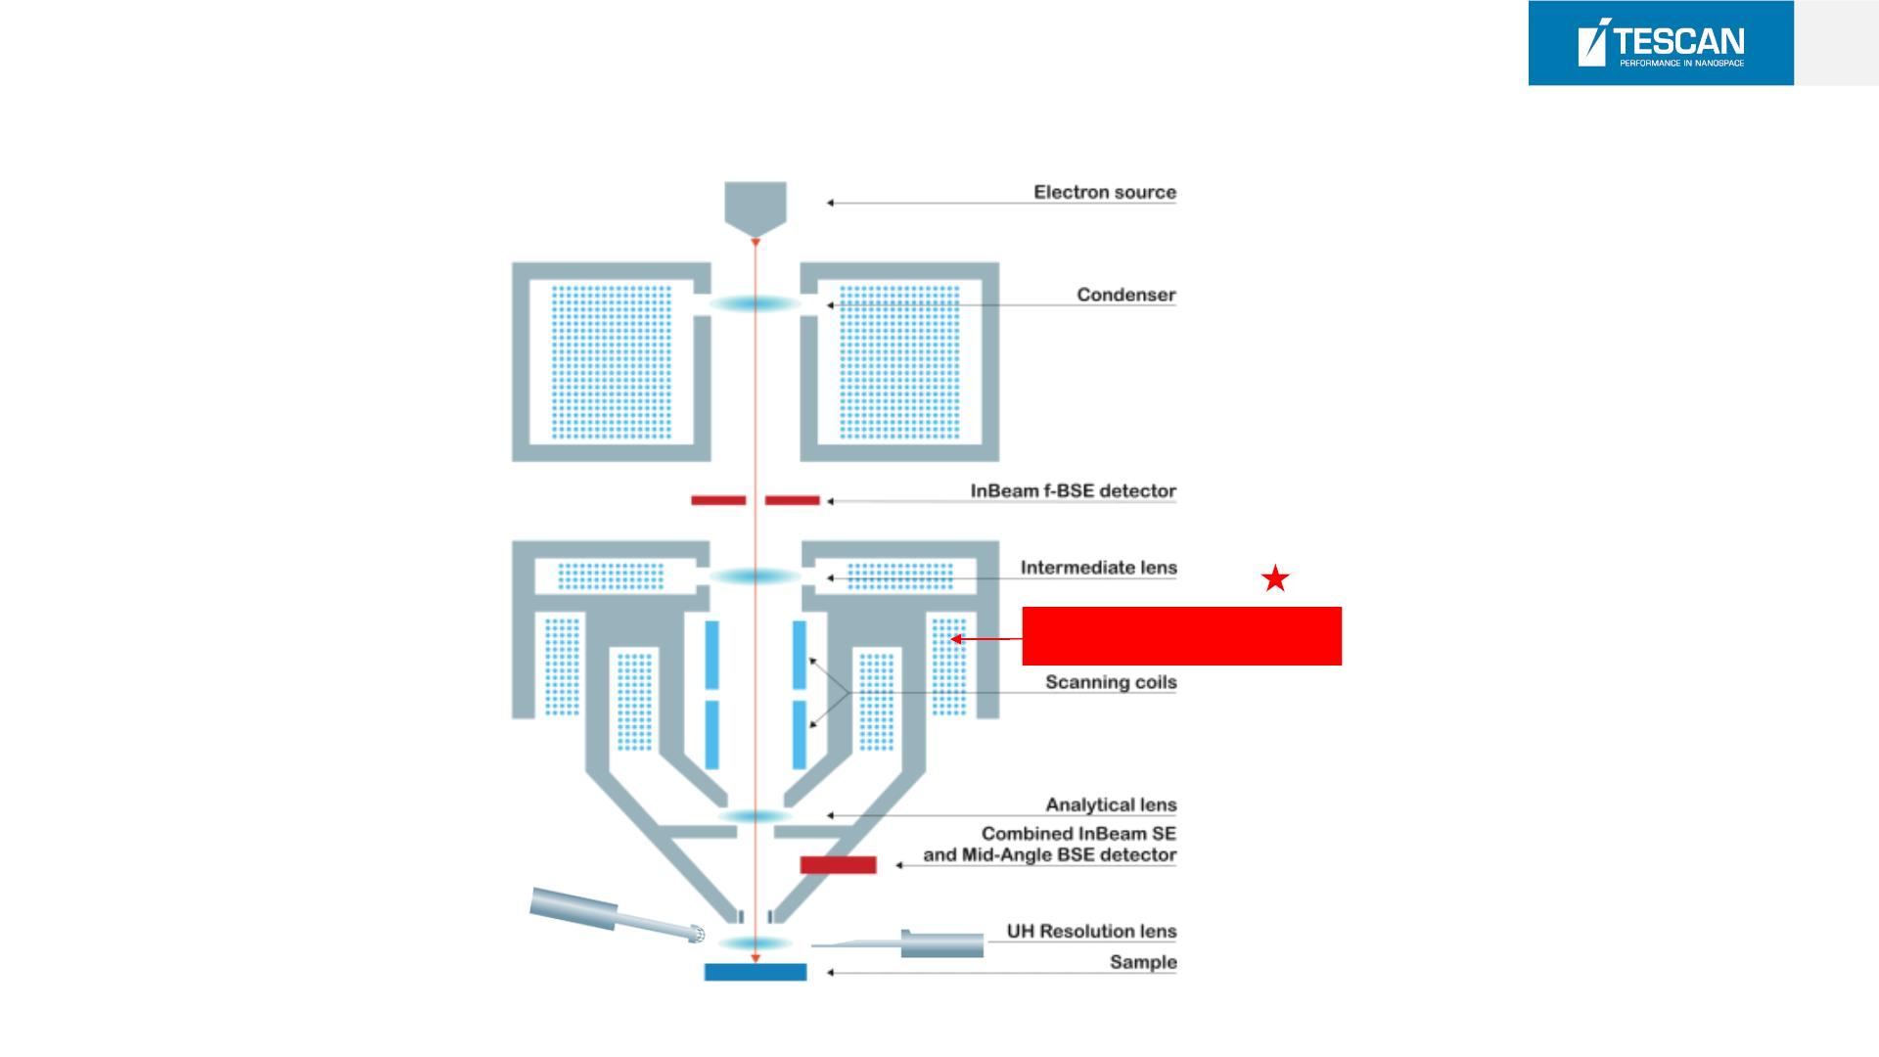
11
SOLARIS [ MAGNA C olumn Technology]
UH-Resolution Lens

Slide 10
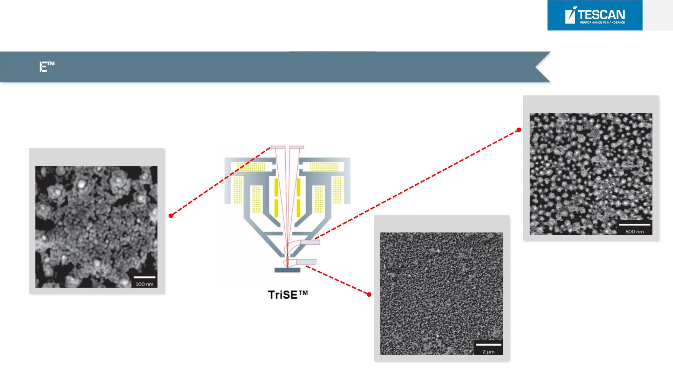
12
S9000G [ MAGNA C olumn Technology]
TriS detection system (requires BDM) - true topography and high surface detail
In Beam SE(UHR Mode)
SE(BDM)
SE(Analysis Mode)

Slide 11
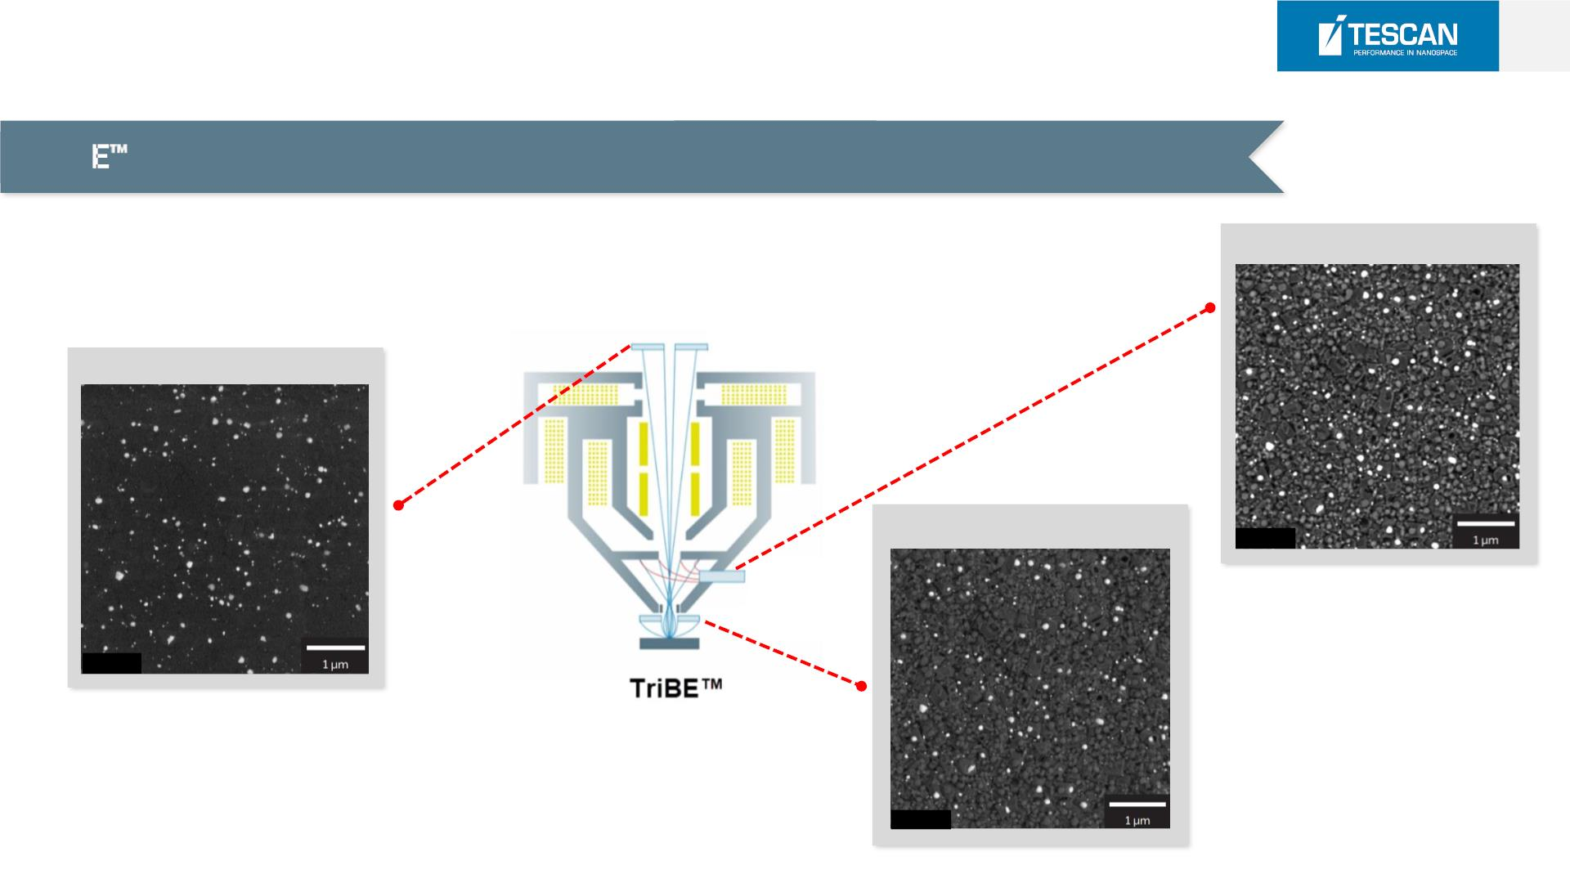
13
S9000G [ MAGNA C olumn Technology]
TriB detection system - angle-selective BSE imaging for true material contrast
Mid Angle BSE
In-Beam f-BSE
R-BSE(Wide angle)
2 keV
2 keV
2 keV

Slide 12
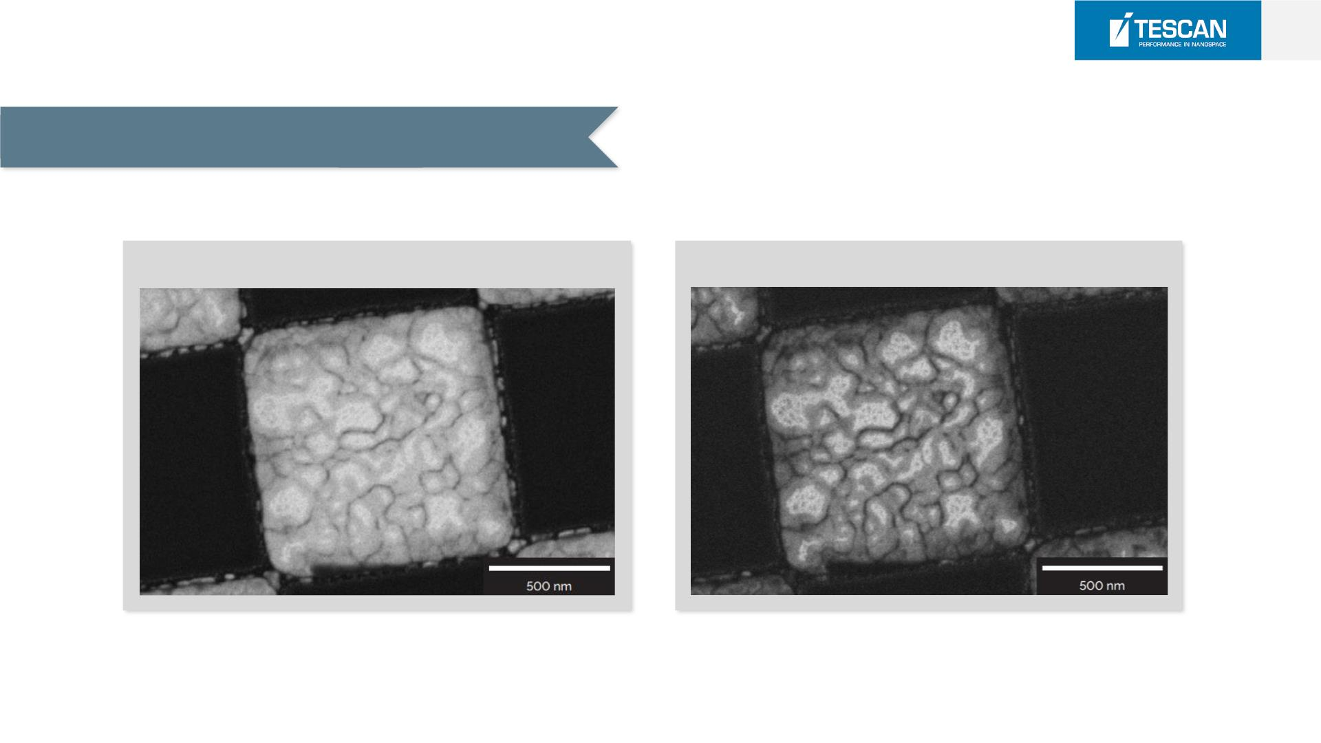
14
S9000G [ MAGNA C olumn Technology]
In column BSE’s selective energy filtering
Energy Filter OFF
Energy Filter ON(3900eV)
BSE image of Au grains on Si imaged at 4 keV
with in-column BSE detector
low loss BSE image of Au grains on Si imaged
at 4 keV with in-column BSE detector

Slide 13
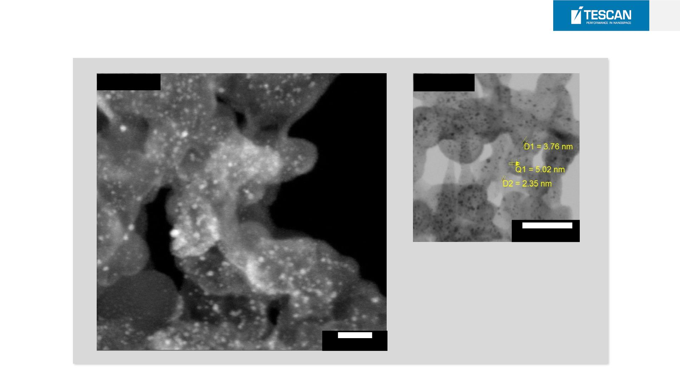
STEM Observation
STEM DF
STEM BF
50 nm
HV: 30 keV
Detector: STEM
Sample: Catalyst from
carbon nanoparticles
doped with Pt
30 nm

Slide 14
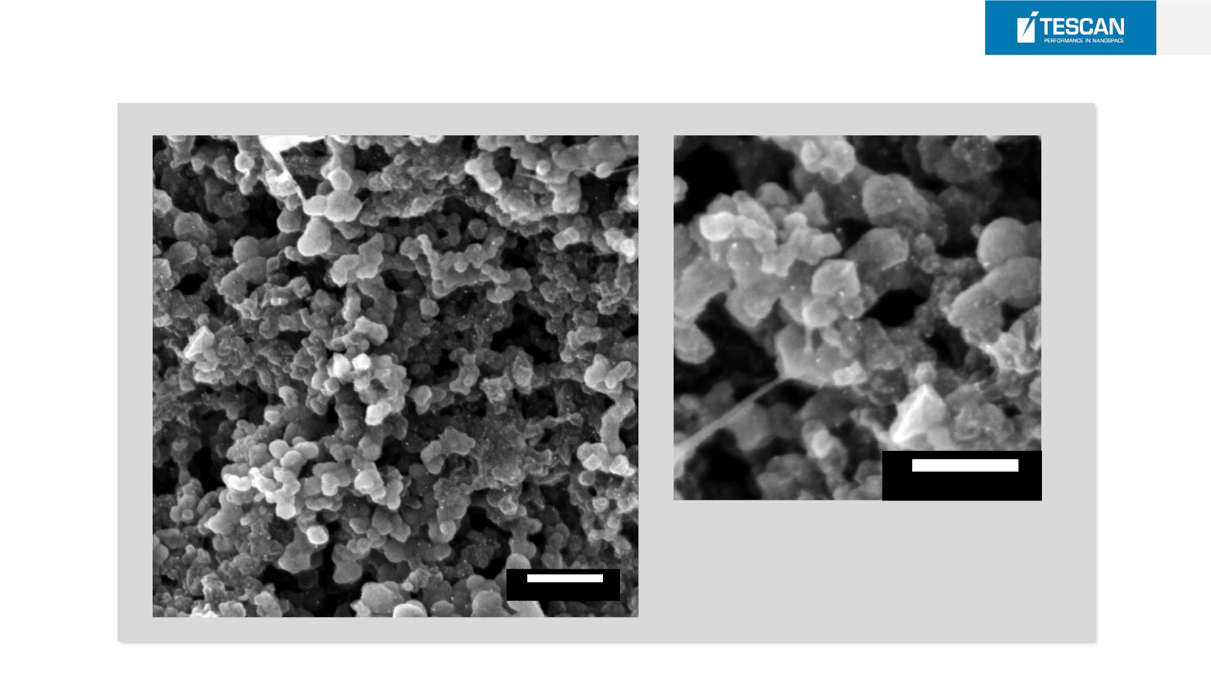
Catalyst Sample Observation
16
100 nm
HV: 2 keV
Detector: In-Beam SE (BDM)
Sample: Catalyst from carbon nanoparticles
doped with Pt
200 nm

Slide 15

SEM Technology
24.05.2024

Slide 16
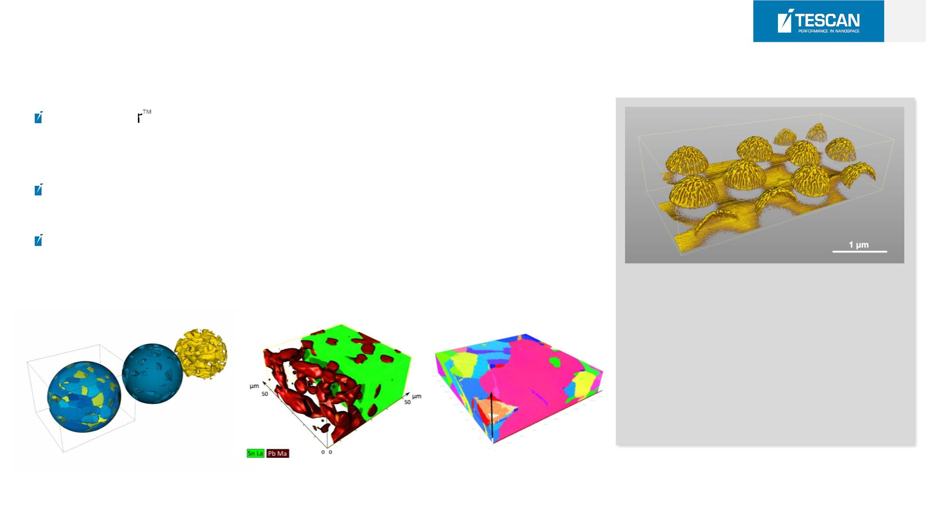
18
Equi-PowerTM T e chnology
EquiPowe technology with constant thermal power dissipation for
excellent column stability during time-consuming applications such
as EDS and FIB-SEM tomography
Electron beam currents up to 400 nA which is beneficial for analysis
such as EBSD, EDS
Rapid beam energy changes and excellent electron column stability
No drift in time-consuming applications.
3D BSE reconstruction of a SERS active
structure (gold-coated partially etched
polystyrene spheres) at 2 keV.
200 slices were acquired in 13 hrs with a
resolution of 3 × 3 × 10 nm.
3D BSE
3D EDS
3D EBSD

Slide 17
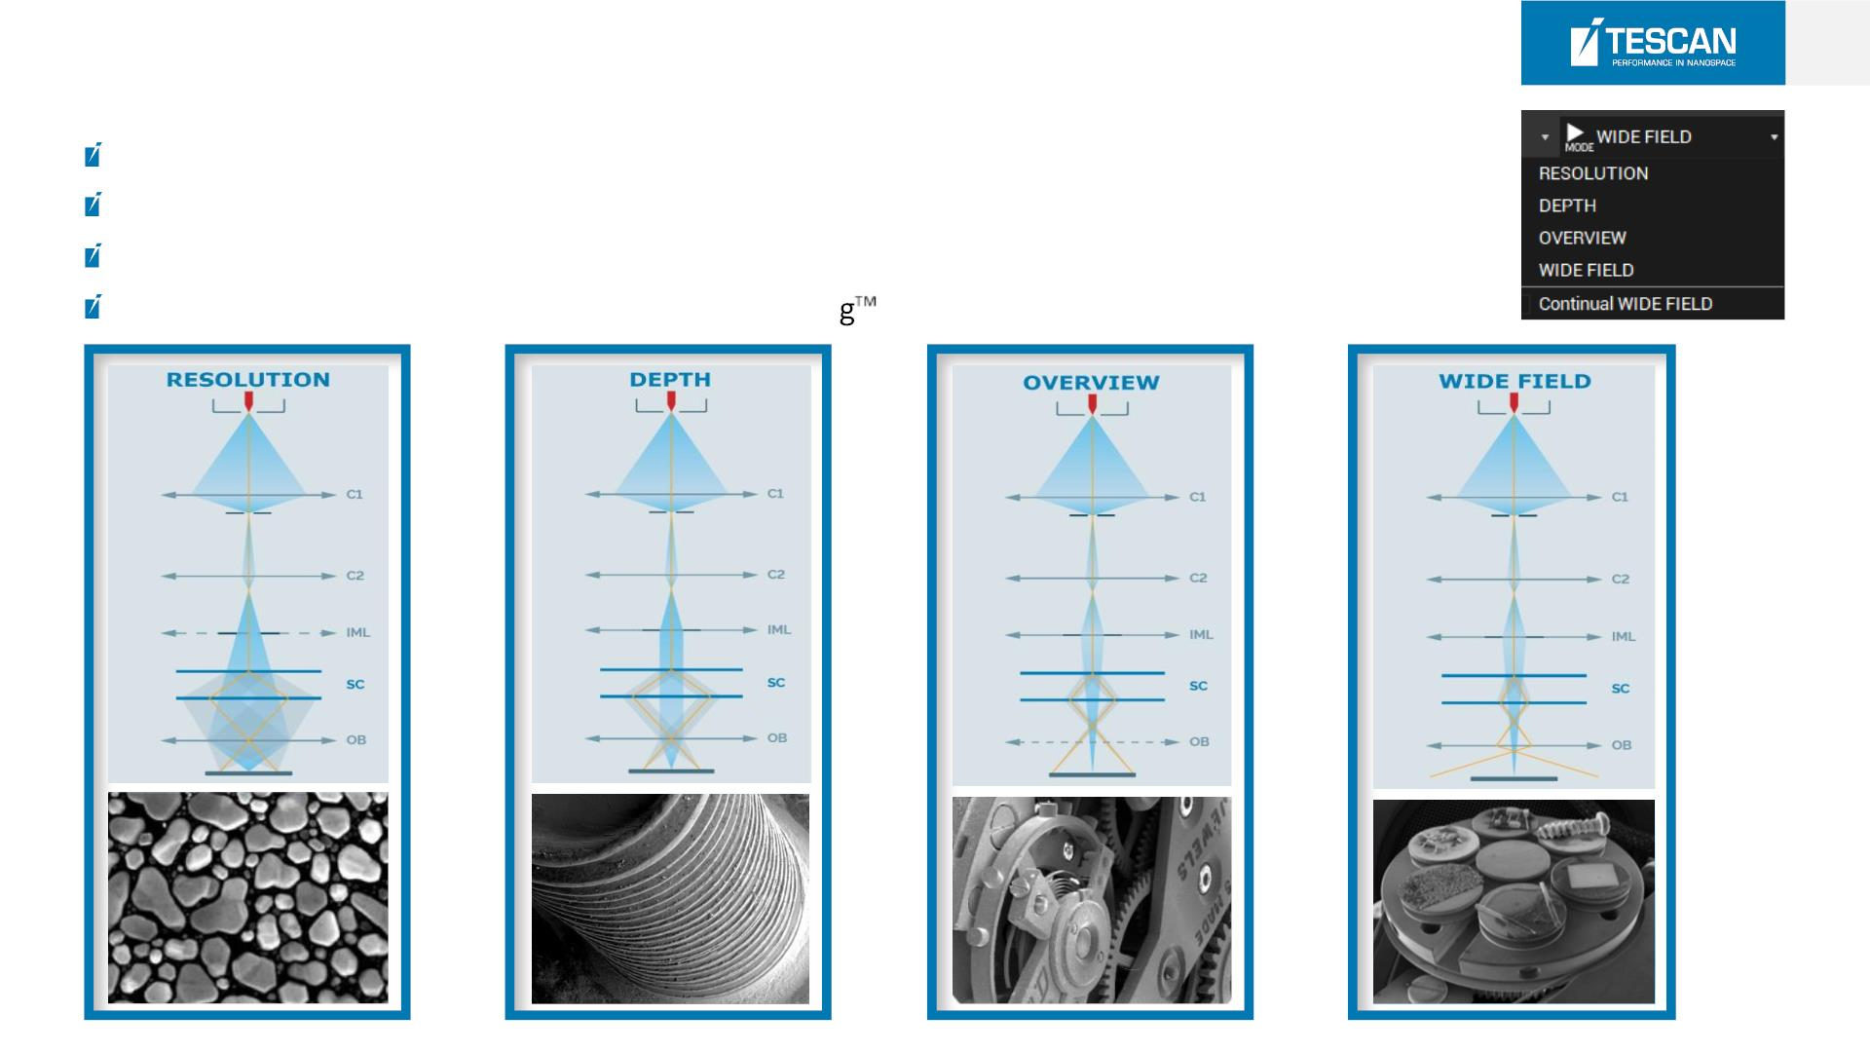
19
IML [Intermediate Lens] PATENT*
IML - Intermediate lens for beam aperture optimization
Unique TESCAN optics design
Automated alignment
IML is powered by TESCAN’s In-Flight Beam Tracin

Slide 18
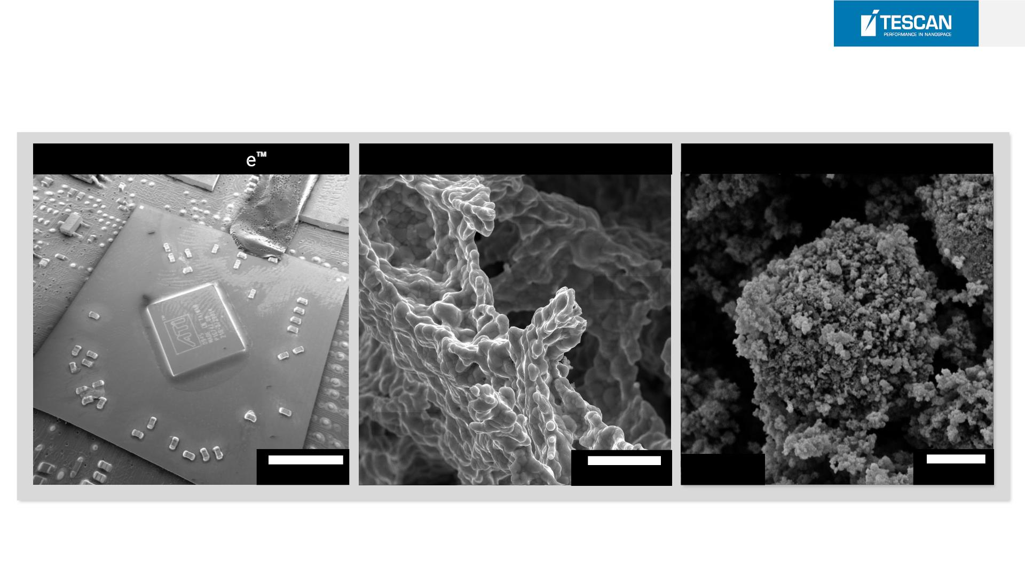
20
IML [Intermediate Lens] PATENT*
Wide Field Mod
RESOLUTION and DEPTH Mode
Fast setup of imaging conditions
In Focus
In Focus
In Focus
10 mm
20 µm
5 keV
2 µm

Slide 19
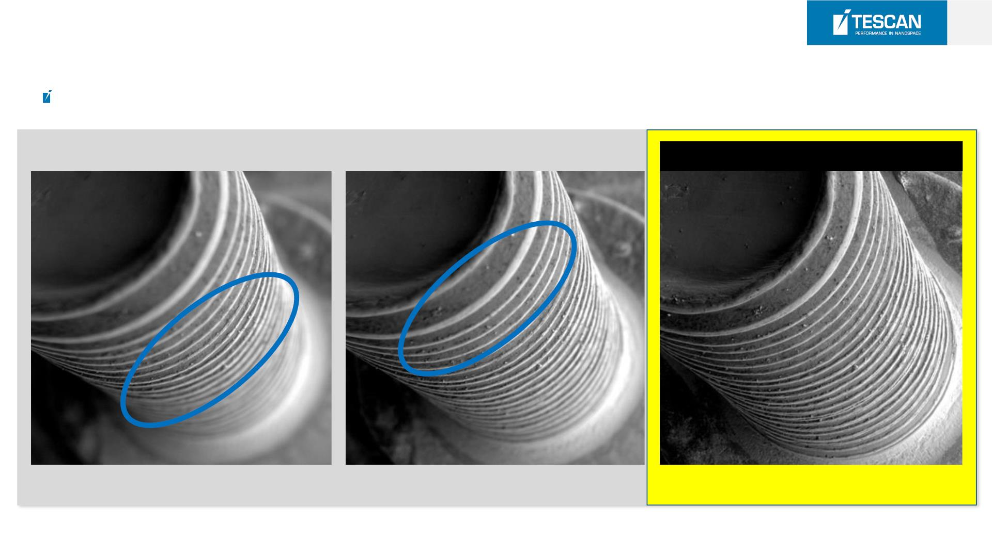
21
IML [ Depth Mode]
Extraordinary Depth of Focus
IML(중간렌즈) 동작
심도편차: 10mm

Slide 20
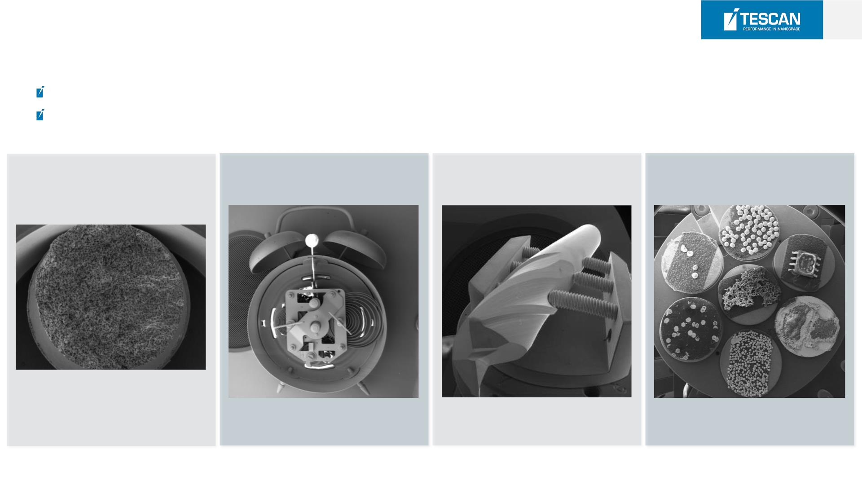
22
IML [Wide Field Mode]
Extra-low magnification (Down to 2x)
Ideal for navigation over multiple samples or large areas
Fracture surface
Alarm Clock
Drill
SEM holder for 7 samples
View field 17 cm
View field 10 cm
View field 8 cm
View field 5 cm

Slide 21
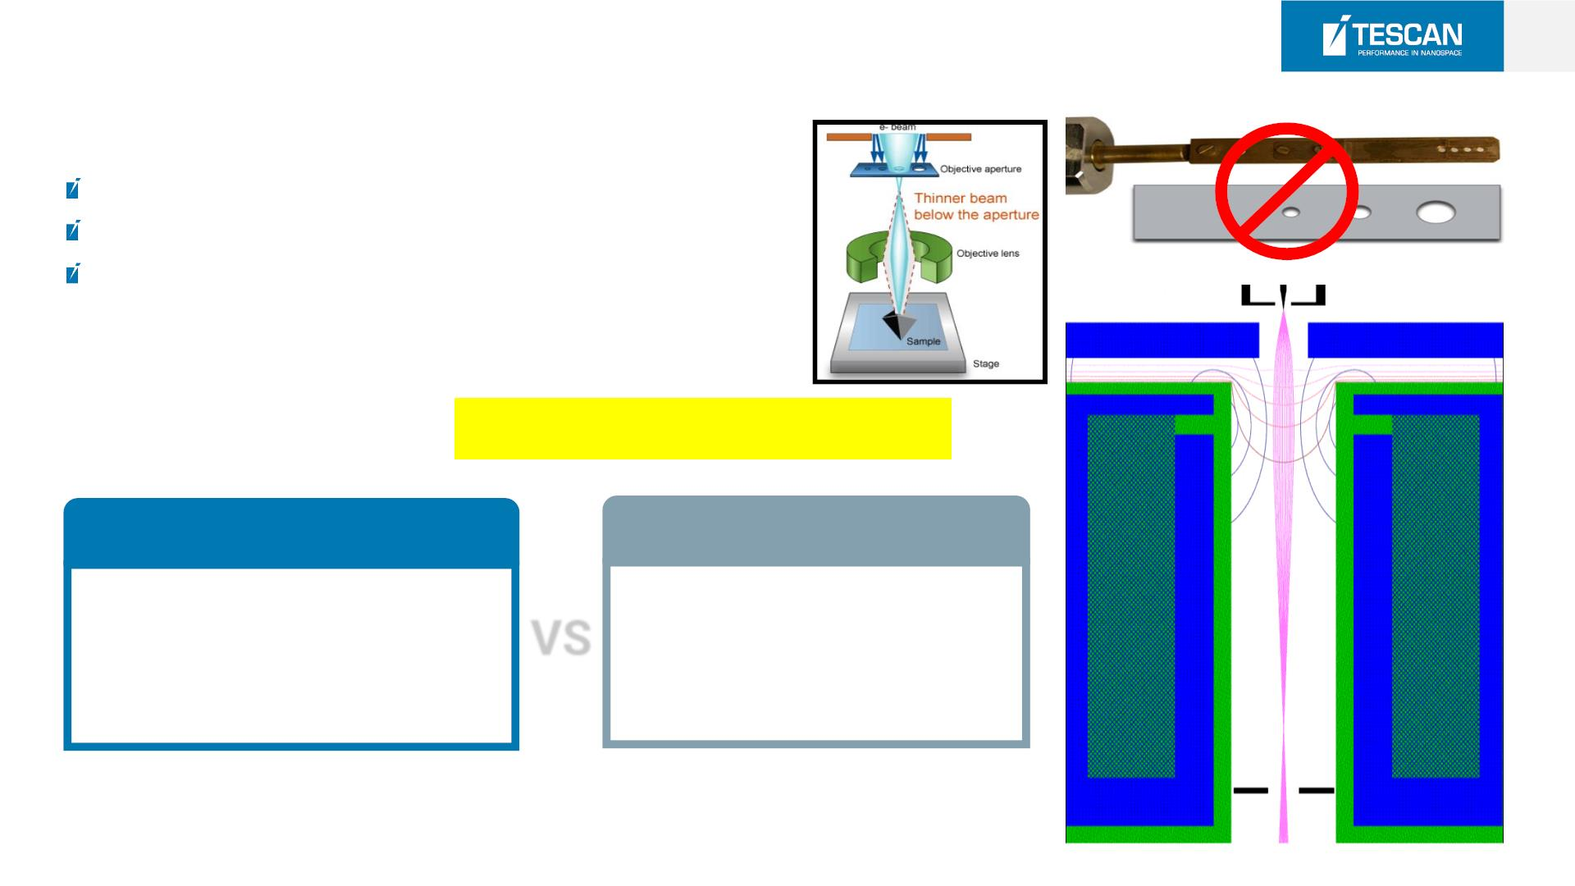
23
In Flight Be am T r acingTM [Patent*]
No mechanical alignment of OL aperture required
Automatic control of beam current and spot size
Optimum imaging and analytical conditions assured
Do you need a control the Beam Current & Spot Size?
Competitors
TESCAN
Competitors
Automatic Control
Mechanical Control
VS
-High Reproducibility
-Easier & Fast Operation
-Need to mechanical alignment
of OL aperture
-Inefficient operation

Slide 22
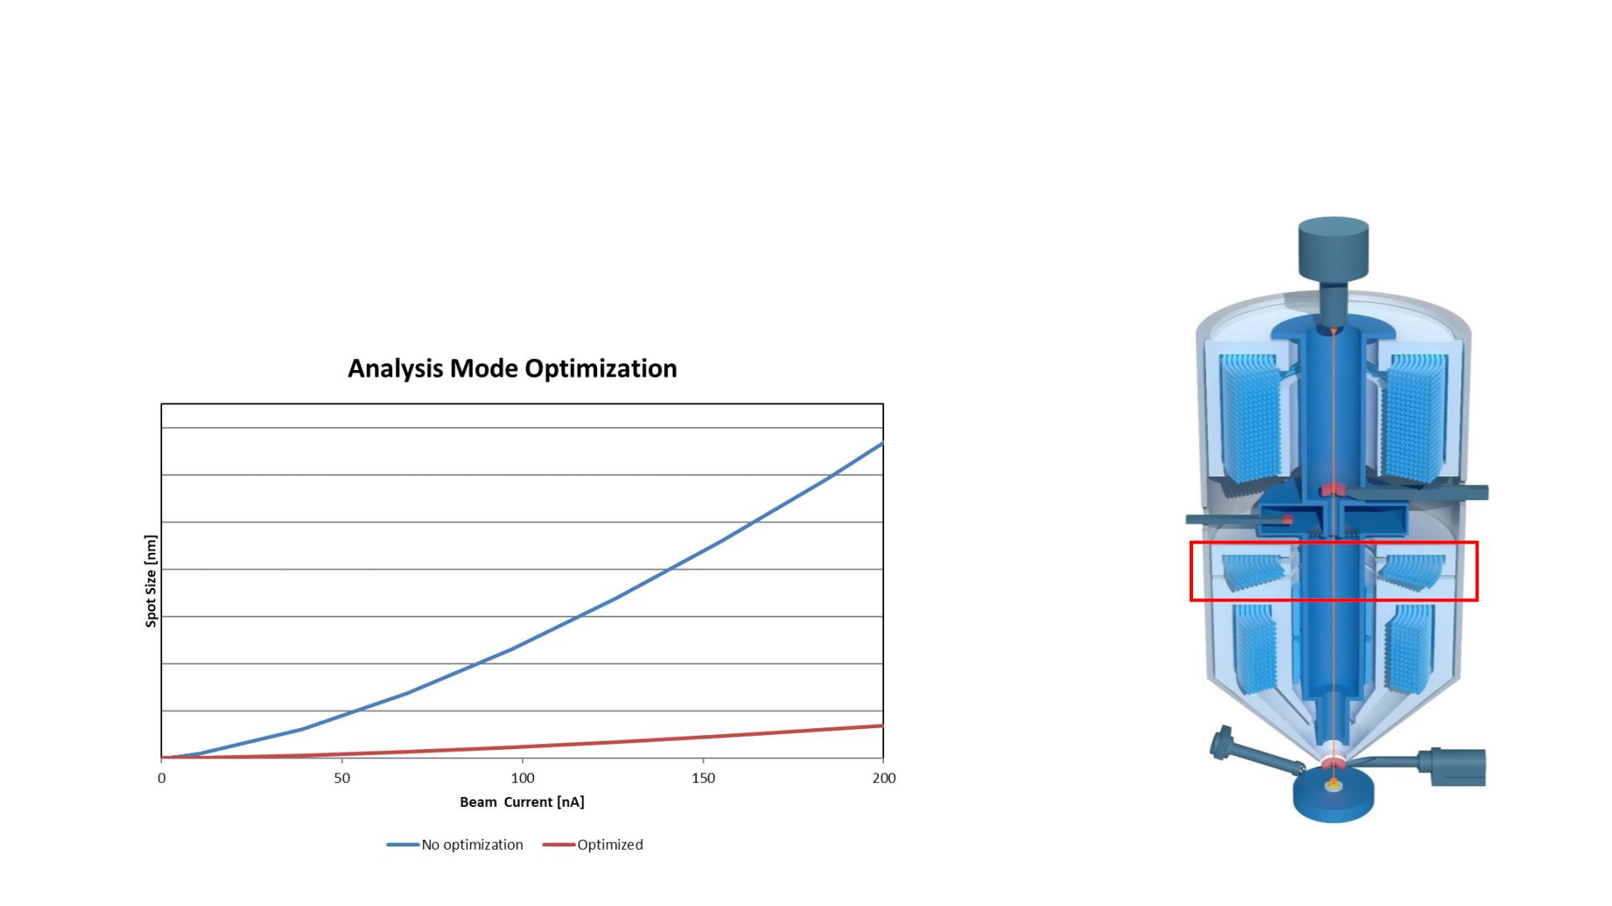
Resolution Optimization at High Currents
 In-Flight Beam TracingTM and Intermediate lens (IML) enable aperture/spot
size optimization for high beam currents in Analysis mo de
IML

Slide 23
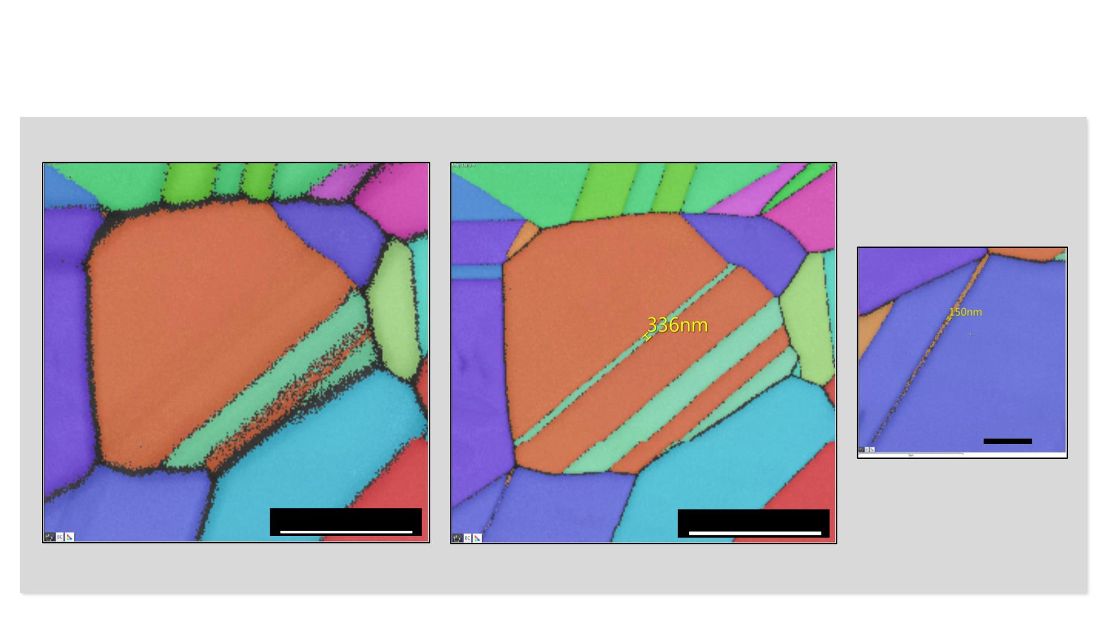
Optimization of Spot Size at High C u rrents
Adaptive spot shape Optimization
1 µm
10 µm
10 µm
Beam not optimized for high beam currents
Beam optimized for high beam currents
(20kV, 20nA)
(20kV, 20nA)

Slide 24

Detection System
1. SE(ET)
2. LE BSE
3. In Column(Multi) Detector
4. In Column(Axial) Detector
5. STEM DF/BF/HADF

Slide 25
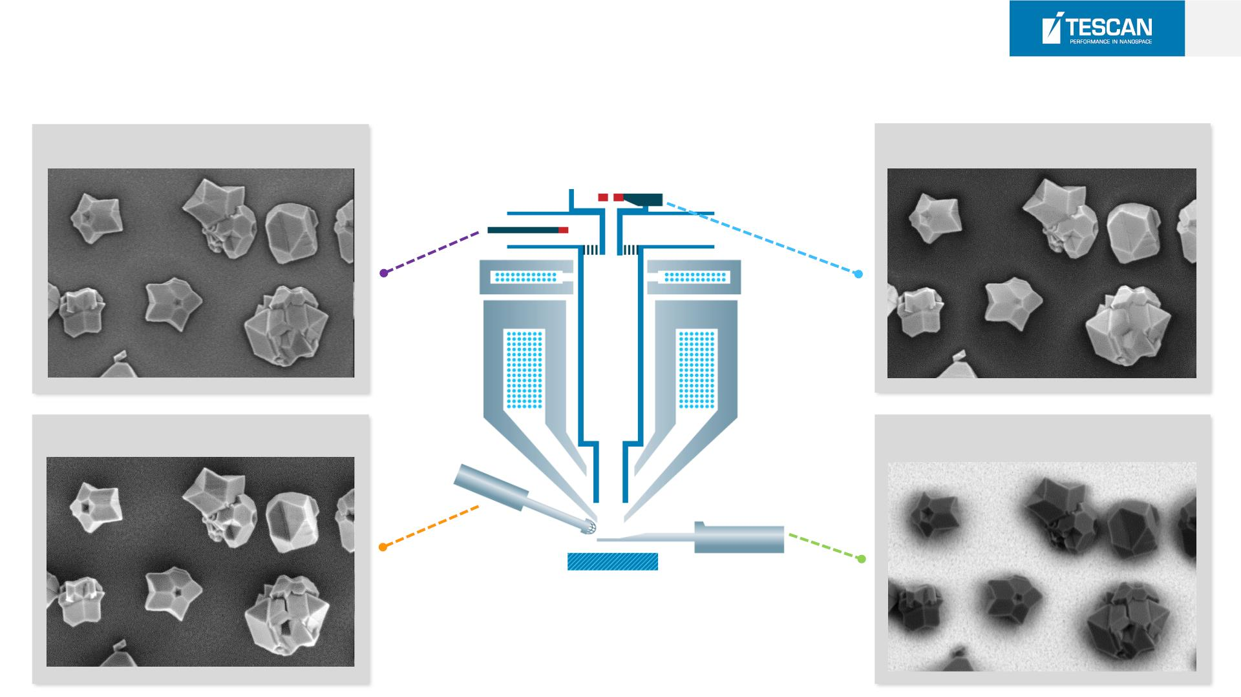
27
Detection System
3. Multi detector
4. Axial detector
1. SE detector(E-T)
2. LE-BSE detector

Slide 26
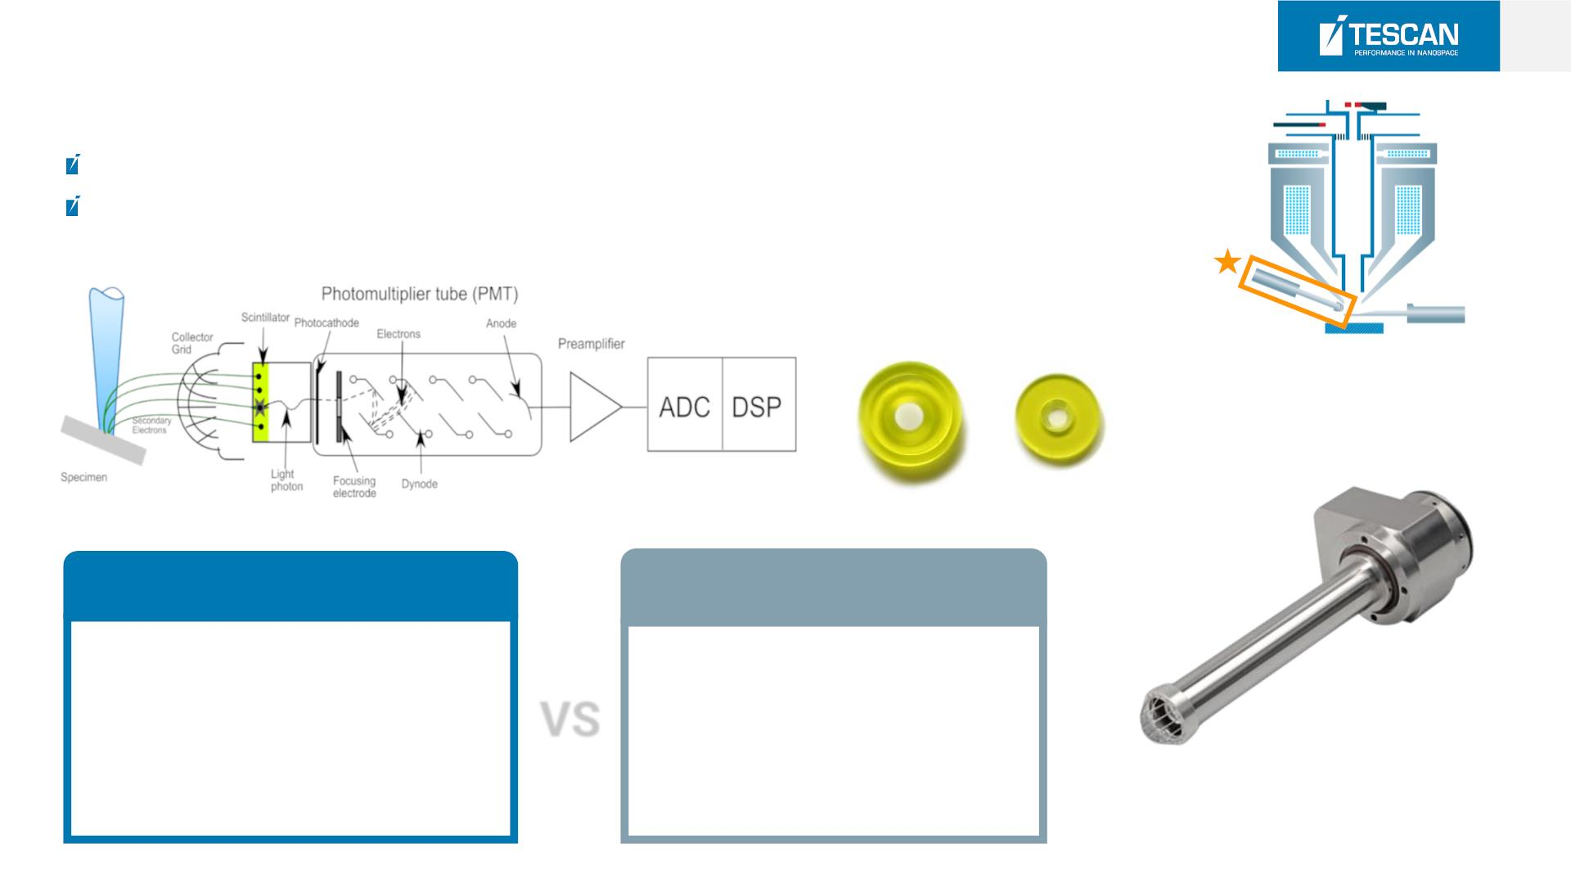
28
SE(E-T) Detector
Everhard-Tornley Detector
Synthetic YAG Crystal type
TESCAN
Competitors
YAG Crystal Type
Normal Type
-High efficiency(Low Noise)
-Fast Response
-Unlimited life time
VS
-High noise
-Short life time
-Vulnerable to impact

Slide 27
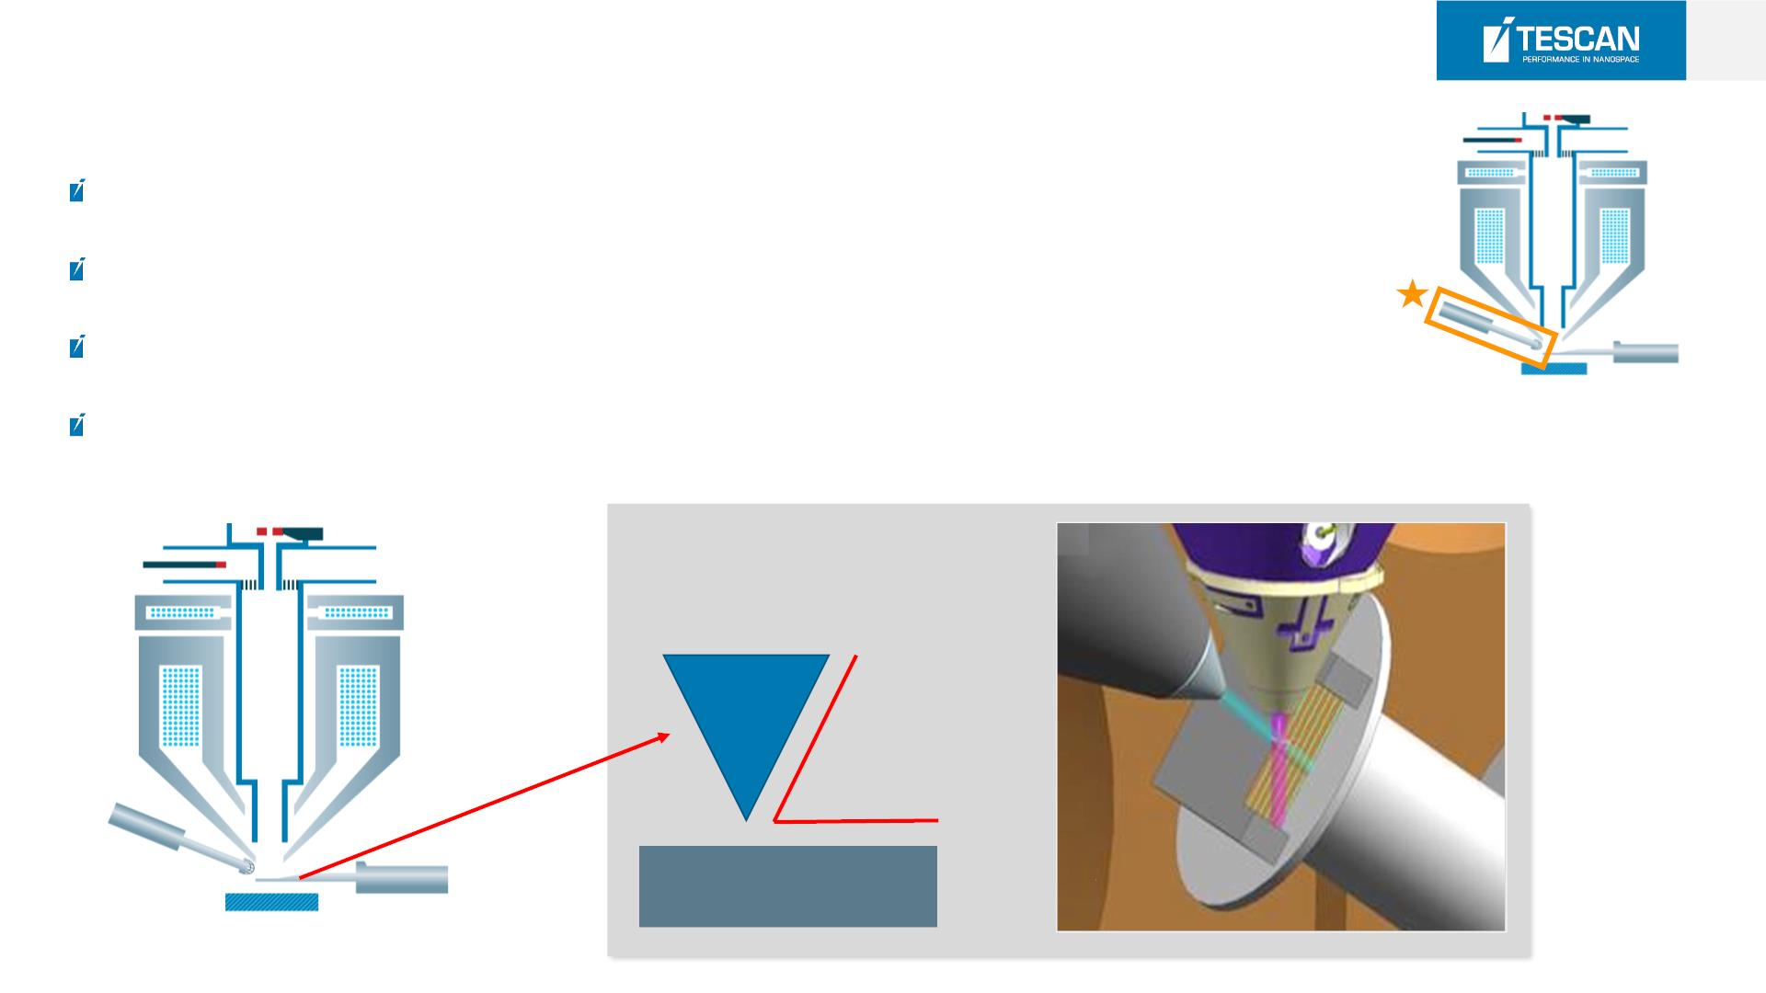
29
SE(E-T) Detector
Topographical contrast without the edge effect
Charge free im aging of Non-conductive samples
Topographical B S E it is like imagingin low vacuum
Fast im age acquisition
70°
TESCAN AMBER : 70°
Other Company : 60°

Slide 28
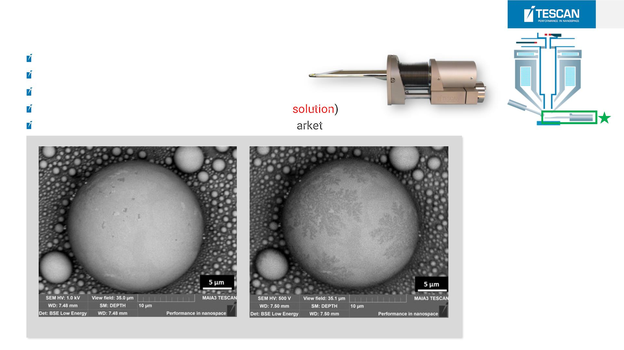
30
LE(Low E nergy) BSE D e tector
Synthetic YAG Crystal Detector
Improved resolution & Less beam damage
BSE Signal detection down to 200 V
High Material Contrast (Element Atomic 0.1% Re
LE-BSE is fully competitive with any BSE on the m
LE-BSE @ 1 keV
LE-BSE @ 500 eV

Slide 29
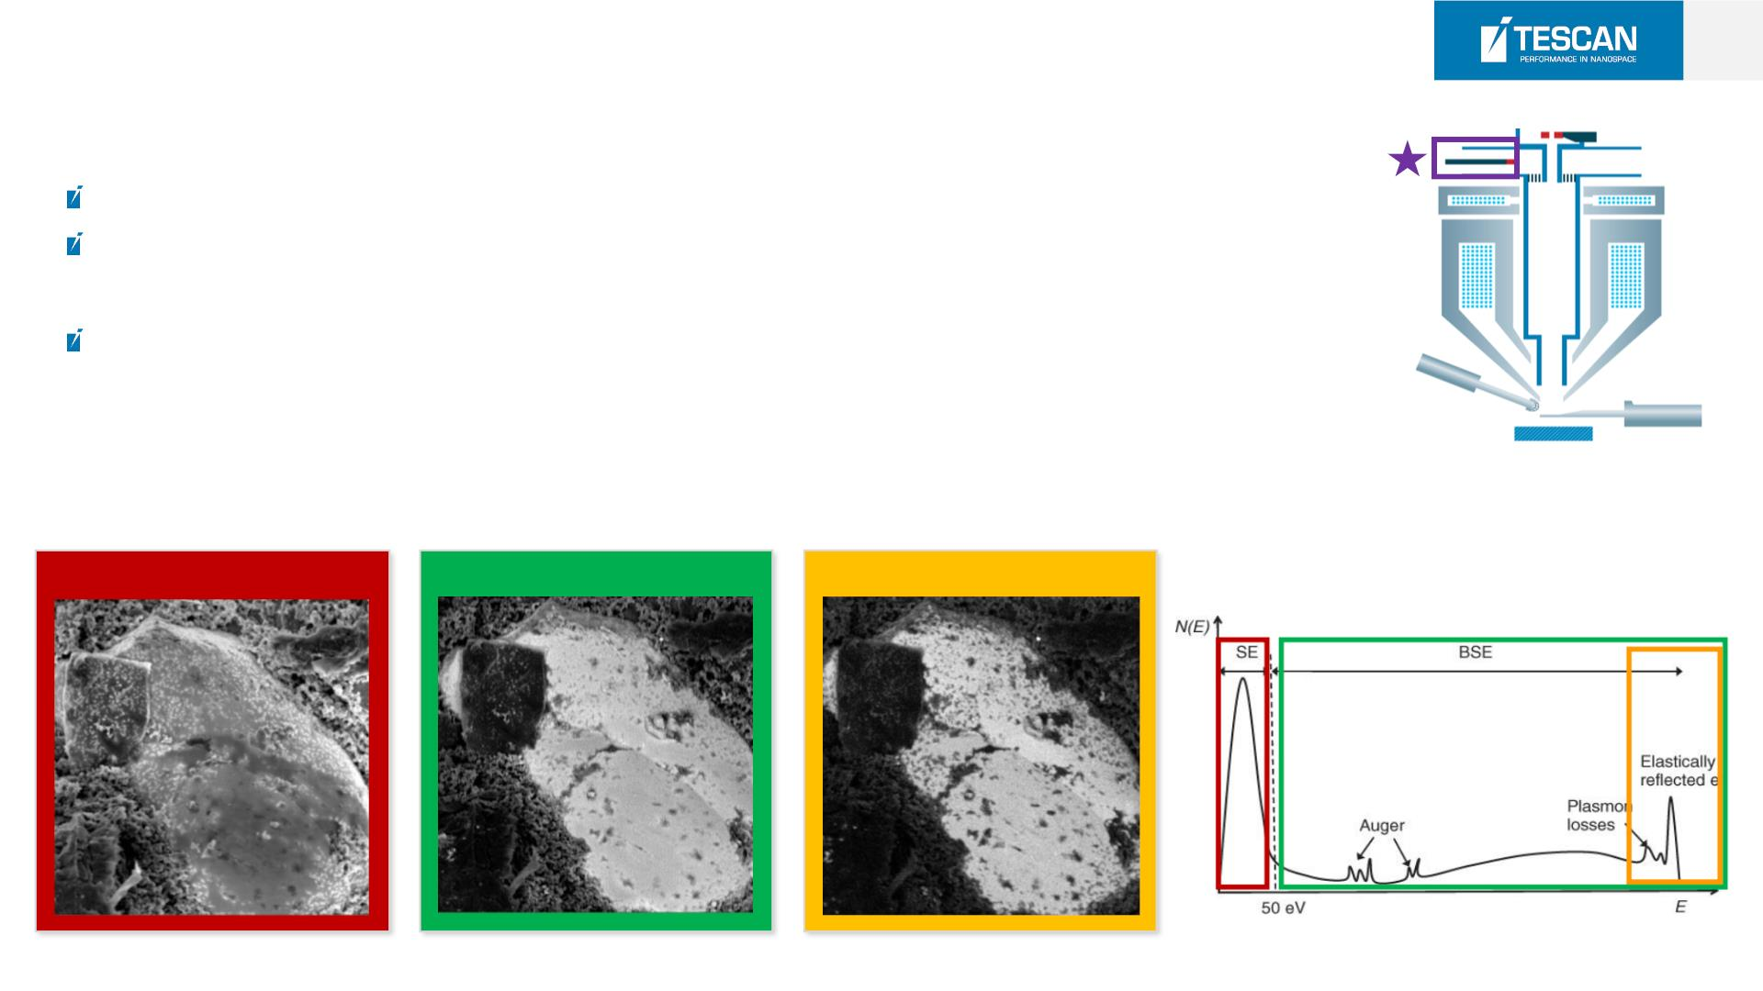
31
In Co lumn [Multi] Detector
Located in the SEM column
It is recomented to use it in the Axial BSE Mode where you can utilize all imaging
features
The detector is equipped with the FILTERING GRID – the electrons are filtered
according to their energy
SE(Filter OFF)
BSE (Filter ON)
Energy filtering

Slide 30
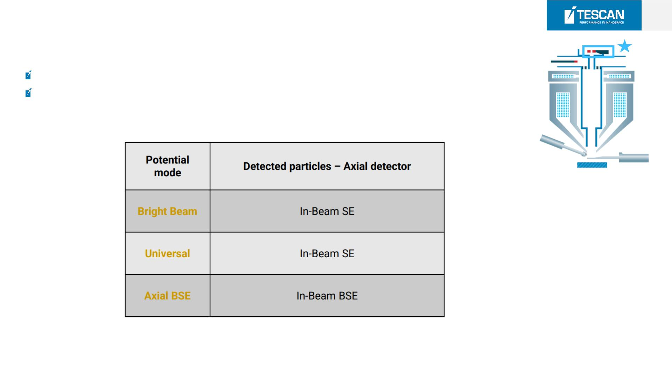
32
In Co lumn [Axial] D e tector
Scintillator type detector located in the SEM column
There is following particles detection according to the potential mode.

Slide 31
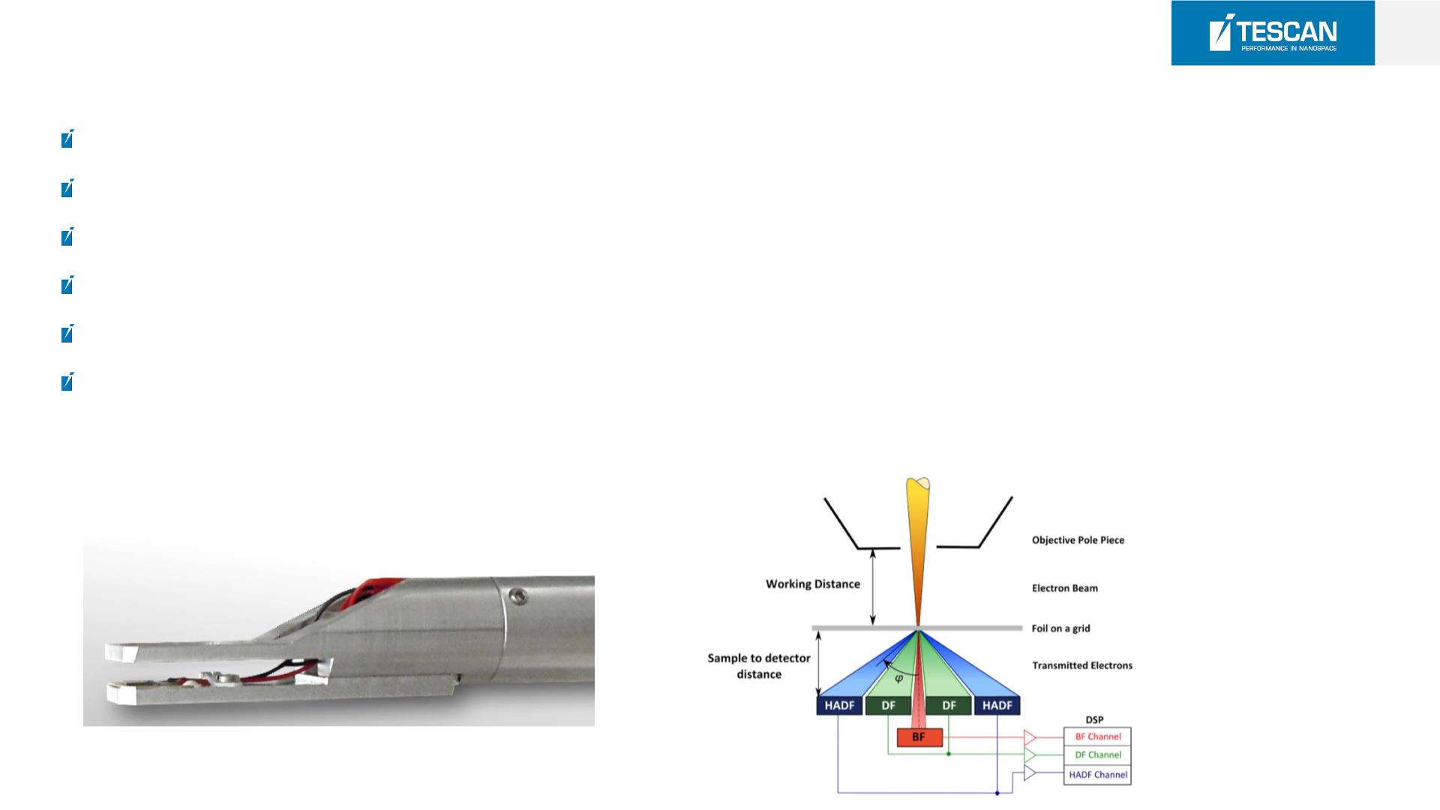
33
Retractable In- Situ STEM D e tector
Multiple samples can be observed without chamber vacuum
Simultaneous acquisition of the Bright Field (BF), Dark Field (DF) and High Angle Dark Field (HADF) signals.
The sample can be moved up and down relative to the detector in order to reach the best imaging conditions
The sample can be tilted independently of the detector
Exchangeable sample holders for easy grid manipulation
Tw o sample holders available: multiple sample holder and TEM lamella holder

Slide 32
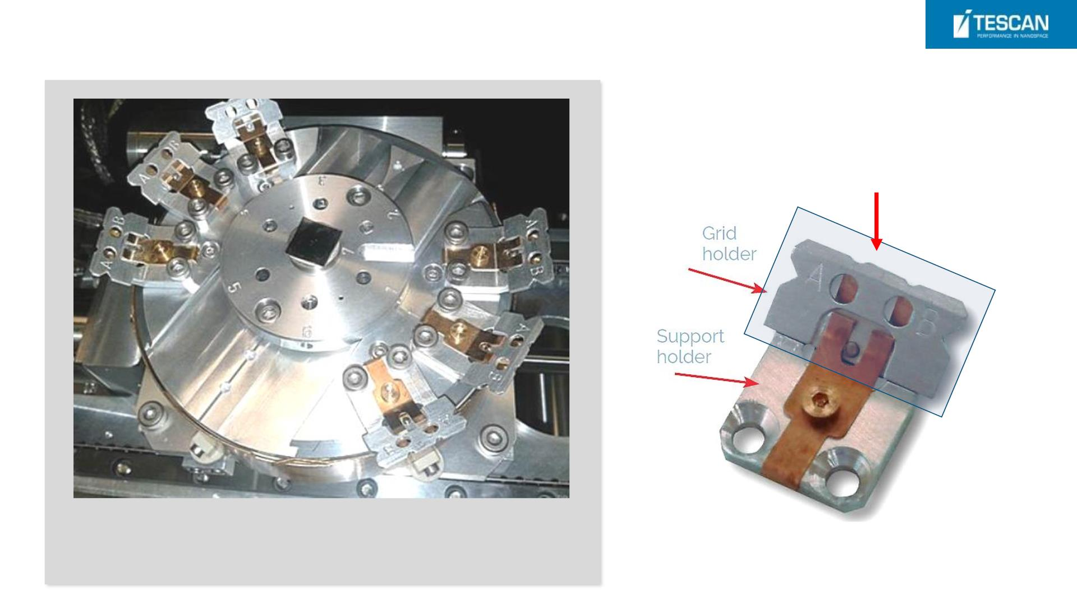
Retractable In- Situ STEM D e tector
Removable grid holder
Removable grid holder (top) mounted on the side of the stage
(bottom). Up to 6 holders(totally 12 grids) can be installed,
depending on the system configuration.

Slide 33
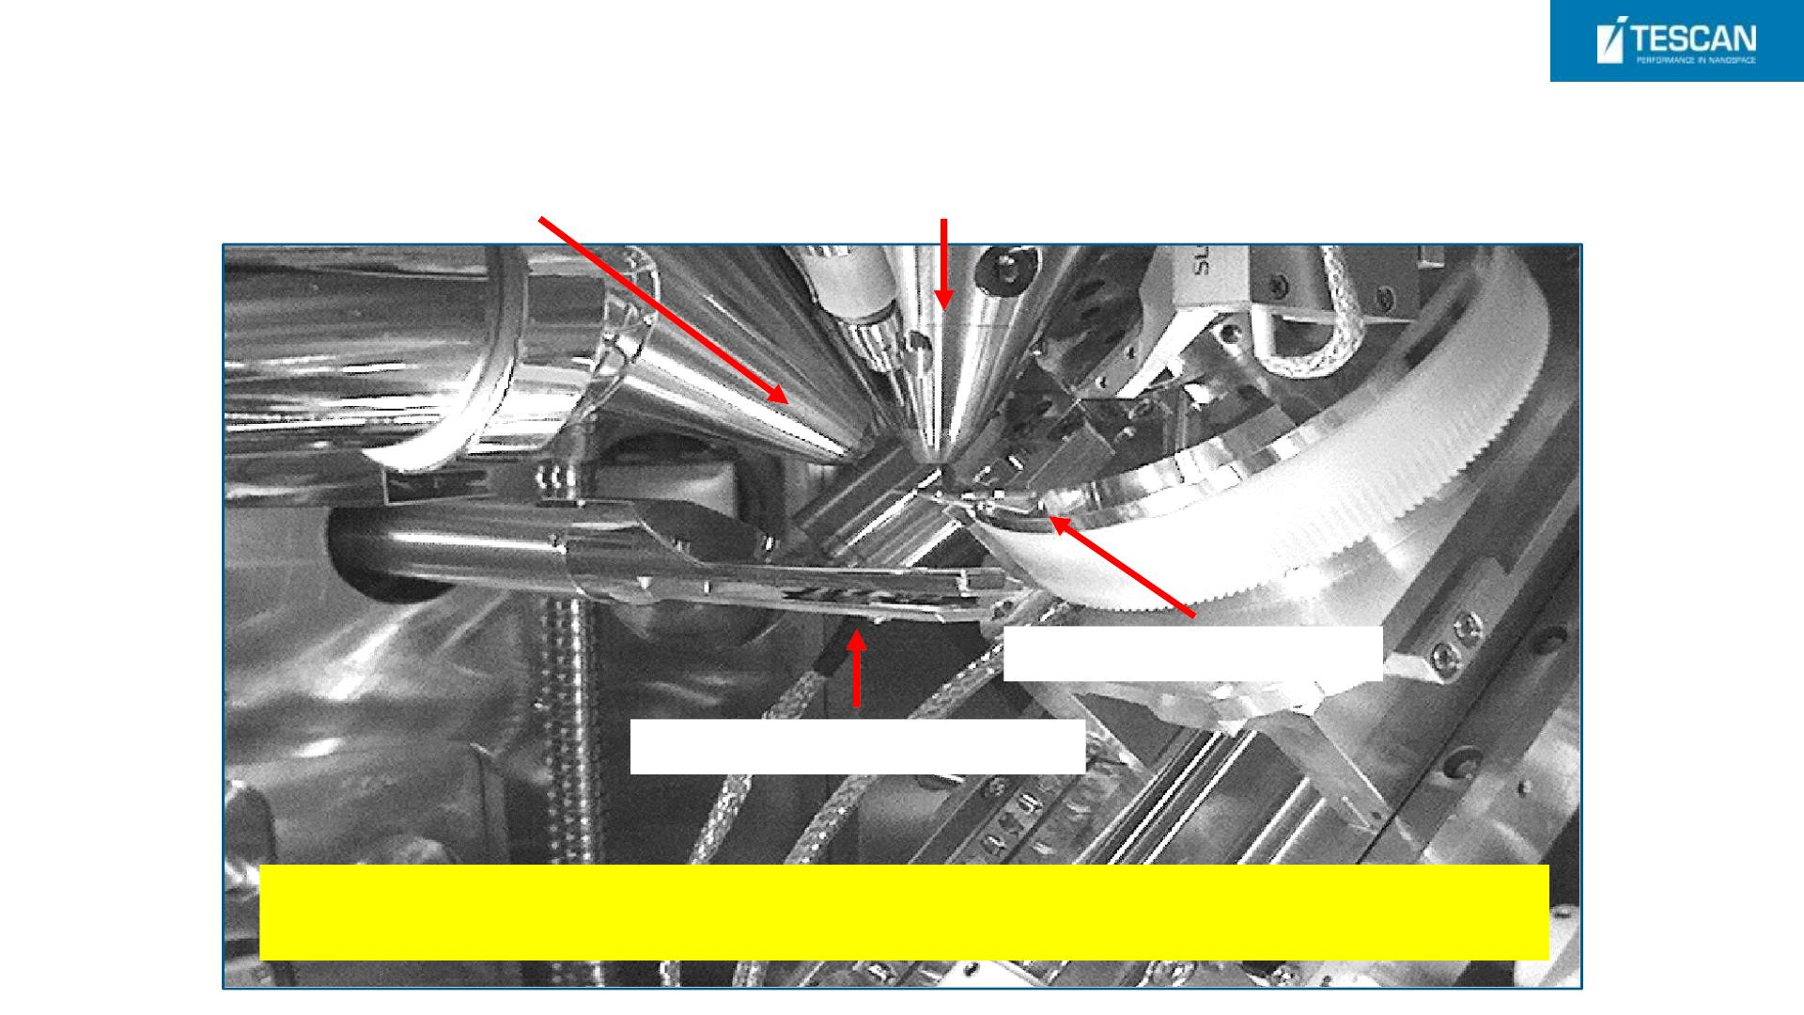
Retractable In- Situ STEM D e tector
FIB Gun
SEM Gun
Removable grid holder
Retractable STEM Detector
TESCAN Pre-tilt support holder designed for in-situ TEM lamella attachment
and polishing, and direct STEM analysis.

Slide 34

Ga FIB Orage Column
24.05.2024

Slide 35
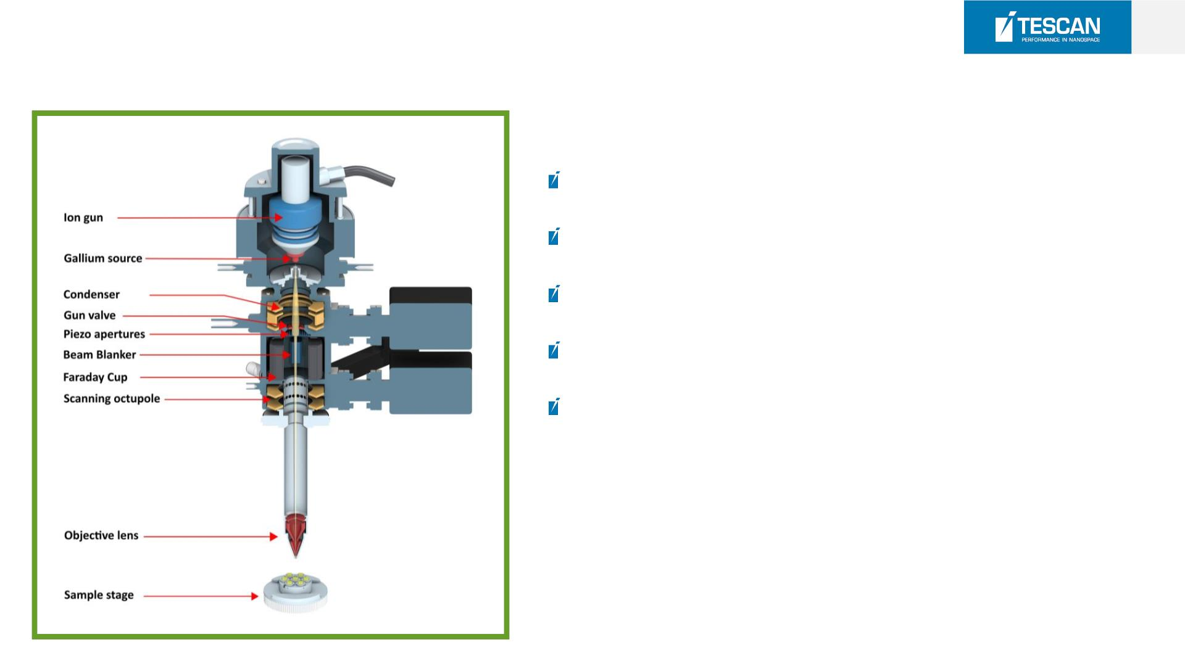
37
Ga FIB Co lumn
OrageTM Ion Column
High resolution : < 2.5 nm at 30 keV (World Best)
Ion beam currents up to 100 nA
Piezo FIB auto alignment
30 Piezo Apertures for precise control selection
Long lifetime FIB source up to 3000uAh(1500hs)

Slide 36
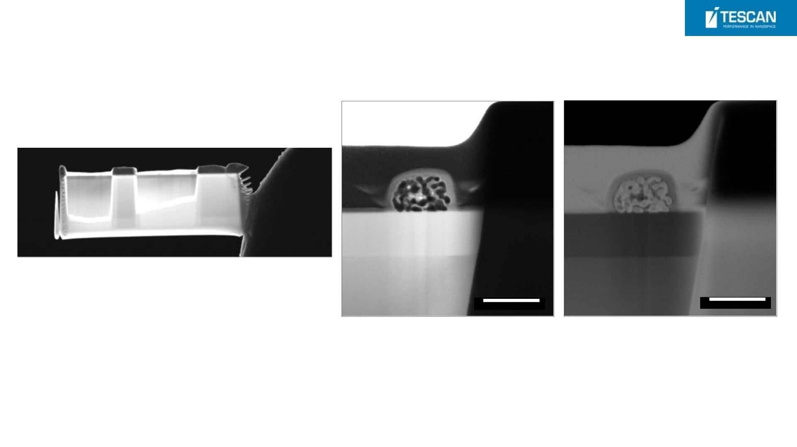
TEM lamellar preparation – Au nanoparticles
Lamella was thinned to electron transparency
1 um
1 um
and a final polishing at 1 keV to minimis e
surface amorphous da ma ge
- STEM -BF(left), DF (right)
- The nanoporous structure is clearly visible as well as both the
passivation SiO2 and Si substrate layers.

Slide 37
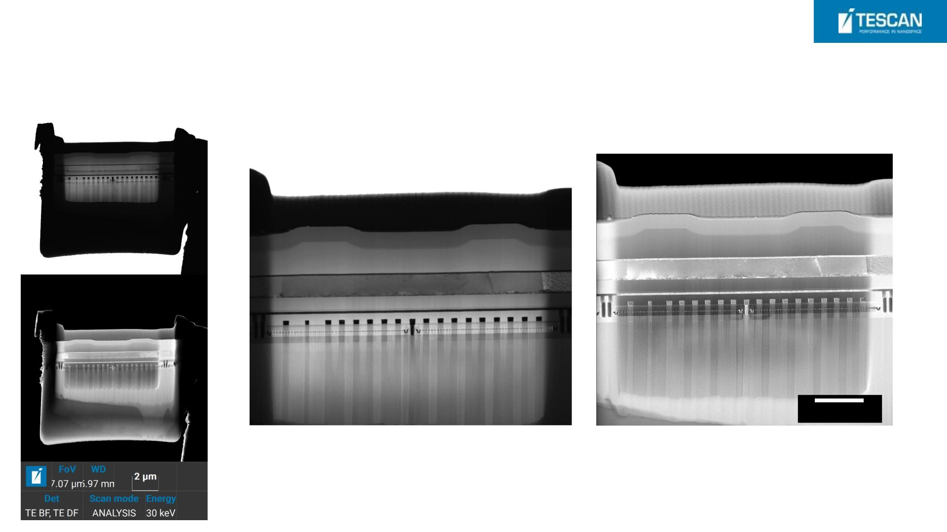
TEM lamellar – Flash memory (14 nm process)
1 um
- STEM images : BF(left), DF (right)

Slide 38
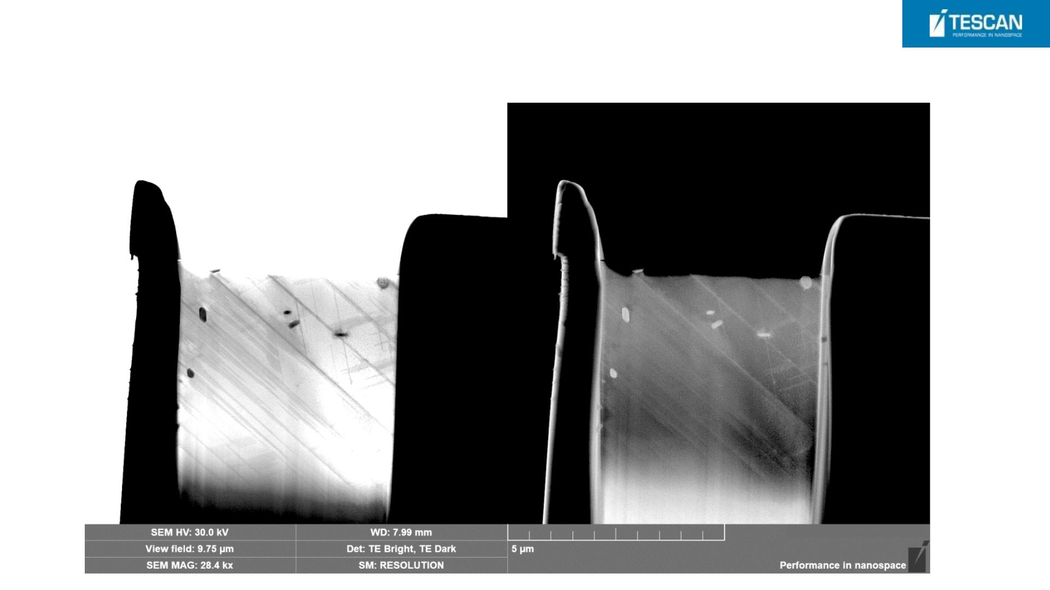
Superalloy with Mo precipitates

Slide 39
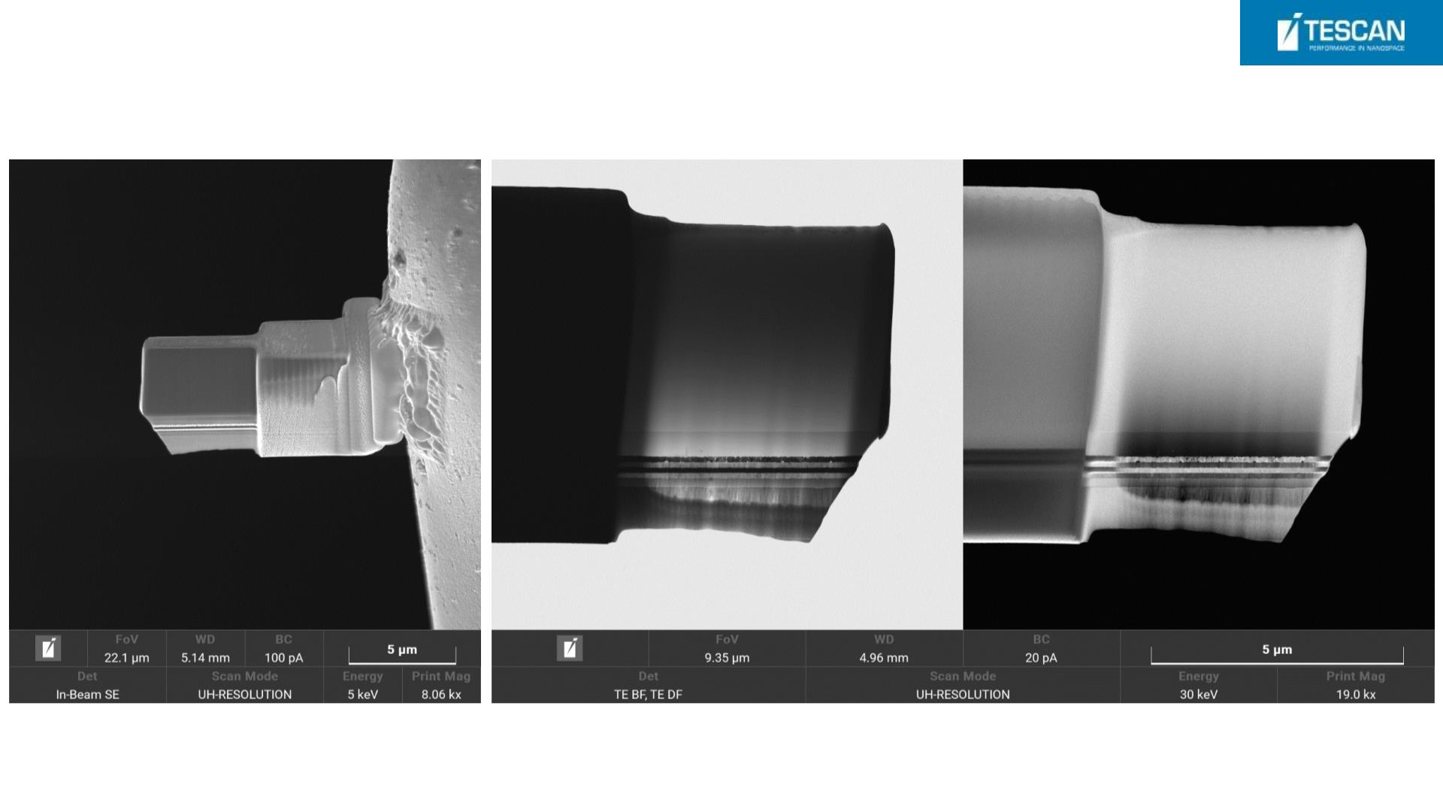
Inverted Lamellas with Ti, Pt, and Si layers
InvertedLamella before 5 keV
cleaning attached to the grid
STEM Image of 5 keV polished STEM Image of 5 keV polished
lamella lamella

Slide 40
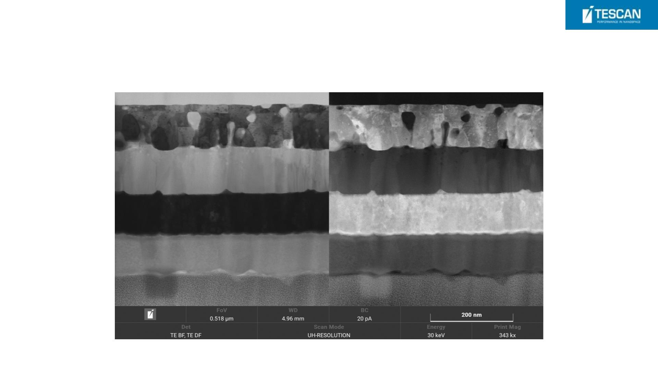
Inverted Lamellas with Ti, Pt, and Si layers
STEM Image of 5
keV polished
lamella

Slide 41
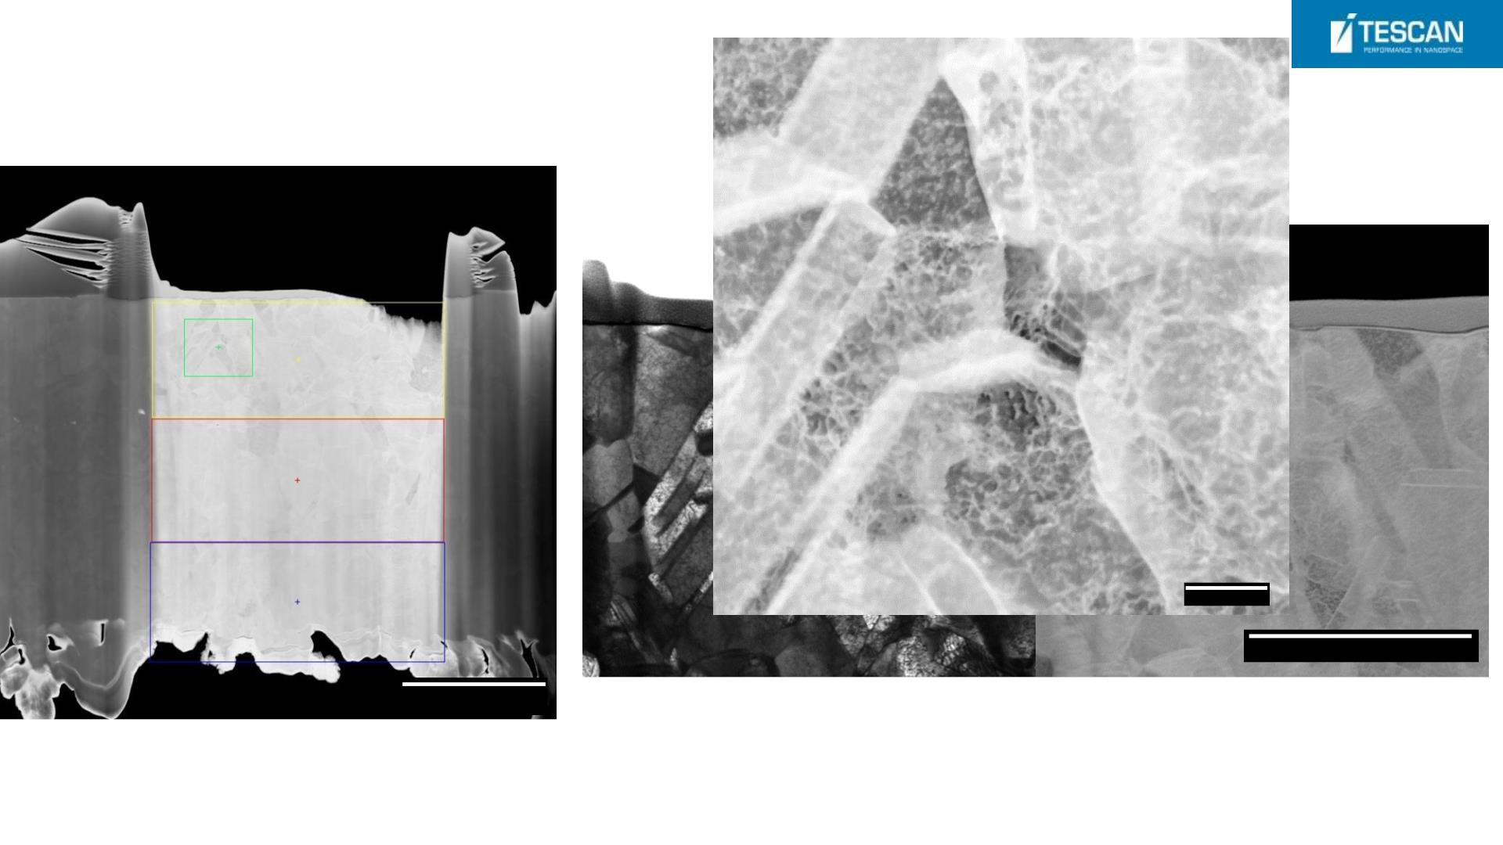
Cu lamella sample
200 nm
2 um
5 um

Slide 42
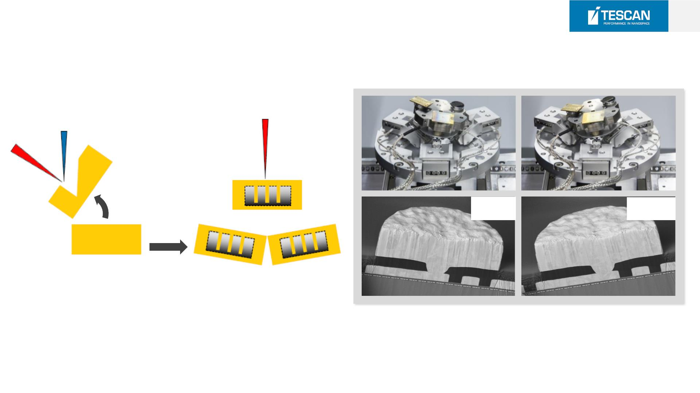
44
Ro cking Stage
SEM
FIB
FIB
Stage tilt 55°
SEM
SEM
SEM view
Sample

Slide 43
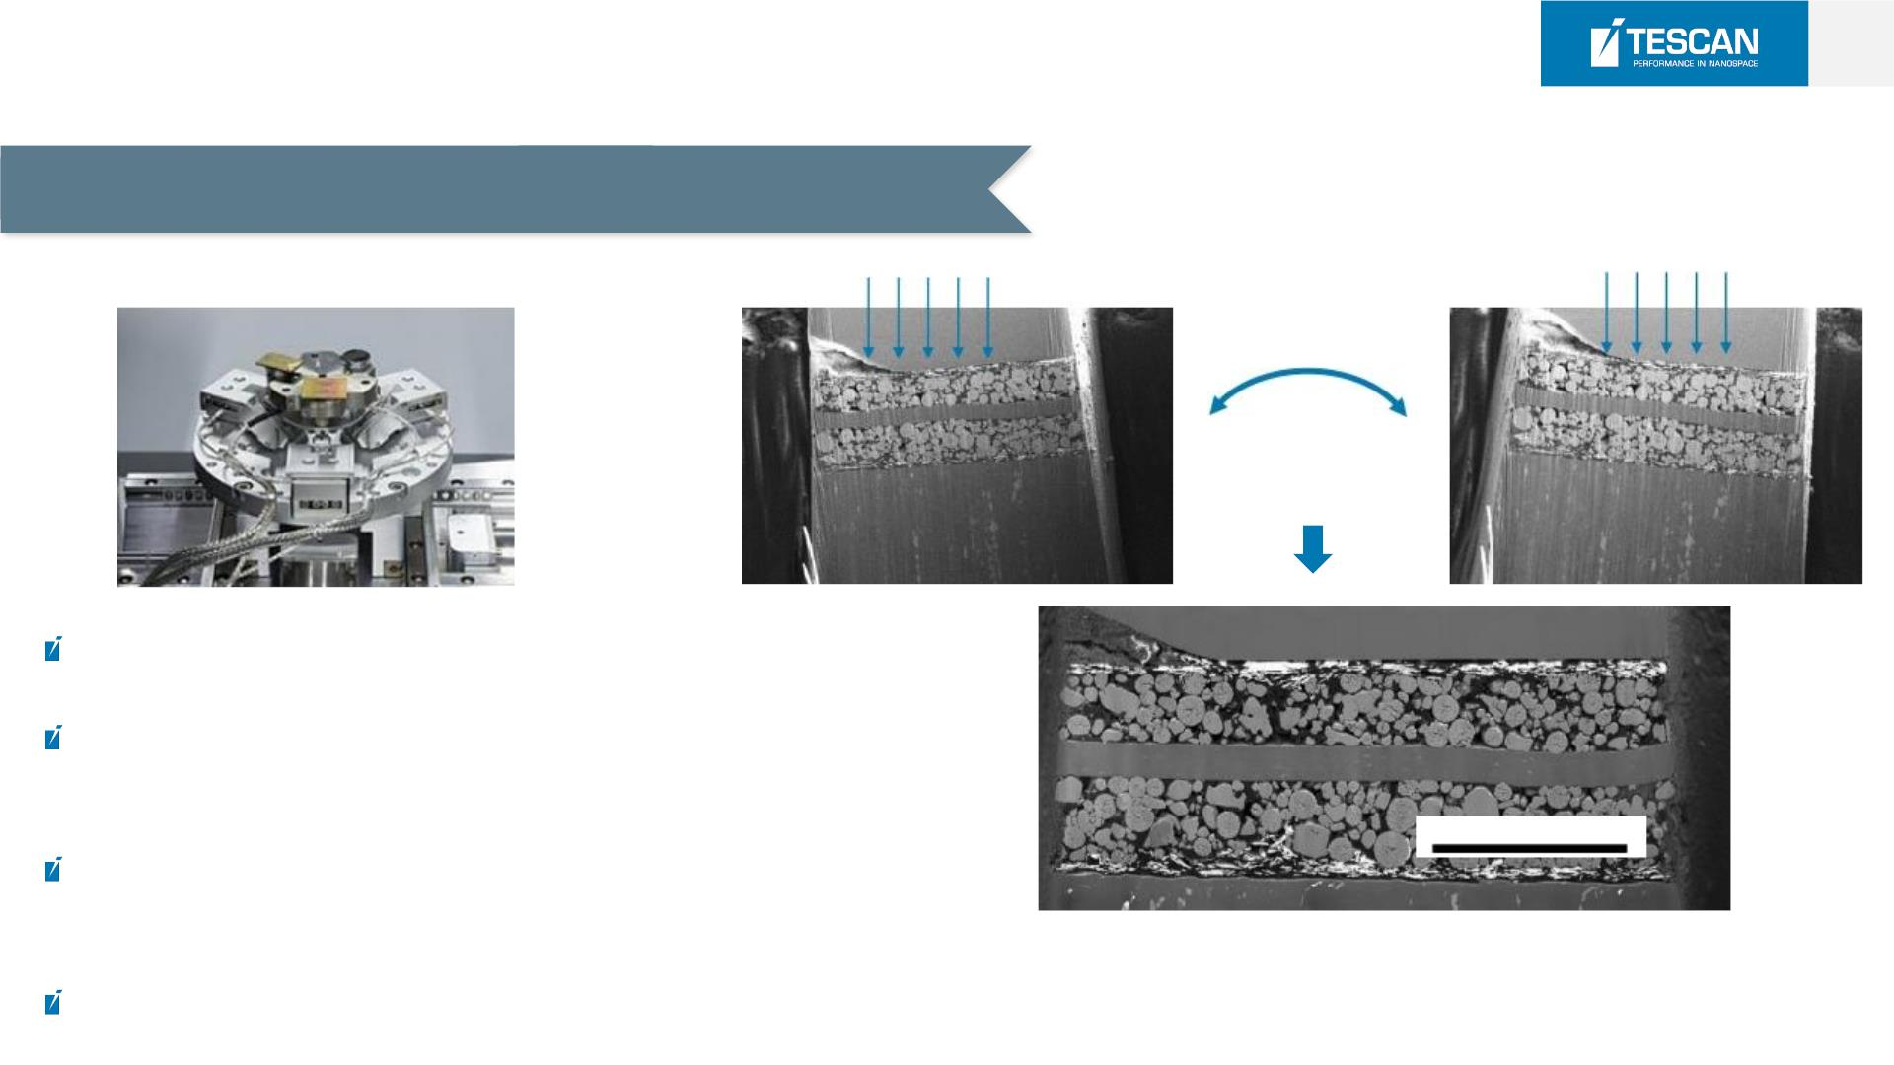
45
Ro cking Stage
Best cross section quality eliminating curtaining
+ / - 5 °
In-situ rocking stage
polishing
Proprietary secondary stage tilt
Minimizing curtaining effect even at very high beam
currents together with
100 µm
Precisely perpendicular cross sections by beam tapper
angle compensation
A Li-ion battery cross-section polished using the
Rocking Stage for curtaining reduction. A thin silicon
mask was used to suppress the surface topography.
Live End-Point Detection (SEM monitoring)

Slide 44
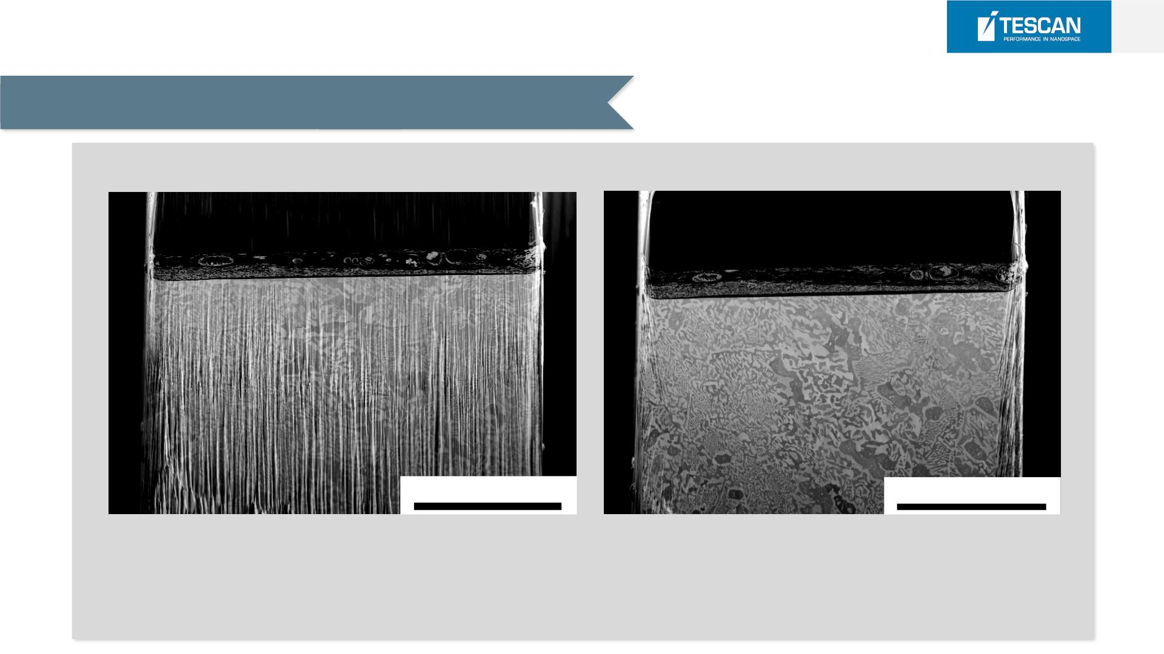
Ro cking Stage
46
Best cross section quality eliminating curtaining
Same time Processing
200 µm
200 µm
Without Rocking
With Rocking
Static Milling at 2 µA beam current
lower beam currents (e.g. 300nA) would be needed
to achieve fine quality (i.e. 6x longer time)
Rocking Milling at 2µA beam current
with sample rocking polishing

Slide 45
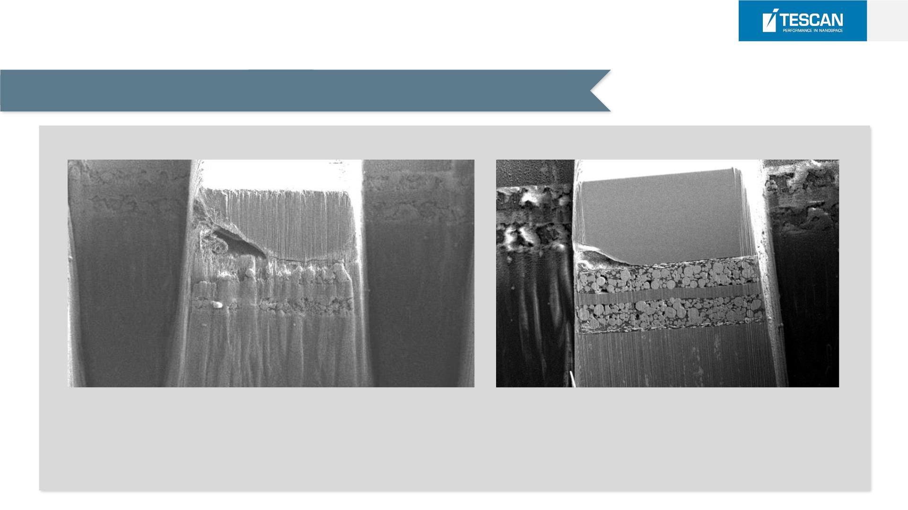
47
Ro cking Stage
Suppression of curtaining artefact on sam ple inhomogeneity
Li-ion battery cathode (with Si mask on top)
with
Without Rocking
With Rocking
curtaining remains on inhomogeneity even after ~1.5 h polishing
using 100 nA
lower beam currents would be needed to achieve fi ne quality (i .e.
+/- 5° sample rocking with quality end-pointing
curtaining suppressed after 30 min polishing using
100nA
longer time)

Slide 46
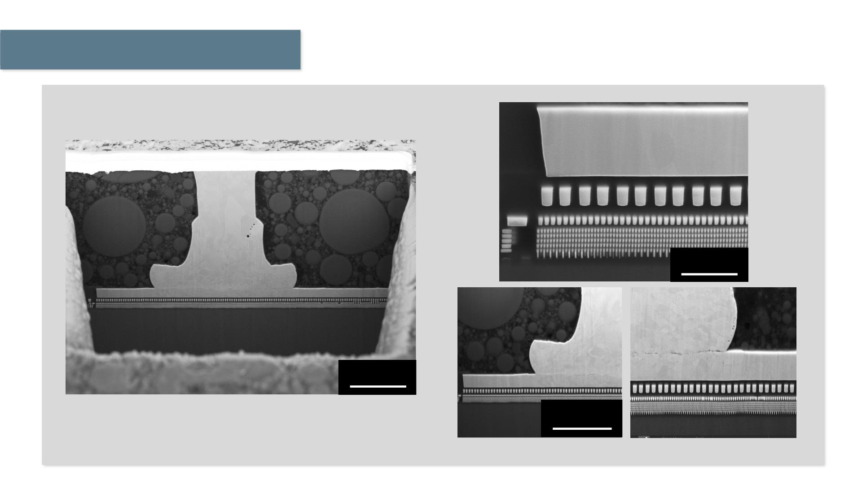
48
Application data
2 µm
20 µm
SE image @15 kV, Ball bond cross section, 120 µm wide,
Process time <1 hour
10 µm
Detailed images of the cross-section

Slide 47
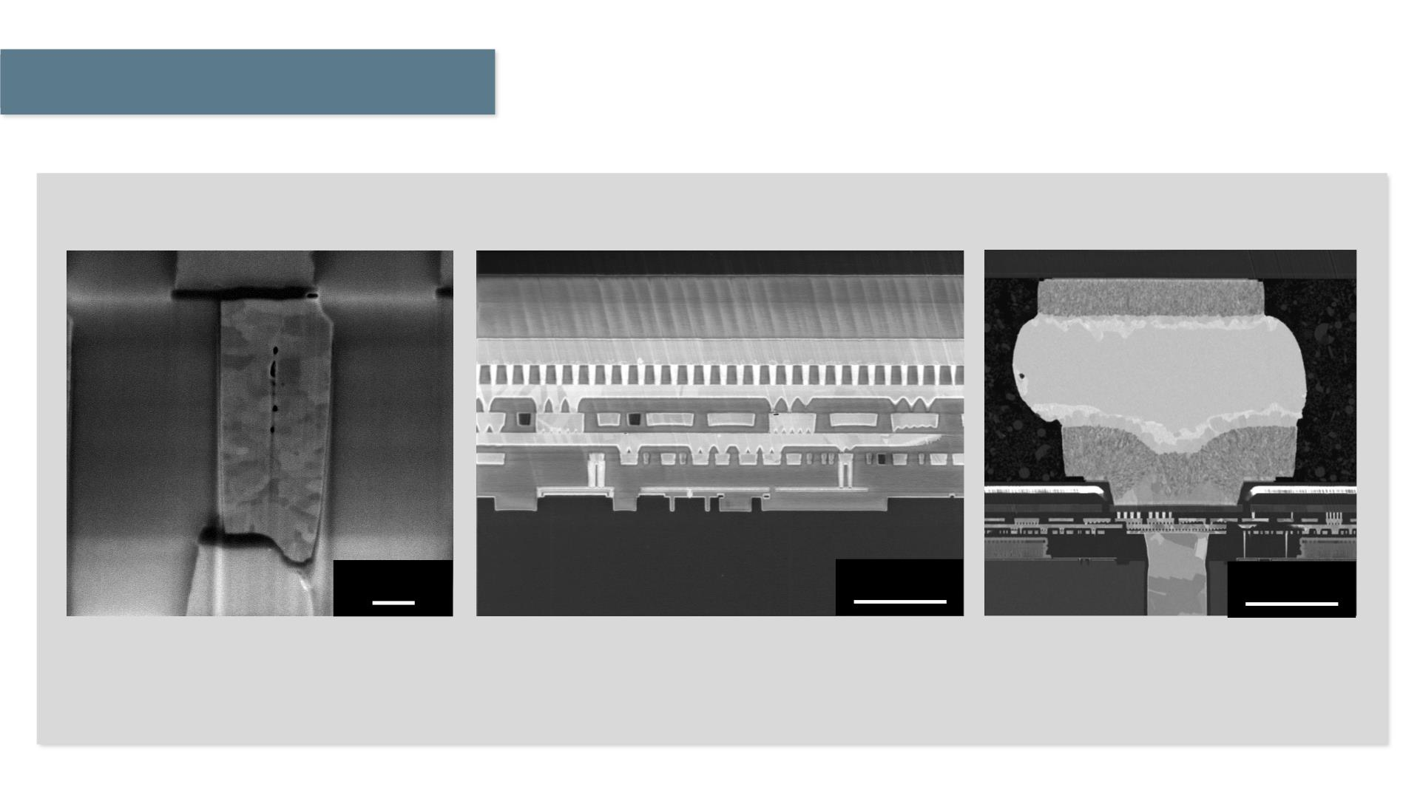
49
Application data
Ultra-high resolution low kV imaging for beam sensitive materials
200 nm
2 µm
5 µm
InBeam-SE image, @2 kV
Tungsten via
InBeam-SE image, @1 kV
Mid-Angle BSE image, @ 5 kV
Integrated circuit
Flip-chip to TSV connection

Slide 48
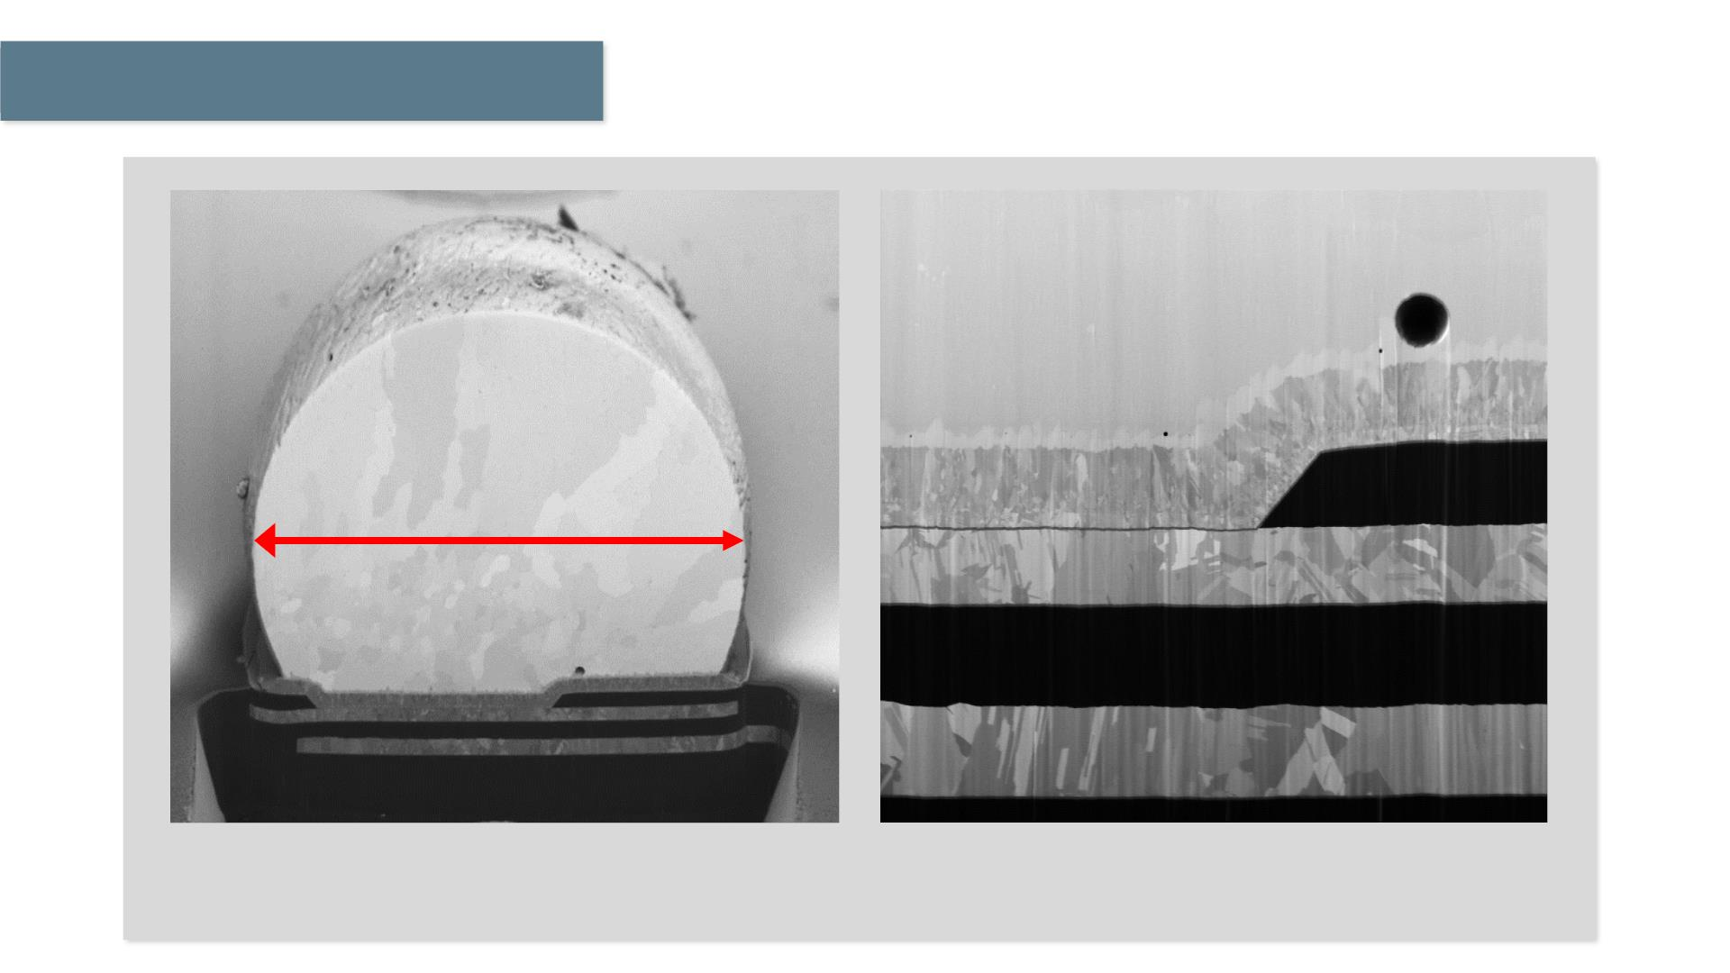
Application data
115 um
BSE image @ 2 keV FIB 100 nA for 1 hour
SEM image @ 1 keV
Solder Ball Cross Section by

Slide 49
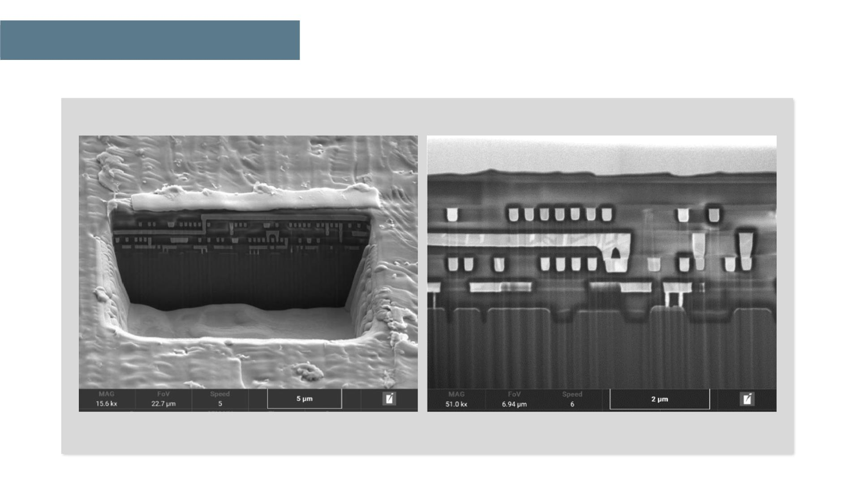
Application data
Intergrated Circuit – 15um Polished Cross Section (Done in 4 min.)
E-T Detector @ 5kV
E-T Detector @ 2kV

Slide 50

ESSENC Software
24.05.2024

Slide 51
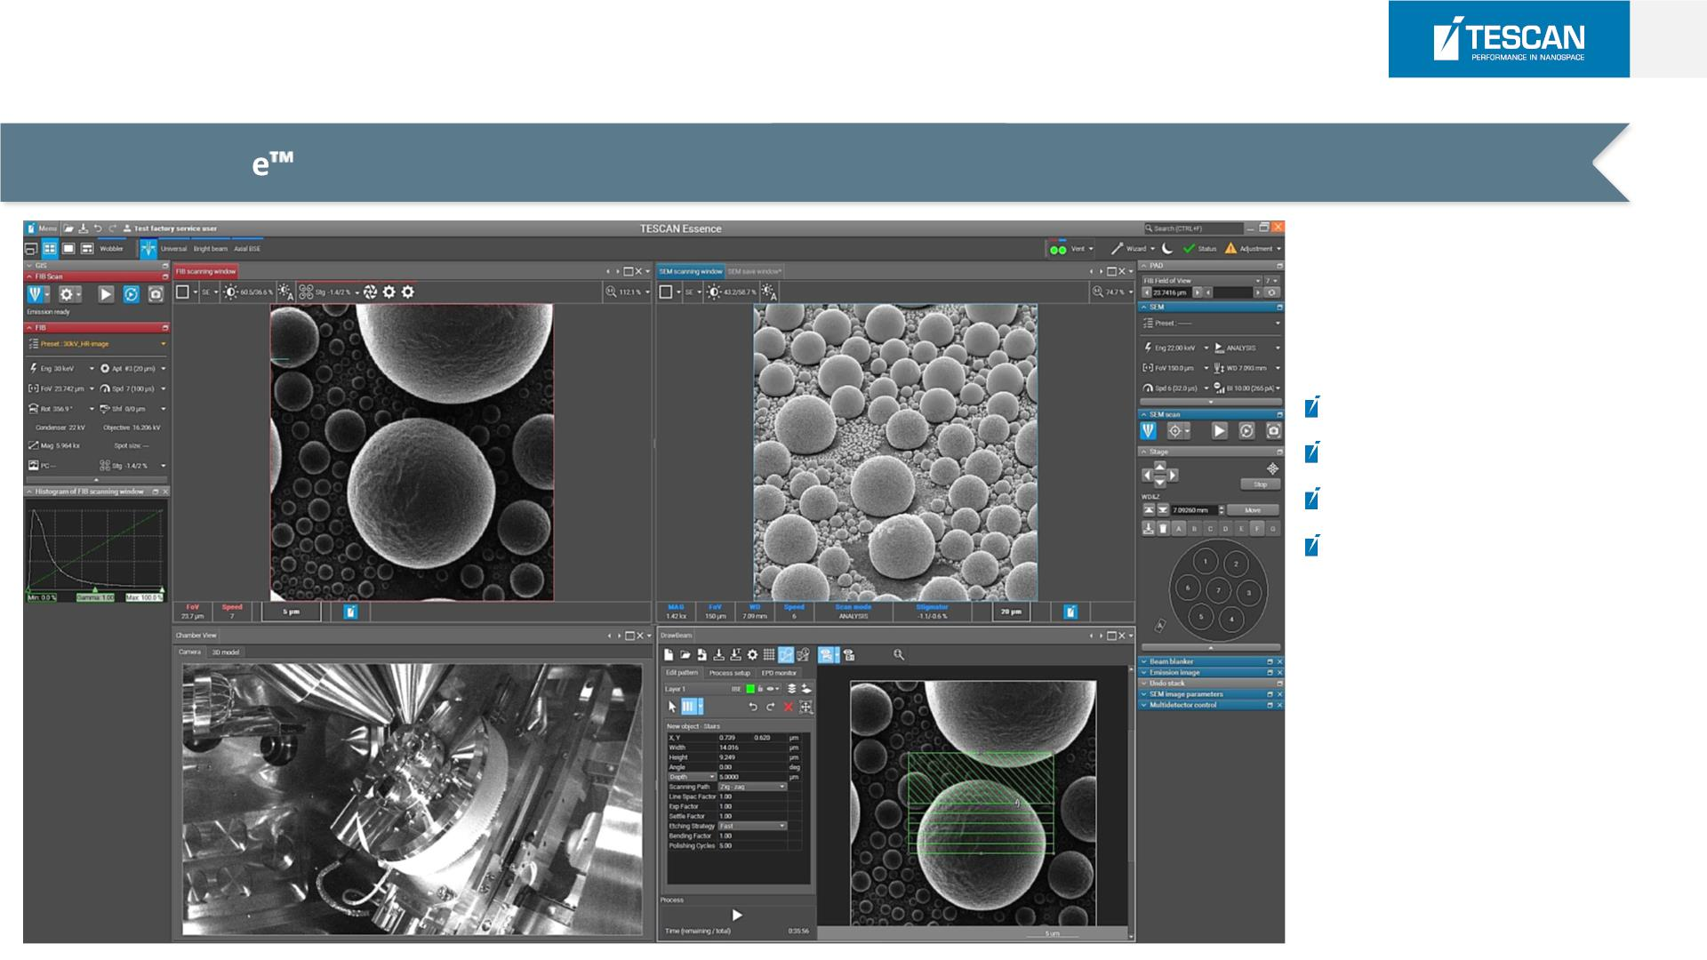
53
ESSENCETM [Software]
Intuitive Essenc software modular platform designed for effortless operation regardless user skill level
Multiuser modular GUI
3D collision model
Quick search box
SEM undo commands

Slide 52
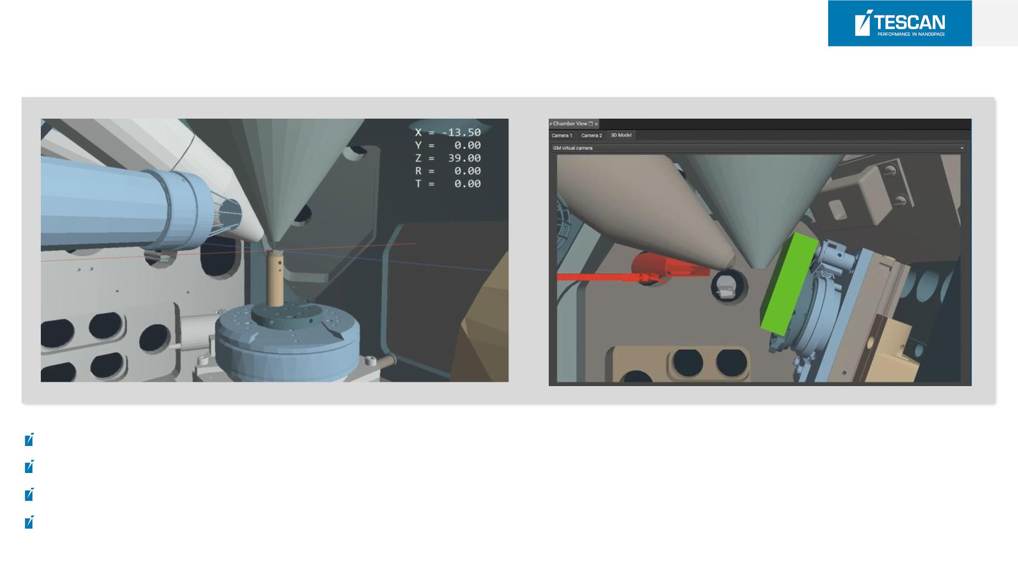
54
ESSENCETM [3D Collision Model]
Effective prediction of stage or sample collisions with chamber or polepieces
Easy navigation with large samples or substages
Allows multiple virtual views into the the chamber
Selected third party systems integrated on request (e.g. tensile stages)

Slide 53

Automation
1. Auto Slicer
2. DrawBeam
3. Image Snaper
24.05.2024

Slide 54

Thank You!

