Slide 1
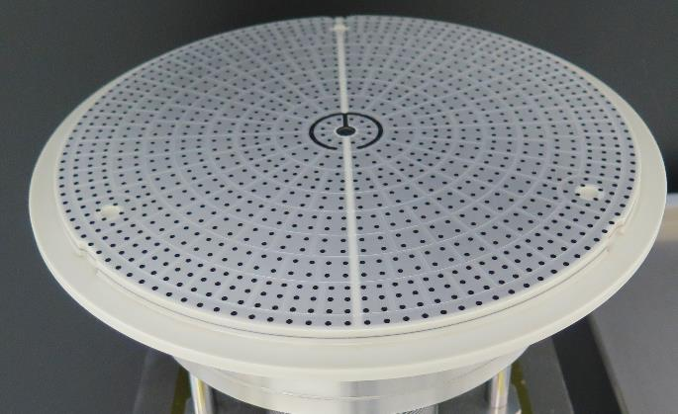
AMAT Endura MCA ESC Repair
Product ：Endura MCA ESC
P／N ：0010-27983 0010-24456
Emboss features
Brighten | Competitor
Emboss material : DLC | Emboss material : TiN / TiCN
Friction : 0.08 ～ 0.11 | Friction : 0.3 ～ 0.4
Hardness : mHv >3200 | Hardness : mHv 2000～2300
Surface roughness : Ra10nm | Unknown

Slide 2
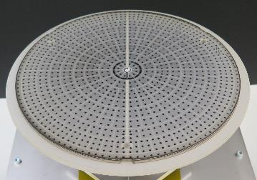
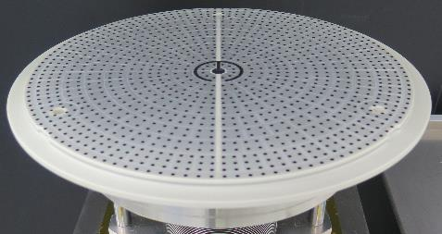
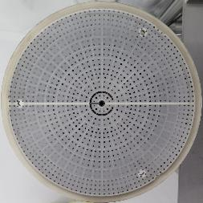
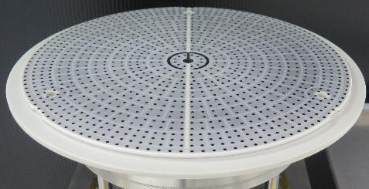
1. Current MCA ESC repair 0010-27983
Domestic １company Using more than 4 years
Before
After
Oversea １company Using more than 1.5 year
Before
After

Slide 3
2. Customer requirement for the repair 0010-27983
Domestic company
Unhurt wafer backside surface
No reflection error
Particle 1um & 0.02um
No metal contamination
Life : 1 year
Oversea company
No Defect error
Life : > 1.5 years
Particle 1um & 0.02um
CMOS sensor
Evaluation passed
Going mass production
Only our repaired MCA passed
Going mass production

Slide 4
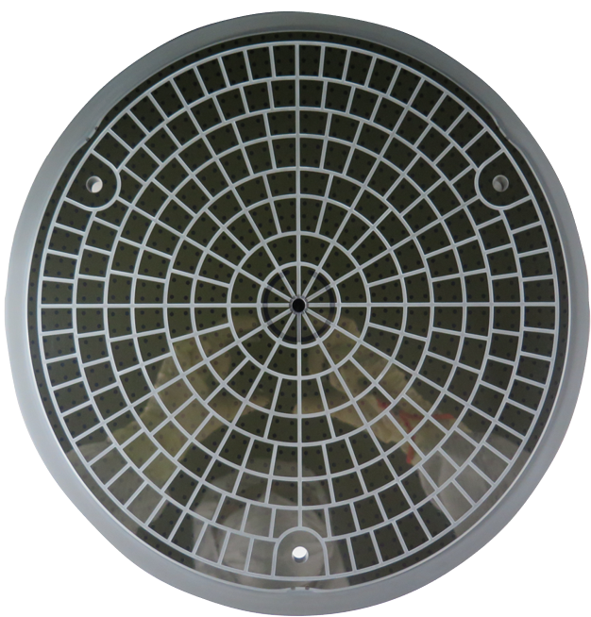
3. Evaluation of 0010-24456
Customer requirement
Oversea company
No backside pressure error
No Defect error
Life > 1 year
Particle 1um & 0.02um
Passed last year

Slide 5
4. QC Flow
１.Incoming
Inspection
2. 1 Emboss
Repair
3. Shipping
Inspection
4. Cleaning
Packing
1.1 | Appearance Inspection
1.2 | Vacuum leak
1.3 | Flatness
1.4 | Ceramic surface roughness
1.5 | Emboss height
1.6 | Argon gas groove depth
1.7 | Dielectric thickness
1.8 | Heater resistance
1.9 | TC resistance
1.10 | Leak current
1.11 | Insulation
1.12 | Ceramic surface insulation
1.13 | Temperature uniformity
1.14 | Chucking force
1.15 | Emboss peeling
1.16 | Diagnose
2.1.1 | Cleaning
2.1.2 | Emboss removal
2.1.3 | Surface grinding & cleaning
2.1.4 | Hot vacuum drying
2.1.5 | Emboss recoating
3.1 | Appearance Inspection
3.2 | Vacuum leak
3.3 | Flatness
3.4 | Ceramic surface roughness
3.5 | Emboss height
3.6 | Argon gas groove depth
3.7 | Dielectric thickness
3.8 | Heater resistance
3.9 | TC resistance
3.10 | Leak current
3.11 | Insulation
3.12 | Ceramic surface insulation
3.13 | Temperature uniformity
3.14 | Chucking force
3.15 | Emboss peeling
3.16 | Judge the repair result
4.1 | DI water and US clean
4.2 | Hot vacuum drying
4.3 | Dual vacuum packing
4.4 | Shipping and the report
NG
NG
2. Bellows
Repair
2.2.1 | Bellows replacement
2.2.2 | Vacuum leak
2.2.3 | Flatness
NG
2.3 Repair
impossible
2.3.1 | Ceramic crack & insulation
2.3.2 | Heater terminal and TC insulation NG
2.3.3 | Blazing portion NG

Slide 6
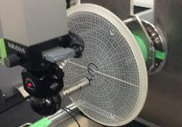
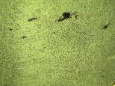
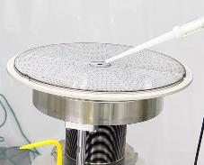
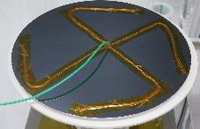
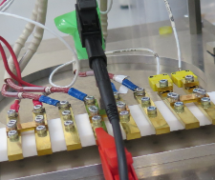
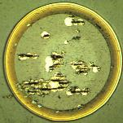
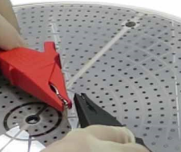
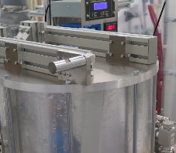
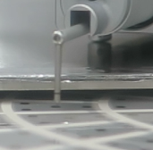
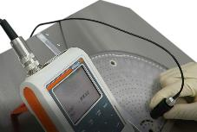
5. Incoming inspection
Incoming and shipping inspection
①Flatness by 3D
②Microscope
surface inspection
③He gas leak detect
④Leak current
⑤Insulation
⑦Emboss height/
surface roughness/
Ar gas groove depth
⑨Wafer temp uniformity and Argon gas
backside pressure (cucking force)
⑥Ceramic surface
inspection
⑧Dielectric layer
thickness

Slide 7
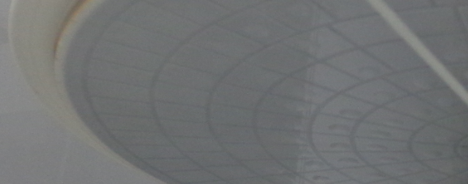
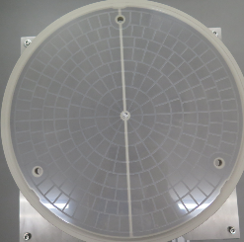
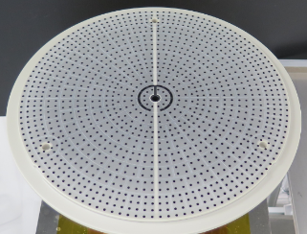
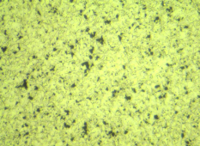
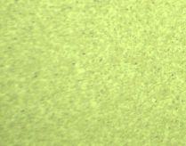
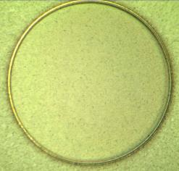
6. Emboss repair
Emboss removal by etching
Grind ceramic surface
Emboss recoating
Surface inspection after
emboss removal by microscope
Surface inspection after
grinding by microscope
After emboss recoated

